Slide 1
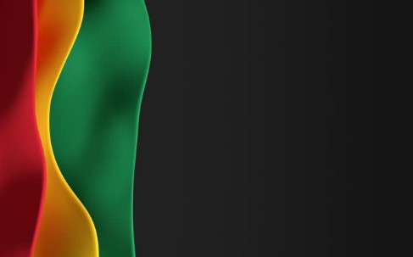
Sunday, February 21,
2026

Slide 2
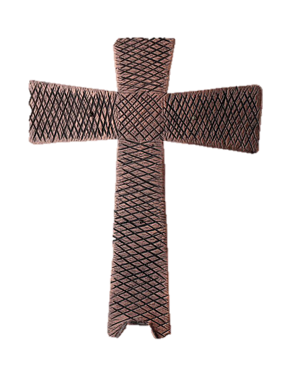
Processional

Slide 3

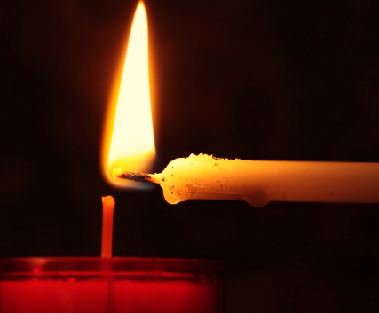
Lighting of Candles

Slide 4


Greetings

Slide 5

Call to Worship…
Leader: Today, we follow Jesus into a wilderness full of isolation, fatigue, hunger, thirst, and temptation.
People: We follow, trusting in God’s mercy.

Slide 6
Leader: We witness Jesus resist the siren calls of sensationalism, notoriety, and Leader: Today, we follow Jesus into a wilderness full of isolation, fatigue, hunger, thirst, and temptation, misuse of power for selfish gain.
People: We recognize God’s mercy at work in the face of temptation.

Slide 7
Leader: We notice the angels who tend Jesus, messengers of care in a harsh and lonely place.
People: We pay attention to God’s merciful presence that did not abandon Jesus and does not abandon us now.

Slide 8
Leader: We come to the wilderness together, clinging to the truth that we are not alone—God is with us.
All: We gather to worship God, whose unfailing mercy journeys with us into the wilderness of our lives. Thanks be to God! Amen

Slide 9
Opening Hymn
“Life Every Voice & Sing”
#519

Slide 10
1 Lift every voice and sing, till earth and heaven ring, ring with the harmonies of liberty;
let our rejoicing rise high as the listening skies, let it resound loud as the rolling sea.

Slide 11
Sing a song full of the faith that the dark past has taught us; sing a song full of the hope that the present has brought us; facing the rising sun of our new day begun, let us march on till victory is won.

Slide 12
2 Stony the road we trod, bitter the chastening rod, felt in the days when hope unborn had died;
yet with a steady beat, have not our weary feet come to the place for which our fathers sighed?

Slide 13
We have come over a way that with tears has been watered; we have come, treading our path thru the blood of the slaughtered, out from the gloomy past, till now we stand at last where the white gleam of our bright star is cast.

Slide 14
3 God of our weary years, God of our silent tears, thou who hast brought us thus far on the way; thou who hast by thy might led us into the light, keep us forever in the path, we pray.

Slide 15
Lest our feet stray from the places, our God, where we met thee; lest our hearts drunk with the wine of the world, we forget thee; shadowed beneath thy hand, may we forever stand, true to our God, true to our native land.

Slide 16


Morning Prayer

Slide 17

Response

Slide 18

Affirmation of
The Apostles’ Creed

Slide 19
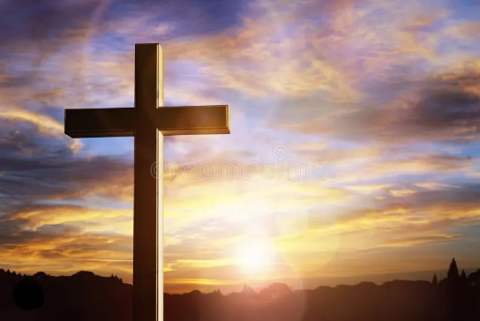
I believe in God the Father Almighty. The maker of heaven and earth;

Slide 20
and in Jesus Christ his only Son our Lord: who was conceived by the Holy Spirit, born of the Virgin Mary,

Slide 21
suffered under Pontius Pilate, was crucified, dead, and buried;

Slide 22
the third day he rose from the dead; he ascended into heaven,

Slide 23
and sitteth at the right hand of God the Father Almighty; from thence he shall come to judge the quick and the dead.

Slide 24
I believe in the Holy Spirit, the Holy catholic** church, the communion of saints, the forgiveness of sins,
**Church Universal

Slide 25
the resurrection of the body, and the life everlasting. Amen.

Slide 26
Gloria Patri
Glory be to the Father, and to the Son and to the Holy Ghost,

Slide 27
as it was in the beginning, is now, and ever shall be, world with-out end.
A-men. A-men

Slide 28

Parish Notices/Recognition of Visitors

Slide 29
The Offering
(It’s Giving Time)
“Praise God, from whom all blessings flow; praise him, all creatures here below; praise him above, ye heavenly host; praise Father Son, and Holy Ghost, Amen”

Slide 30
*The Dedication of Tithes and Offering
UMH #588
“All things come of thee, O Lord, and of thine own have we given thee.” AMEN!

Slide 31
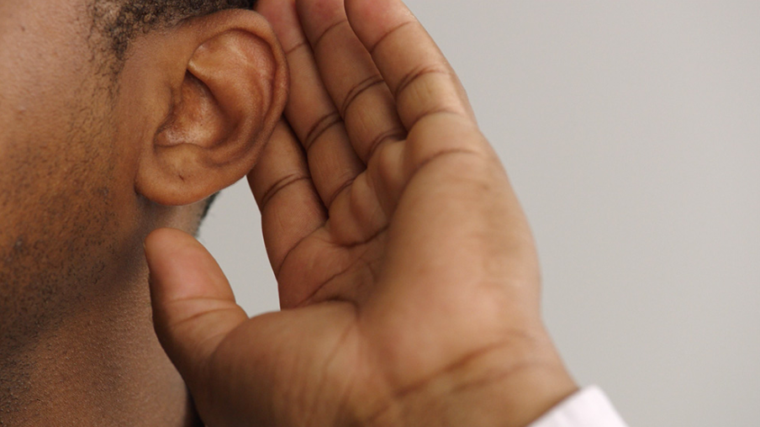
WE Listen for God’s Word

Slide 32
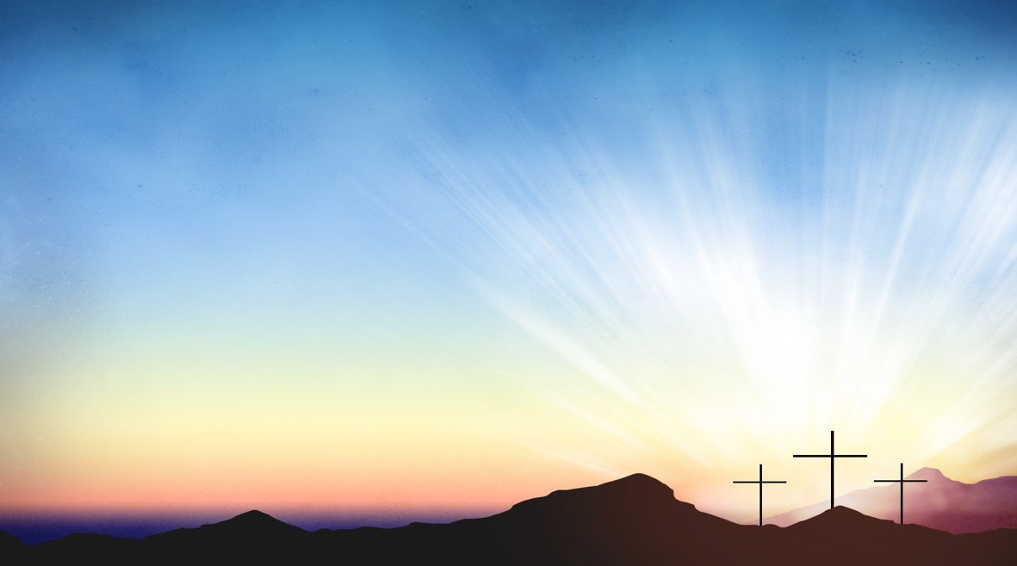
Proclamation and Response/We Listen for God’s Word
Old Testament: Psalm 32 (ESV)
New Testament: Matthew 4:1-11(ESV)

Slide 33
Old Testament: Psalm 32 (ESV)
1 Blessed is the one whose transgression is forgiven, whose sin is covered.
2 Blessed is the man against whom the Lord counts no iniquity, and in whose spirit there is no deceit.

Slide 34
3 For when I kept silent, my bones wasted away through my groaning all day long.
4 For day and night your hand was heavy upon me; my strength was dried up as by the heat of summer.

Slide 35
5 I acknowledged my sin to you, and I did not cover my iniquity; I said, “I will confess my transgressions to the Lord,”
and you forgave the iniquity of my sin.

Slide 36
6 Therefore let everyone who is godly offer prayer to you at a time when you may be found; surely in the rush of great waters, they shall not reach him.

Slide 37
7 You are a hiding place for me; you preserve me from trouble; you surround me with shouts of deliverance.
8 I will instruct you and teach you in the way you should go; I will counsel you with my eye upon you.

Slide 38
9 Be not like a horse or a mule, without understanding, which must be curbed with bit and bridle, or it will not stay near you.

Slide 39
10 Many are the sorrows of the wicked, but steadfast love surrounds the one who trusts in the Lord.
11 Be glad in the Lord, and rejoice, O righteous, and shout for joy, all you upright in heart!

Slide 40
New Testament: Matthew 4:1-11
The Temptation of Jesus
1 Then Jesus was led up by the Spirit into the wilderness to be tempted by the devil.
2 And after fasting forty days and forty nights, he was hungry.

Slide 41
³ And the tempter came and said to him, “If you are the Son of God, command these stones to become loaves of bread.” ⁴ But he answered, “It is written,
“‘Man shall not live by bread alone,
but by every word that comes from the mouth of God.’”

Slide 42
⁵ Then the devil took him to the holy city and set him on the pinnacle of the temple ⁶ and said to him, “If you are the Son of God, throw yourself down, for it is written,
“‘He will command his angels concerning you,’
and
“‘On their hands they will bear you up,
lest you strike your foot against a stone.’”

Slide 43
⁷ Jesus said to him, “Again it is written, ‘You shall not put the Lord your God to the test.’”
⁸ Again, the devil took him to a very high mountain and showed him all the kingdoms of the world and their glory.

Slide 44
⁹ And he said to him, “All these I will give you, if you will fall down and worship me.”
¹⁰ Then Jesus said to him, “Be gone, Satan! For it is written,

Slide 45
“‘You shall worship the Lord your God and him only shall you serve.’”
¹¹ Then the devil left him, and behold, angels came and were ministering to him.

Slide 46

Introduction
of Speaker
Rev. Doris Bright, Pastor

Slide 47
Selection
Wesley’s Ensemble

Slide 48

The Message
by
“Bro. Denzel Whaley”

Slide 49

Invitational

Altar Call

Slide 50
Song of Sending Forth

Slide 51

Extinguishing of the Candles

Slide 52


