Slide 1

August 16th

Slide 2

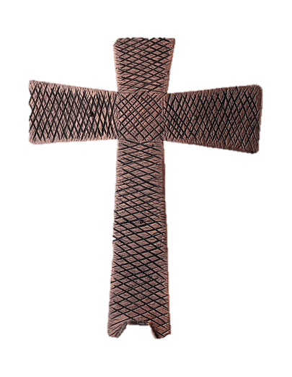

Processional
Lighting of Candles

Slide 3


Greetings

Slide 4
Call to Worship…
Leader: Family of God, we gather today to unite our voices and our lives in praise to God!
People: How good and pleasant it is when we live together in unity!

Slide 5
Leader: We gather to celebrate how God binds us together to live, work, play, and rest as the Body of Christ!
People: How good and pleasant it is when we live together in unity!

Slide 6
Leader: We gather to remember how God has worked through us to share Christ’s love with one another and our neighbors through our prayers, our presence, our gifts, our service, and our witness.
People: How good and pleasant it is when we live together in unity!

Slide 7
Leader Family of God, today we come as diverse and unique members of the Body of Christ to learn and grow not in uniformity in unity to love God, self, neighbor, and all creation.
People: How good and pleasant it is when we live together in unity! Thanks be to God! Amen

Slide 8
Opening Hymn
“Every time I feel the spirit”
#404

Slide 9
Refrain:
Every time I feel the spirit
moving in my heart, I will pray.
Yes, every time I feel the spirit
moving in my heart, I will pray.

Slide 10
1 Upon the mountain, my Lord spoke,
out his mouth came fire and smoke.
All around me looks so shine,
ask my Lord if all was mine. (Refrain)

Slide 11
Refrain:
Every time I feel the spirit
moving in my heart, I will pray.
Yes, every time I feel the spirit
moving in my heart, I will pray.

Slide 12
2 Jordan river runs right cold,
chills the body, not the soul.
Ain't but one train on this track,
runs to heaven and right back. (Refrain)

Slide 13
Refrain:
Every time I feel the spirit
moving in my heart, I will pray.
Yes, every time I feel the spirit
moving in my heart, I will pray.

Slide 14


Morning Prayer

Slide 15

Response
⧫
Wesley Ensemble

Slide 16

Affirmation of
#881
The Apostles’ Creed

Slide 17
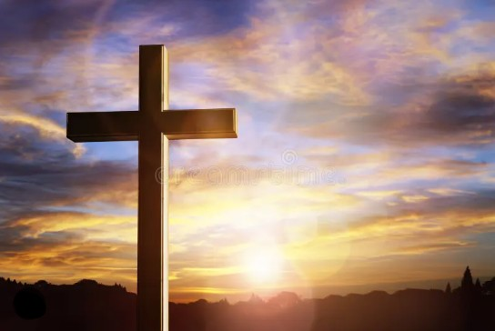
I believe in God the Father Almighty. The maker of heaven and earth;

Slide 18
and in Jesus Christ his only Son our Lord: who was conceived by the Holy Spirit, born of the Virgin Mary,

Slide 19
suffered under Pontius Pilate, was crucified, dead, and buried;

Slide 20
the third day he rose from the dead; he ascended into heaven,

Slide 21
and sitteth at the right hand of God the Father Almighty; from thence he shall come to judge the quick and the dead.

Slide 22
I believe in the Holy Spirit, the Holy catholic** church, the communion of saints, the forgiveness of sins,
**Church Universal

Slide 23
the resurrection of the body, and the life everlasting. Amen.

Slide 24
Gloria Patri, #71
Glory be to the Father, and to the Son and to the Holy Ghost,

Slide 25
as it was in the beginning, is now, and ever shall be, world with-out end.
A-men. A-men

Slide 26


Slide 27
The Offering
(It’s Giving Time)
“Praise God, from whom all blessings flow; praise him, all creatures here below; praise him above, ye heavenly host; praise Father Son, and Holy Ghost, Amen”

Slide 28
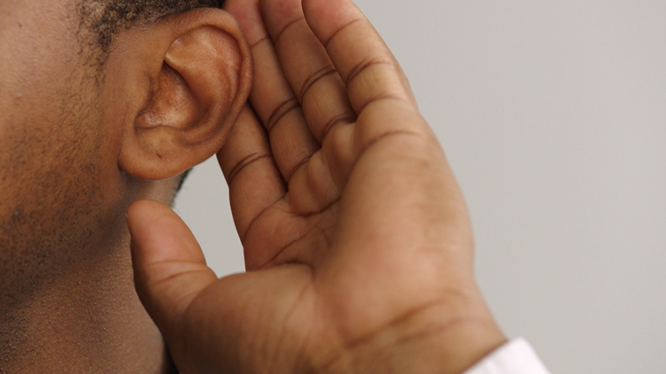
WE Listen for God’s Word

Slide 29
Proclamation and Response
We Listen for God’s Word
Old Testament: Psalm 133 (ESV)
New Testament:
Matthew 15:21-28, (ESV)

Slide 30
Old Testament: Genesis Psalm 17: 1-7, 15, (ESV)
Psalm 133
Behold, how good and pleasant it is when brothers dwell in unity!^{[a]}

Slide 31
² It is like the precious oil on the head, running down on the beard, on the beard of Aaron, running down on the collar of his robes!

Slide 32
³ It is like the dew of Hermon,
which falls on the mountains of Zion! For there the Lord has commanded the blessing, life forevermore.

Slide 33
New Testament: Matthew 15: 21-28 (ESV)
²¹ And Jesus went away from there and withdrew to the district of Tyre and Sidon. ²² And behold, a Canaanite woman from that region came out and was crying, “Have mercy on me, O Lord, Son of David; my daughter is severely oppressed by a demon.”

Slide 34
²³ But he did not answer her a word. And his disciples came and begged him, saying, “Send her away, for she is crying out after us.” ²⁴ He answered, “I was sent only to the lost sheep of the house of Israel.”

Slide 35
²⁵ But she came and knelt before him, saying, “Lord, help me.” ²⁶ And he answered, “It is not right to take the children's bread and throw it to the dogs.” ²⁷ She said, “Yes, Lord, yet even the dogs eat the crumbs that fall from their masters' table.”

Slide 36
²⁸ Then Jesus answered her, “O woman, great is your faith! Let it be done for you as you desire.” And her daughter was healed instantly.^{[a]}

Slide 37
SELECTION
Wesley Ensemble

Slide 38
The Message
Reverend Doris R. Bright, Pastor

Slide 39
Invitational/Altar Call

Wesley Ensemble

Slide 40

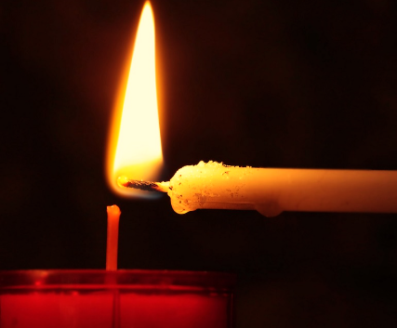
Extinguishing of the Candles

Slide 41

Song of Sending Forth

Slide 42


