Slide 1
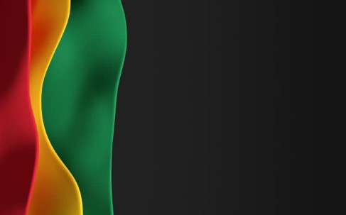

Sunday, March 15,
2026

Slide 2
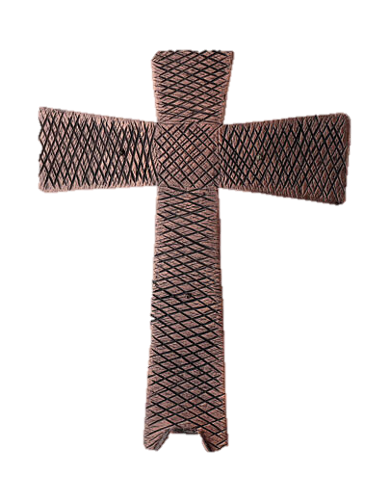
Processional

Slide 3
He could have let me drown.

Slide 4
I was sinking in a sea of sin and shame, but Jesus found me and changed my name, He could have let me drown, he could have let me drown, he could have let me drown, but instead he took me in.

Slide 5
(Choir) I was sinking in a sea of sin and shame, but Jesus found me and changed my name, He could have let me drown, he could have let me drown, he could have let me drown, but instead he took me in.

Slide 6
Love lifted me, love lifted me, Love lifted me, when nothing else could help,
Love, Lifted Me.

Slide 7
He could have let me drown, he could have let me drown, he could have let me drown, but instead he took me in.

Slide 8
Love lifted me, love lifted me, Love lifted me, when nothing else could help,
Love, Lifted Me.
When nothing else could help
When nothing else could help
When nothing else could help

Slide 9
He could have let me drown, he could have let me drown, he could have let me drown, but instead he took me in. (3x)

Slide 10

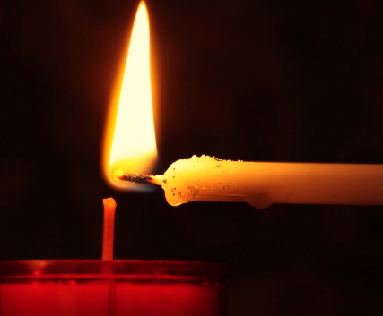
Lighting of Candles

Slide 11


Greetings

Slide 12

Call to Worship…
Leader: Beloved, the journey of grace takes us to still waters, the valley of the shadow of death, even to tables surrounded by our enemies.
People: We gather to worship God, our Shepherd, who guides us on the journey.

Slide 13
Leader: The journey of grace points us toward the Light so that we may bear the fruit of the Light in all that we do.
People: We gather to be formed by grace so that our lives may bear the fruit of all that is good and right and true.

Slide 14
Leader: The journey of grace calls us to pay attention, to discern what is pleasing to God.
People: We gather to listen to the Spirit, who empowers us to go from this place to work together to do what is pleasing to God.

Slide 15
Leader: Come, let us worship God who provides, inspires, and empowers us on the journey of grace.
People: Come, let us worship God as we journey in grace together! Amen

Slide 16
Opening Hymn
“Leaning on the Everlasting Arms”
UM Hymnal #133

Slide 17
1. What a fellowship, what a joy divine, leaning on the everlasting arms; what a blessedness, what a peace is mine, leaning on the everlasting arms.

Slide 18
Refrain:
Leaning, leaning,
safe and secure from all alarms;
leaning, leaning,
leaning on the everlasting arms.

Slide 19
2. O how sweet to walk in this pilgrim way, leaning on the everlasting arms; O how bright the path grows from day to day,
leaning on the everlasting arms.
(Refrain)

Slide 20
Refrain:
Leaning, leaning,
safe and secure from all alarms;
leaning, leaning,
leaning on the everlasting arms.

Slide 21
3. What have I to dread, what have I to fear, leaning on the everlasting arms? I have blessed peace with my Lord so near,
leaning on the everlasting arms.
(Refrain)

Slide 22
Refrain:
Leaning, leaning,
safe and secure from all alarms;
leaning, leaning,
leaning on the everlasting arms.

Slide 23


Morning Prayer
⧫
Sis. Thelma Cohen

Slide 24

Response
⧫
Wesley’s Women Choir

Slide 25
Chant:
I feel like going on (2x)
tho… trials come,
on every hand, I feel like going on.

Slide 26

Affirmation of
The Apostles’ Creed

Slide 27
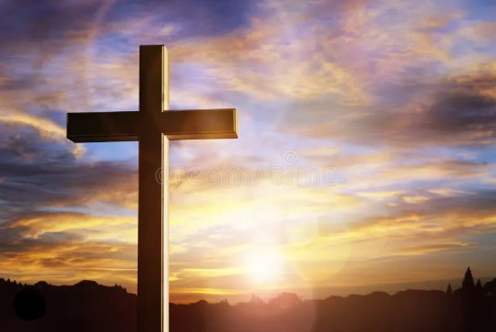
I believe in God the Father Almighty. The maker of heaven and earth;

Slide 28
and in Jesus Christ his only Son our Lord: who was conceived by the Holy Spirit, born of the Virgin Mary,

Slide 29
suffered under Pontius Pilate, was crucified, dead, and buried;

Slide 30
the third day he rose from the dead; he ascended into heaven,

Slide 31
and sitteth at the right hand of God the Father Almighty; from thence he shall come to judge the quick and the dead.

Slide 32
I believe in the Holy Spirit, the Holy catholic** church, the communion of saints, the forgiveness of sins,
**Church Universal

Slide 33
the resurrection of the body, and the life everlasting. Amen.

Slide 34
Gloria Patri
Glory be to the Father, and to the Son and to the Holy Ghost,

Slide 35
as it was in the beginning, is now, and ever shall be, world with-out end.
A-men. A-men

Slide 36

Parish Notices/Recognition of Visitors

Slide 37
The Offering
(It’s Giving Time)
“Praise God, from whom all blessings flow; praise him, all creatures here below; praise him above, ye heavenly host; praise Father Son, and Holy Ghost, Amen”

Slide 38
Come on and Bless the Lord with me (3x)
Hallelujah (4x)

Slide 39
Come on and Clap your hands with me (3x)
Hallelujah (4x)

Slide 40
Come on lets sing before the Lord (3x)
Hallelujah (4x)

Slide 41
*The Dedication of Tithes and Offering
UMH #588
“All things come of thee, O Lord, and of thine own have we given thee.” AMEN!

Slide 42
Recognition of
Wesley’s Women
⧫
Sis. Shirley Legare

Slide 43
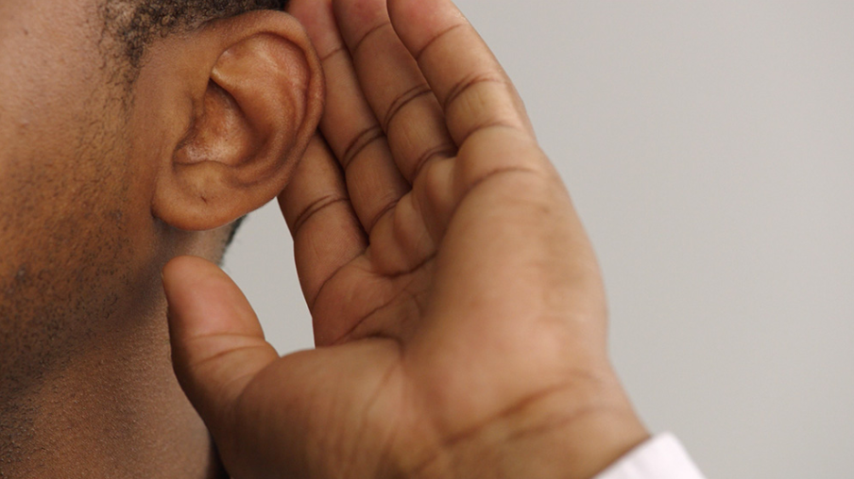
WE Listen for God’s Word

Slide 44
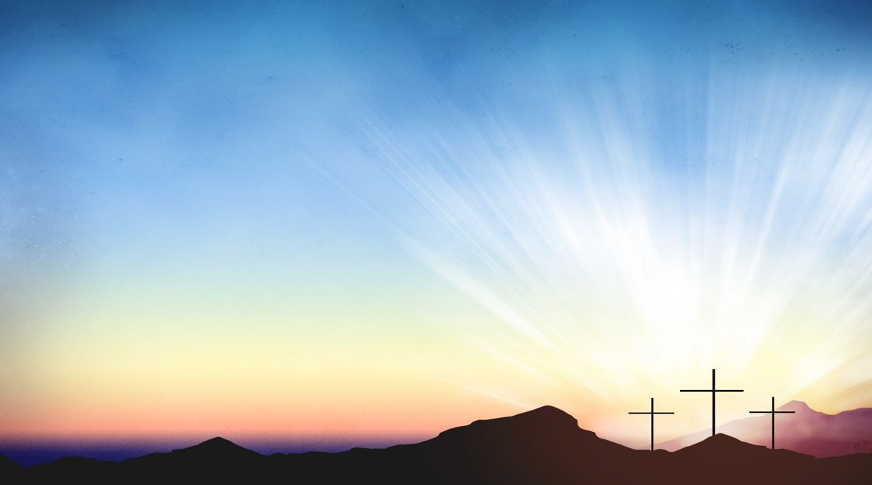
Proclamation and Response/We Listen for God’s Word
Old Testament: 1 Samuel 16:1-13(ESV)
New Testament: Ephesians 5:8-14(ESV)

Slide 45
¹ The Lord said to Samuel, “How long will you grieve over Saul, since I have rejected him from being king over Israel? Fill your horn with oil, and go. I will send you to Jesse the Bethlehemite, for I have provided for myself a king among his sons.” ² And Samuel said, “How can I go? If Saul hears it, he will kill me.” And the Lord said, “Take a heifer with you and say, ‘I have come to sacrifice to the Lord.’

Slide 46
³ And invite Jesse to the sacrifice, and I will show you what you shall do. And you shall anoint for me him whom I declare to you.” ⁴ Samuel did what the Lord commanded and came to Bethlehem. The elders of the city came to meet him trembling and said, “Do you come peaceably?”

Slide 47
⁵ And he said, “Peaceably; I have come to sacrifice to the Lord. Consecrate yourselves, and come with me to the sacrifice.” And he consecrated Jesse and his sons and invited them to the sacrifice.

Slide 48
⁶ When they came, he looked on Eliab and thought, “Surely the Lord’s anointed is before him.”

Slide 49
⁷ But the Lord said to Samuel, “Do not look on his appearance or on the height of his stature, because I have rejected him. For the Lord sees not as man see:man looks on the outward appearance, but the Lord looks on the heart.”

Slide 50
⁸ Then Jesse called Abinadab and
made him pass before Samuel.
And he said, “Neither has the Lord chosen this one.” ⁹ Then Jesse made Shammah pass by. And he said, “Neither has the Lord chosen this one.”

Slide 51
¹⁰ And Jesse made seven of his sons pass before Samuel. And Samuel said to Jesse, “The Lord
has not chosen these.” ¹¹ Then Samuel said to
Jesse, “Are all your sons here?” And he said,
“There remains yet the youngest, but behold, he is keeping the sheep.”
And Samuel said to Jesse, “Send and
get him, for we will not sit down till he comes
here.”

Slide 52
¹² And he sent and brought him in. Now he was ruddy and had beautiful eyes and was handsome. And the Lord said, “Arise,
anoint him, for this is he.”
¹³ Then Samuel took the horn of oil and anointed him in the midst of his brothers. And the Spirit of the Lord rushed upon David from that day forward. And Samuel rose up
and went to Ramah.

Slide 53
New Testament: Ephesians 5:8-14(ESV)
⁸ for at one time you were darkness, but now you are light in the Lord. Walk as children of light ⁹ (for the
fruit of light is found in all that is
good and right and true),

Slide 54
¹⁰ and try to discern what is pleasing to the Lord. ¹¹ Take no part in the unfruitful works of darkness, but
instead expose them.

Slide 55
¹² For it is shameful even to speak of the things that they do in secret. ¹³ But when anything is
exposed by the light, it becomes visible,

Slide 56
¹⁴ for anything that becomes visible is light. Therefore it says,
“Awake, O sleeper, and arise from the dead,
and Christ will shine on you.”

Slide 58
Introduction of Speaker
⧫
Sis. Whitney Patterson

Slide 59
Selection
Wesley’s Women Choir

Slide 60
I AM DEPENDING ON YOUR LORD (DEPENDING ON YOU) 3x
Oh Lord
(O Lord, depending on you) 1x

Slide 61
O WHEN I’M SICK AND I CAN’T GET WELL , I AM
(DEPENDING ON YOU) 3x
Oh Lord
(O Lord, depending on you) 1x

Slide 62
O WHEN I’M DOWN TO MY LAST DIME, I AM
(DEPENDING ON YOU) 3x
Oh Lord
(O Lord, depending on you) 1x

Slide 63
Oh Lord
(Oh Lord)
Oh Lord
(Oh Lord)
Oh Lord
(Oh Lord)
Oh Lord
(Oh Lord) 2x

Slide 64
Depending
(Depending on you)
Lord I’m depending

Slide 65
Oh Lord
(Oh Lord)
Oh Lord
(Oh Lord)
Oh Lord
(Oh Lord)
Oh Lord
I’m depending
(Depending on you)

Slide 66

The Message
by
“Sis. Jewroshelwa O’Banner”
President, United Women of Faith
New Webster UM Church

Slide 67
Father
Help your children
And don’t let them fall
By the side
of the road
Hmm, and teach them
To love one another
That Heaven might find
A place in their hearts

Slide 68
‘Cause Jesus is (Love)
He won’t let you down
And I know, He’s (Mine)
Forever
Oh, in my heart

Slide 69
We’ve got to walk on
Walk on through temptation
“cause His Love
And His wisdom
Will be our helpin’ hand

Slide 70
And I know the Truth
And His Words will be our salvation
Lift up our hearts
To be thankful and glad
That (Jesus is love)
He won’t let you down
And (I know, He’s mine)
Forever
Oh, in my heart

Slide 71

Invitational

Altar Call
⧫
Sis. Evelyn Brown

Slide 72
“COME JESUS COME”
Sometime I fall to my knees and pray
Come, Jesus, come
Let today be the day
Sometimes I feel, like I’m gonna break
But I’m holding on
To a hope that won’t fade

Slide 73
Come, Jesus, Come
We’ve been waiting so long
Fo the day You return
To heal every hurt and right every wrong
We need You right now
Come and turn this around
Deep down I know, this world isn’t home
Come, Jesus, come

Slide 74
There’ll be no war
And there’ll be no chains
(When Jesus come)
Let today be the day
He’ll come for the weak
And the strong just the same, oh-ooh
(And all will believe) and all will believe in the power of
His name

Slide 75
Come, Jesus, Come
We’ve been waiting so long
Fo the day You return
To heal every hurt and right every wrong
We need You right now
Come and turn this around
Deep down I know, this wolld isn’t home
Come, Jesus, come

Slide 76
Presentation/Remarks
Sis. Bettye Legare

Slide 77
Song of Sending Forth
(please stand as you are able.)

Slide 78

Extinguishing of the Candles

Slide 79

Reverend Doris Bright

