Slide 1
December 3, 2023
The 1st
Sunday of ADVENT

Slide 2
Church News & Announcements

Slide 3
Processional…

Slide 4
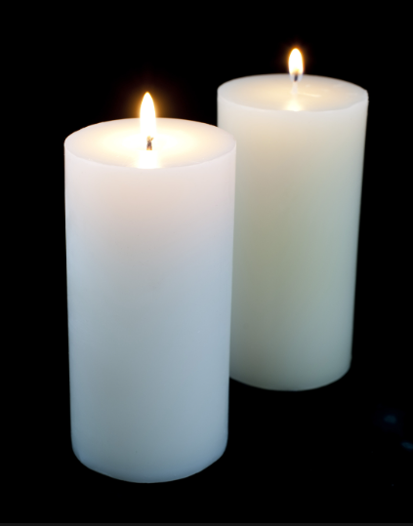
Lighting of Candles
Greetings

Slide 5
Call to Worship…
Leader: If only the heavens would tear open and God would come down!
People: The mountains would shake and tremble - all earth would stand in
awe!

Slide 6
Leader: People have turned their backs on God, believing that they, under their own power, can right all wrongs.
People: We have failed miserably when we depend only on ourselves.

Slide 7
Leader: Be with us, O Lord. Tear open our hearts and pour your love into our
lives.
People: Give us confidence in you, for you are always with us. AMEN.

Slide 8
Opening Selection

Slide 9
Morning Prayer

Slide 10
Response

Slide 11
Affirmation of Faith

Slide 12
I believe in God the Father Almighty. The maker of heaven and earth;

Slide 13
and in Jesus Christ his only Son our Lord: who was conceived by the Holy Spirit, born of the Virgin Mary,

Slide 14
suffered under Pontius Pilate, was crucified, dead, and buried;

Slide 15
the third day he rose from the dead; he ascended into heaven,

Slide 16
and sitteth at the right hand of God the Father Almighty; from thence he shall come to judge the quick and the dead.

Slide 17
I believe in the Holy Spirit, the Holy catholic** church, the communion of saints, the forgiveness of sins,
**Church Universal

Slide 18
the resurrection of the body, and the life everlasting. Amen.

Slide 19
Glory be to the Father, and to the Son and to the Holy Ghost,

Slide 20
as it was in the beginning, is now, and ever shall be, world with-out end.
A-men. A-men

Slide 21
The Offering (It’s Giving Time) (Offering Baskets will not be passed. Please leave your tithes and offerings in the back of the Sanctuary when entering or leaving.)

Slide 22
*The Dedication of Tithes and Offering UMH # 588 “All things come of thee, O Lord, and of thine own have we given thee.” AMEN!

Slide 23
WE Listen for God’s Word

Slide 24
Proclamation and Response/We Listen for God’s Word
Old Testament: Isaiah 64:1-9
New Testament: Mark 113:24-37
Leader: The Word of God for the people of God.
People: Thanks be to God

Slide 25
Selection

Slide 26
The Message by
Reverend Doris Bright

Slide 27
Invitational /
Altar Call

Slide 28
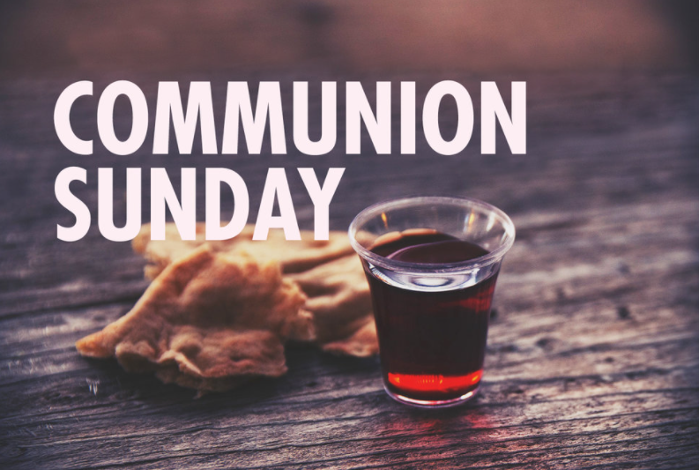

Slide 29
INVITATION
Christ our Lord invites to his table all who love him, who earnestly repent of their sin
and seek to live in peace with one another.
Therefore, let us confess our sin before God and one another.

Slide 30
CONFESSION AND PARDON
Merciful God,
We confess that we have not loved you with our whole heart.
We have failed to be an obedient church.
We have not done your will,
We have broken your law,

Slide 31
We have rebelled against your love,
we have not loved our neighbors,
and we have not heard the cry of the needy.
Forgive us, we pray.
Free us for joyful obedience,
through Jesus Christ our Lord. Amen.

Slide 32
Leader to people:
Here the good news:
Christ died for us while we were yet sinners; that proves God’s love toward us.
In the name of Jesus Christ, you are forgiven!

Slide 33
People to leader:
In the name of Jesus Christ, you are forgiven!

Slide 34
Leader to people:
Glory to God. Amen

Slide 35
THE PEACE:
Let us offer one another signs of reconciliation and love.
OFFERING
As forgiven and reconciled people, let us offer ourselves and our gifts to God.

Slide 36
TAKING THE BREAD AND CUP
THE GREAT THANKSGIVING
The Lord be with you.
And also with you.
Lift up your hearts.
We lift them up to the Lord.

Slide 37
Let us give thanks to the Lord our God.
It is right to give our thanks and praise.

Slide 38
It is right, and a good and joyful thing, always and everywhere to give thanks to you, Father Almighty, creator of heaven and earth.*

Slide 39
And so,
with your people on earth and all the company of heaven we praise your name and join their unending hymn:

Slide 40
Holy, holy, holy Lord, God of power and might, heaven and earth are full of your glory. Hosanna in the highest. Blessed is he who comes in the name of the Lord. Hosanna in the highest.

Slide 41
Holy are you, and blessed is your Son Jesus Christ.* By the baptism of his suffering, death, and resurrection you give birth to your church,

Slide 42
delivered us from slavery to sin and death, and made with us a new covenant by water and the Spirit.*

Slide 43
On the night in which he gave himself up for us he took bread, gave thanks to you, broke the bread, gave it to his disciples, and said:
“Take, eat; this is my body which is given for you.
Do this in remembrance of me.”

Slide 44
When the supper was over, he took the cup, gave thanks to you, gave it to his disciples, and said:
“Drink from this, all of you;
This is my blood of the new covenant, poured out for your and for many for the forgiveness of sins.
Do this, as often as your drink it,
In remembrance of me.”

Slide 45
And so,
In remembrance of these your mighty acts in Jesus Christ, we offer ourselves in praises and thanksgiving as a holy and living sacrifice, in union with Christ’s offering for us, as we proclaim the mystery of faith.

Slide 46
Christ has died; Christ is risen; Christ will come again.

Slide 47
Pour out your Holy Spirit on us gathered here, and on these gifts of bread and wine. Make them be for us the body of blood of Christ, that we may be for the world the body of Christ, redeemed by his blood.”

Slide 48
By your Spirit make us one with Christ, one with each other, and one in ministry to all the world, until Christ comes in final victory, and we feast at his heavenly banquet.

Slide 49
Through your Son Jesus Christ, with the Holy Spirit in your holy church, all honor and glory is yours, almighty Father, now and for ever.

Slide 50
Amen.
And now, with the confidence of children of God, let us pray:
THE LORD’S PRAYER

Slide 51
BREAKING THE BREAD
GIVING THE BREAD AND CUP
The body of Christ, given for you. Amen
The blood of Christ, given for you. Amen

Slide 52
HYMN OR SONG
DISMISSAL WITH BLESSING
Go forth in peace.
The grace of the Lord Jesus Christ,
And the love of God, and the communion of the Holy Spirit be with you all. Amen

Slide 53
Extinguishing of the Candles

Slide 54
Song of
Sending Forth

Slide 55
Benediction

