Slide 1
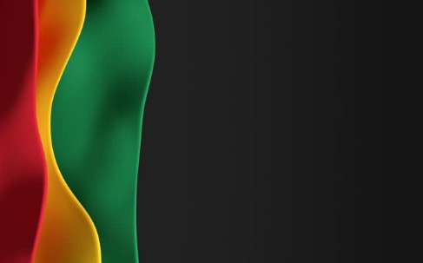

Sunday, March 22,
2026

Slide 2
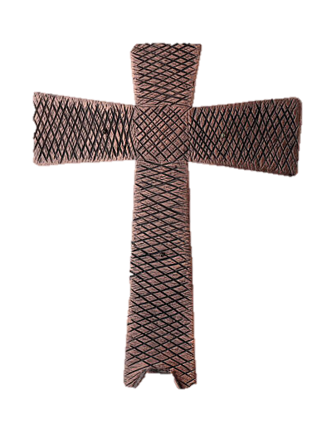
Processional

Slide 3

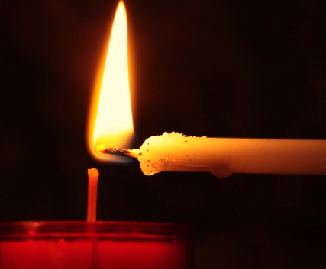
Lighting of Candles

Slide 4


Greetings

Slide 5

Call to Worship…
LEADER: Some of us come to worship today, weary and worn, heavy with all the circumstances that are too much to bear alone.

Slide 6
PEOPLE: We gather to travel God’s redemption road together.
LEADER: Some of us come to worship today, dry and thirsty, longing for relief and peace from the troubles that surround us.

Slide 7
PEOPLE: We gather to travel God’s redemption road together.
LEADER: Some of us come to worship today with stories to tell of little resurrections, moments of new life that sprang up when we least expected them.

Slide 8
PEOPLE: We gather to travel God’s redemption road together.
LEADER: Beloved, whatever we bring with us to worship today, God welcomes us and calls us to work together as we travel God’s redemption road together.

Slide 9
People: We gather to be truth-tellers and life-bringers as we travel God’s redemption road together. Amen

Slide 10
Opening Hymn
“I Am On The Battlefield For My Lord”

Slide 11
Refrain: I am on the battlefield for my Lord, I’m on the battlefield for my Lord; And I promised Him that I would serve Him till I die.
I am on the battlefield for my Lord

Slide 12
1) I was alone and idle, I was a sinner too,
I heard a voice from heaven
say there is work to do,
I took the Master’s hand and I joined the Christian band,
I’m on the battlefield for my Lord. Refrain

Slide 13
Refrain: I am on the battlefield for my Lord, I’m on the battlefield for my Lord; And I promised Him that I would serve Him till I die.
I am on the battlefield for my Lord

Slide 14
2) I left my friends and kindred bound for the Promise Land,
The grace of God upon me, the Bible in my hand, In distant lands I trod,
crying, sinner, come to God,
I’m on the battlefield for my Lord, Refrain

Slide 15
I am on the battlefield for my Lord, I’m on the battlefield for my Lord; And I promised Him that I would serve
Him till I die.
I am on the battlefield for my Lord

Slide 16
3) Now when I met my Savior, I met Him with a smile,
He healed my wounded spirit, and owned me as His child,
Around the throne of grace, He appoints my soul a place
I’m on the battlefield for my Lord. Refrain.

Slide 17
I am on the battlefield for my Lord, I’m on the battlefield for my Lord; And I promised Him that I would serve Him till I die.
I am on the battlefield for my Lord

Slide 18


Morning Prayer
⧫
Sis. Easter LaRoche

Slide 19

Response
⧫
Wesley’s
Male Ensemble

Slide 20

Affirmation of
#881
The Apostles’ Creed

Slide 21
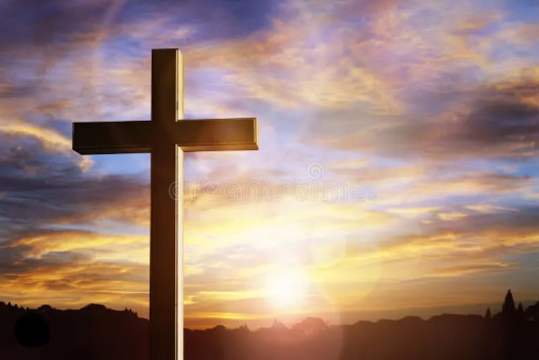
I believe in God the Father Almighty. The maker of heaven and earth;

Slide 22
and in Jesus Christ his only Son our Lord: who was conceived by the Holy Spirit, born of the Virgin Mary,

Slide 23
suffered under Pontius Pilate, was crucified, dead, and buried;

Slide 24
the third day he rose from the dead; he ascended into heaven,

Slide 25
and sitteth at the right hand of God the Father Almighty; from thence he shall come to judge the quick and the dead.

Slide 26
I believe in the Holy Spirit, the Holy catholic** church, the communion of saints, the forgiveness of sins,
**Church Universal

Slide 27
the resurrection of the body, and the life everlasting. Amen.

Slide 28
Gloria Patri, #71
Glory be to the Father, and to the Son and to the Holy Ghost,

Slide 29
as it was in the beginning, is now, and ever shall be, world with-out end.
A-men. A-men

Slide 30

Parish Notices/Recognition of Visitors

Slide 31
The Offering
(It’s Giving Time)
“Praise God, from whom all blessings flow; praise him, all creatures here below; praise him above, ye heavenly host; praise Father Son, and Holy Ghost, Amen”

Slide 32
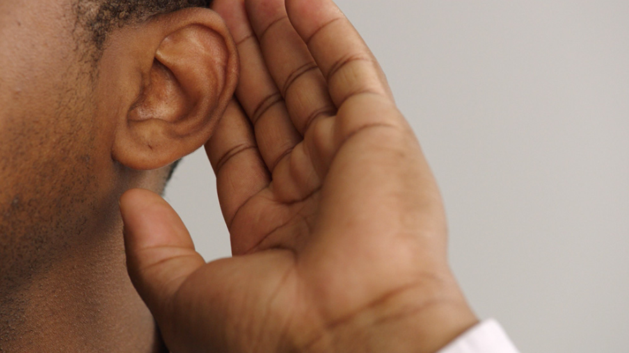
WE Listen for God’s Word

Slide 33
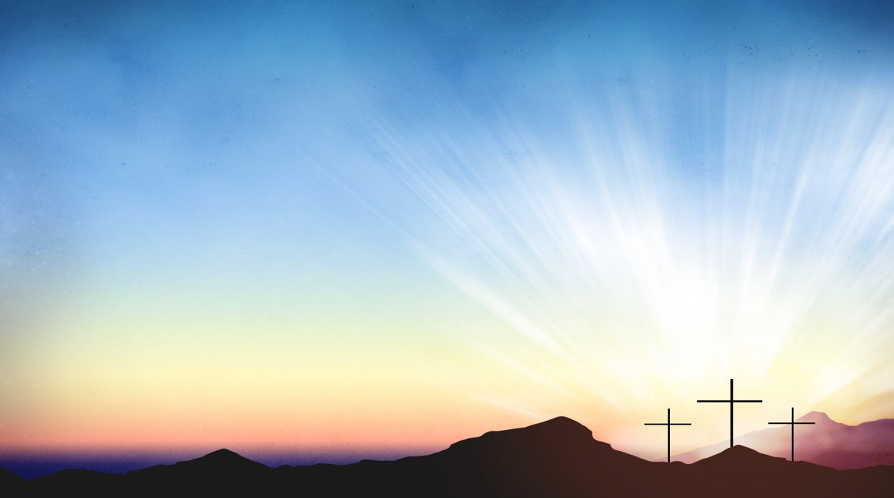
Proclamation and Response/We Listen for God’s Word
Old Testament: Psalm 130(ESV)
New Testament: Romans 8:6-11(ESV)

Slide 34
Psalm 130:
130:1 Out of the depths I cry to you, O LORD.
130:2 Lord, hear my voice! Let your ears be attentive to the voice of my supplications!

Slide 35
130:3 If you, O LORD, should mark
iniquities, Lord, who could stand?
130:4 But there is forgiveness with you, so that you may be revered.

Slide 36
130:5 I wait for the LORD; my soul waits, and in his word I hope;
130:6 my soul waits for the Lord more than those who watch for the morning, more than those who watch for the morning.

Slide 37
130:7 O Israel, hope in the LORD! For with the LORD there is steadfast love, and with him is great power to redeem.
130:8 It is he who will redeem Israel
from all its iniquities.

Slide 38
Romans 8:6-11
8:6 set the mind on the flesh is death,
but to set the mind on the Spirit is life
and peace.
8:7 For this reason the mind that is set
on the flesh is hostile to God; it does
not submit to God’s law--indeed, it cannot,

Slide 39
8:8 and those who are in the flesh
cannot please God.
8:9 But you are not in the flesh; you are in the Spirit, since the Spirit of God dwells in you. Anyone who does not have the Spirit of Christ does not
belong to him.

Slide 40
8:10 But if Christ is in you, then the
body is dead because of sin, the Spirit is life because of righteousness.

Slide 41
8:11 If the Spirit of him who raised Jesus from the dead dwells in you, he who raised Christ Jesus from the dead will give life to your mortal bodies also through his Spirit that dwells in you.

Slide 42
SELECTION
Wesley’s Male Ensemble

Slide 43
THE MESSAGE
Rev. Doris R. Bright, Pastor

Slide 44
Invitational / Altar Call
Wesley’s Male Ensemble

Slide 45

Reception Into

The Church
⧫
#39

Slide 46

Extinguishing of the Candles

Slide 47

Reverend Doris Bright

