Slide 1

Sunday, January 18th

Slide 2
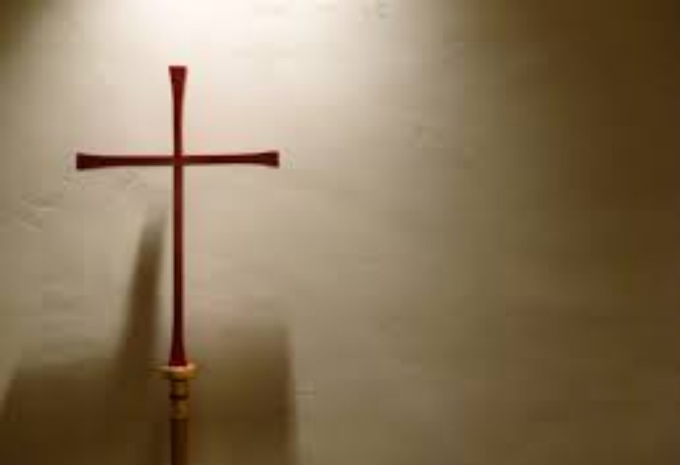
Processional

Slide 3
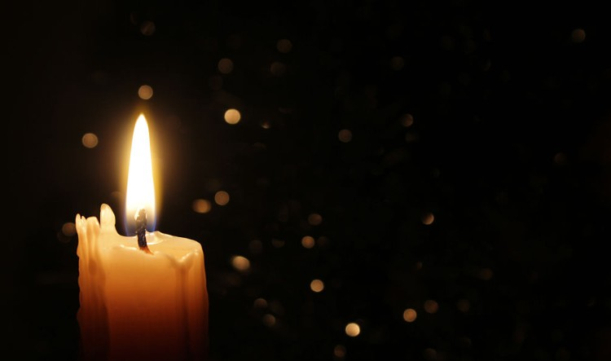
Lighting of Candles

Slide 4
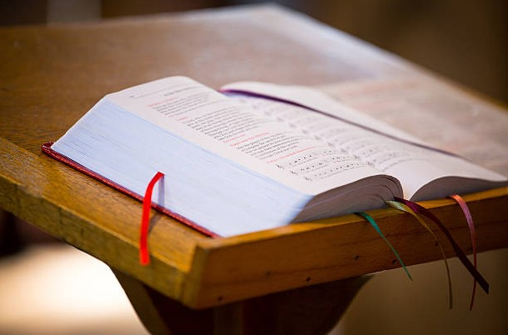
Greetings

Slide 5

Call to Worship…
Leader: Children of God, who has God called you to be?.
People: A light to all the nations!

Slide 6
Leader: When confusion, disunity, and misinformation threaten to undo us, who are you called to be?.
People: A light to all the nations!

Slide 7
Leader: When wars and rumors of wars in our communities and around the world overwhelm us, who are you
called to be?
People: A light to all the nations!

Slide 8
Leader: When the vulnerable are left
without care or hope for flourishing,
who are you called to be?
People: A light to all the nations!

Slide 9
Leader: Come! Let us worship God, who gives us as a light of good news to
all the nations!
ALL: We come to worship God, who
calls us and equips us to reflect God’s
glory and abundant life into all the
world. Amen.

Slide 10

Opening Hymn
“WE SHALL OVERCOME”
#533 (versus 1,2,& 5)

Slide 11
We shall overcome,
we shall overcome,
we shall overcome someday!
Oh, deep in my heart
I do believe
we shall overcome someday!

Slide 12
2. We’ll walk hand in hand, we’ll walk hand in hand, we’ll walk hand and hand someday!
Oh, deep in my heart
I do believe
we’ll walk hand and hand, someday!

Slide 13
5. The Lord will see us through,
The Lord will see us through,
The Lord will see us through someday!
Oh, deep in my heart I do believe, The Lord will see us through someday!

Slide 14
We shall overcome,
we shall overcome,
we shall overcome someday!
Oh, deep in my heart
I do believe
we shall overcome someday!

Slide 15
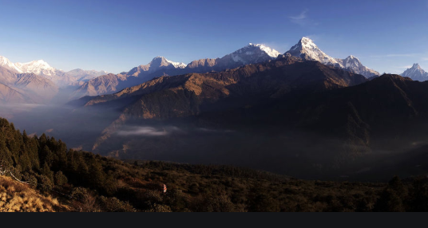
Morning Prayer

Slide 16
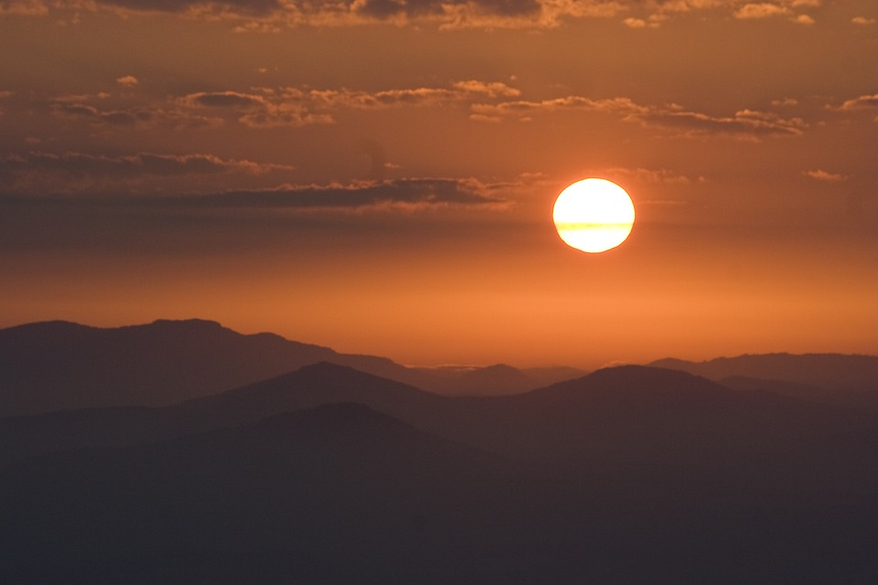
Response

Slide 17
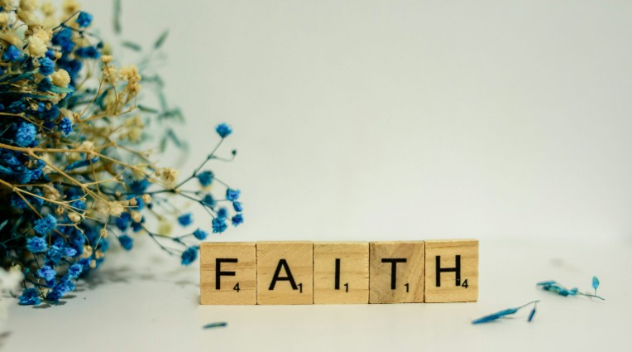
Affirmation of
The Apostles’ Creed

Slide 18

I believe in God the Father Almighty. The maker of heaven and earth;

Slide 19
and in Jesus Christ his only Son our Lord: who was conceived by the Holy Spirit, born of the Virgin Mary,

Slide 20
suffered under Pontius Pilate, was crucified, dead, and buried;

Slide 21
the third day he rose from the dead; he ascended into heaven,

Slide 22
and sitteth at the right hand of God the Father Almighty; from thence he shall come to judge the quick and the dead.

Slide 23
I believe in the Holy Spirit, the Holy catholic** church, the communion of saints, the forgiveness of sins,
**Church Universal

Slide 24
the resurrection of the body, and the life everlasting. Amen.

Slide 25

Gloria Patri
Glory be to the Father, and to the Son and to the Holy Ghost,

Slide 26
as it was in the beginning, is now, and ever shall be, world with-out end.
A-men. A-men

Slide 27

Parish Notices/Recognition of Visitors

Slide 28

The Offering
(It’s Giving Time)
“Praise God, from whom all blessings flow; praise him, all creatures here below; praise him above, ye heavenly host; praise Father Son, and Holy Ghost, Amen”

Slide 29
*The Dedication of Tithes and Offering
UMH #588
“All things come of thee, O Lord, and of thine own have we given thee.” AMEN!

Slide 30
Installation of 2026 Officers

Slide 31
Pastor: My Sisters and Brothers, you have been called by God and chosen by the people of God for leadership in the church. This ministry is a blessing and a serious responsibility. It recognizes your special gifts and calls you to work among us and for us. In love, we thank you and I thank you for accepting your obligation and challenge you to offer your best to the Lord, to this people, and to our ministry in the world. Live a life in Christ and make Christ known in your witness and
your work.

Slide 32
Today we install the following 2026 Officers of Wesley United Methodist Church…

Slide 33
Pastor: Do you this day acknowledge yourself a faithful disciple of Jesus Christ?
Response: I do.
Pastor: Will you devote yourself to the service of God in the world and Wesley United Methodist Church?
Officers Response: I will

Slide 34
Pastor: Will you so live that you enable this church to be a people of love and peace?
Officers Response: I will.
Pastor: Will you do all in your power to be responsible to the task for which you have been chosen?
Officers Response: I will.

Slide 35
Pastor: We also recognize those persons who have been elected to office by the United
Methodist Men, United Women in Faith (United Methodist Women), and United Methodist
Youth (and other organizations as appropriate)

Slide 36
Pastor: Let us pray. Almighty God, pour out your blessings upon these your servants who have been given particular ministries in your church, Wesley United Methodist Church. Grant them grace to give themselves wholeheartedly in your service. Keep before them the example of our Lord,

Slide 37
who did not think first of himself, but gave himself for us all. Let them share his ministry and consecration, that they may enter into his joy. Guide them in their work. Reward their faithfulness with the knowledge that through them your purposes are accomplished; through
Jesus Christ our Lord. Amen.

Slide 38
To the Congregation: Let us rejoice that God provided laborers for the vineyard. Will you do all you can to assist and encourage them in the responsibilities to which they have been called,
giving them your cooperation, your counsel, and your prayers?
The Congregation Responds:
We will.

Slide 39
To the Congregation: My Sisters and brothers, rejoice that God provides laborers for the
vineyards. Will you do all you can to assist and encourage them in the responsibilities to which
they have been called, giving them your cooperation, your counsel, and your prayers?
The Congregation Responds:
We will.

Slide 40
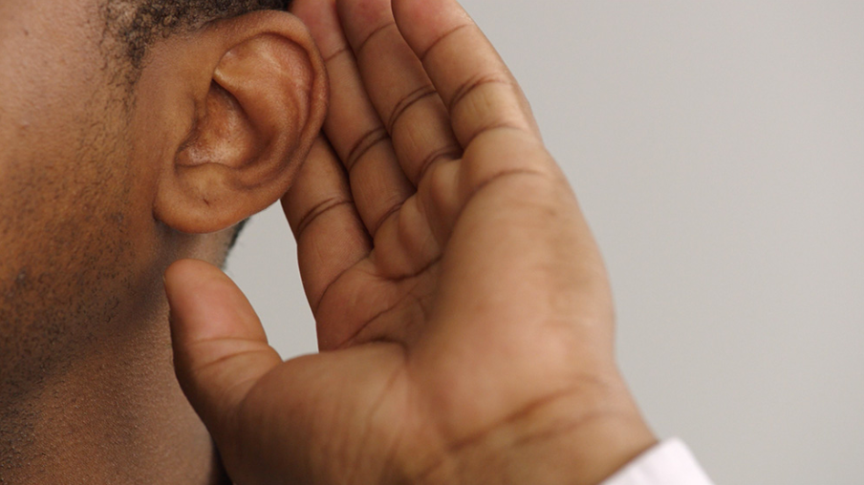
WE Listen for God’s Word

Slide 41
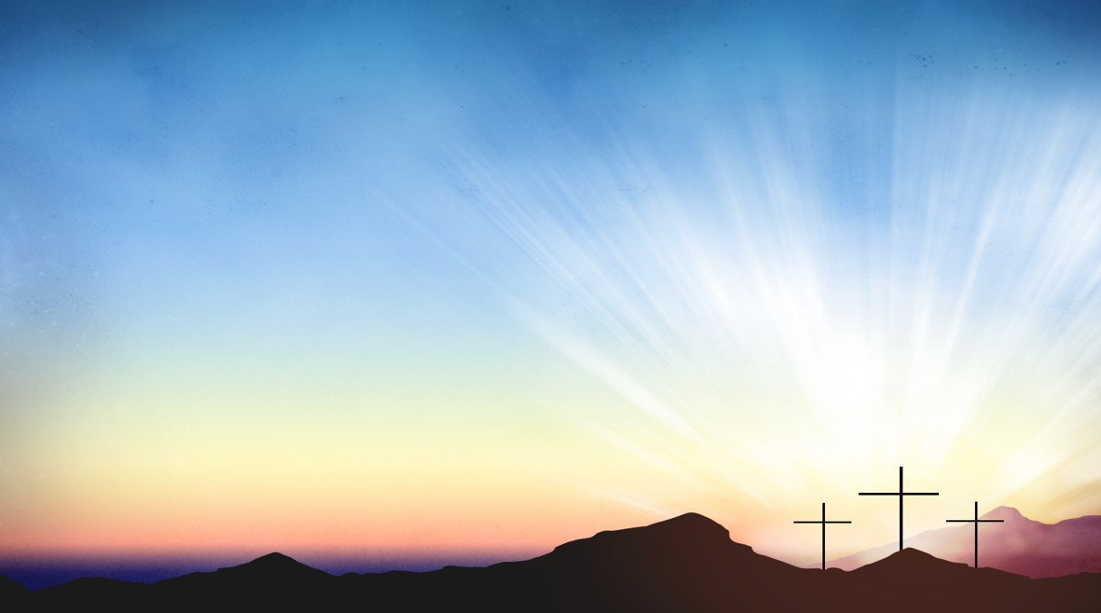
Proclamation and Response/We Listen for God’s Word
Old Testament: Psalm 40: 1-11 (ESV)
New Testament: John: 1:29-42 (ESV)

Slide 42
Old Testament: Psalm 40: 1-11 (ESV)
¹ I waited patiently for the Lord;
he inclined to me and heard my cry.
² He drew me up from the pit of destruction, out of the miry bog,
and set my feet upon a rock, making my steps secure.

Slide 43
³ He put a new song in my mouth, a song of praise to our God. Many will see and fear, and put their trust in the Lord.
⁴ Blessed is the man who makes the Lord his trust, who does not turn to the proud, to those who go astray after a lie!

Slide 44
⁵ You have multiplied, O Lord my God, your wondrous deeds and your thoughts toward us; none can compare with you! I will proclaim and tell of them, yet they are more than can be told

Slide 45
⁶ In sacrifice and offering you have not delighted, but you have given me an open ear. Burnt offering and sin offering you have not required.

Slide 46
⁷ Then I said, “Behold, I have come;
in the scroll of the book it is written of me:
⁸ I delight to do your will, O my God; your law is within my heart.

Slide 47
⁹ I have told the glad news of deliverance in the great congregation;
behold, I have not restrained my lips,
as you know, O Lord.

Slide 48
¹⁰ I have not hidden your deliverance within my heart; I have spoken of your faithfulness and your salvation; I have not concealed your steadfast love and your faithfulness from the great congregation

Slide 49
¹¹ As for you, O Lord, you will not restrain your mercy from me; your steadfast love and your faithfulness will ever preserve me

Slide 50
New Testament: John 1:29-42
²⁹ The next day he saw Jesus coming toward him, and said, “Behold, the Lamb of God, who takes away the sin of the world! ³⁰ This is he of whom I said, ‘After me comes a man who ranks before me, because he was before me.’

Slide 51
³¹ I myself did not know him, but for this purpose I came baptizing with water, that he might be revealed to Israel.” ³² And John bore witness: “I saw the Spirit descend from heaven like a dove, and it remained on him.

Slide 52
³³ I myself did not know him, but he who sent me to baptize with water said to me, ‘He on whom you see the Spirit descend and remain, this is he who baptizes with the Holy Spirit.’ ³⁴ And I have seen and have borne witness that this is the Son^{[a]} of God.”

Slide 53
³⁵ The next day again John was standing with two of his disciples, ³⁶ and he looked at Jesus as he walked by and said, “Behold, the Lamb of God!”

Slide 54
³⁷ The two disciples heard him say this, and they followed Jesus. ³⁸ Jesus turned and saw them following and said to them, “What are you seeking?” And they said to him, “Rabbi” (which means Teacher), “where are you staying?”

Slide 55
³⁹ He said to them, “Come and you will see.” So they came and saw where he was staying, and they stayed with him that day, for it was about the tenth hour. ⁴⁰ One of the two who heard John speak and followed Jesus was Andrew, Simon Peter's brother.

Slide 56
⁴¹ He first found his own brother Simon and said to him, “We have found the Messiah” (which means Christ). ⁴² He brought him to Jesus. Jesus looked at him and said, “You are Simon the son of John. You shall be called Cephas” (which means Peter).
Leader: The Word of God for the people of God. | People: Thanks be to God.

Slide 57

Selection
Wesley’s Ensemble

Slide 58

The Message
by
Rev. Doris Bright,
Pastor

Slide 59
Invitational /
Altar Call

Slide 60
Song of Sending Forth

Slide 61
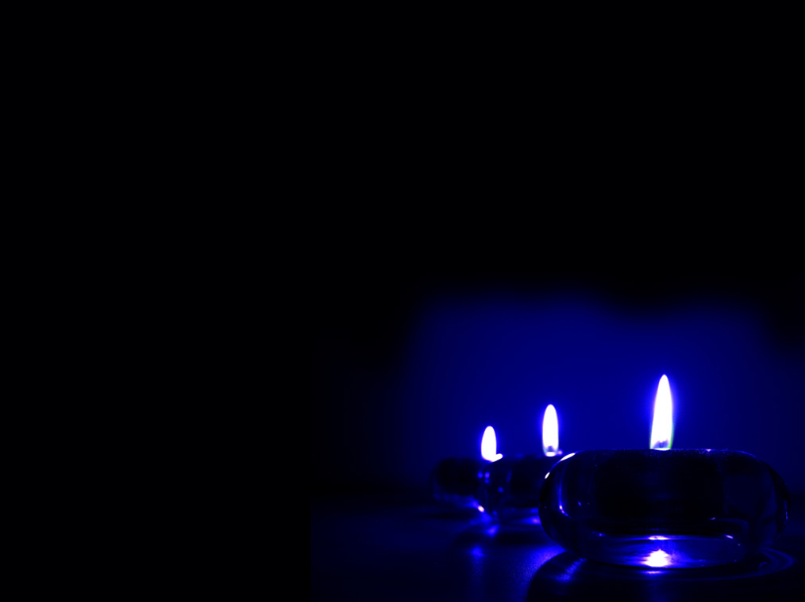
Extinguishing of the Candles

Slide 62


