Slide 1

Sunday, February 15,
“Go Red Sunday”

Slide 2

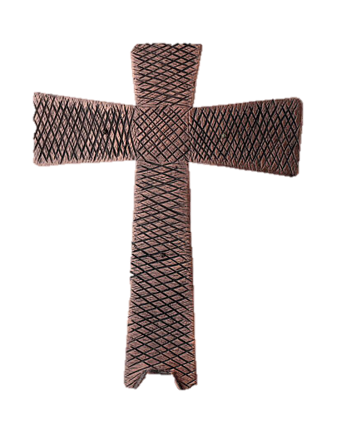
Processional

Slide 3

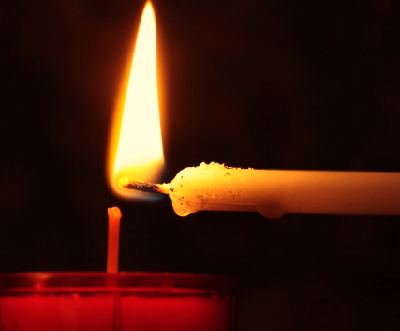
Lighting of Candles

Slide 4


Greetings

Slide 5


Call to Worship…
Leader: On this Transfiguration Sunday, we gather on the Mountain top with Jesus, wondering what we will encounter.
People: We come to encounter God’s glory revealed.

Slide 6
Leader: We witness the revelation of Christ’s divinity made plain before us.
People: We come to witness God’s glory revealed.

Slide 7
Leader: We remember that God’s glory is not about spectacle but truth, not about show but about Love made real among us.
People: We come to remember God’s glory revealed.

Slide 8
Leader: We follow Jesus down from the mountain top into the valleys, as God’s glory goes before us and behind us.
All: We come to be sent out to share God’s glory revealed. Thanks be to God! Amen.

Slide 9

Opening Selection
Wesley’s Male Ensemble

Slide 10


Morning Prayer

Slide 11
Response

Slide 12

Affirmation of
The Apostles’ Creed

Slide 13
I believe in God the Father Almighty. The maker of heaven and earth;

Slide 14
and in Jesus Christ his only Son our Lord: who was conceived by the Holy Spirit, born of the Virgin Mary,

Slide 15
suffered under Pontius Pilate, was crucified, dead, and buried;

Slide 16
the third day he rose from the dead; he ascended into heaven,

Slide 17
and sitteth at the right hand of God the Father Almighty; from thence he shall come to judge the quick and the dead.

Slide 18
I believe in the Holy Spirit, the Holy catholic** church, the communion of saints, the forgiveness of sins,
**Church Universal

Slide 19
the resurrection of the body, and the life everlasting. Amen.

Slide 20
Gloria Patri
Glory be to the Father, and to the Son and to the Holy Ghost,

Slide 21
as it was in the beginning, is now, and ever shall be, world with-out end.
A-men. A-men

Slide 22

Parish Notices/Recognition of Visitors

Slide 23
The Offering
(It’s Giving Time)
“Praise God, from whom all blessings flow; praise him, all creatures here below; praise him above, ye heavenly host; praise Father Son, and Holy Ghost, Amen”

Slide 24
*The Dedication of Tithes and Offering
UMH #588
“All things come of thee, O Lord, and of thine own have we given thee.” AMEN!

Slide 25
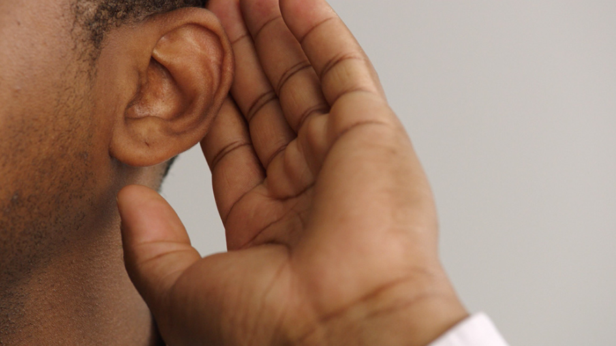
WE Listen for God’s Word

Slide 26

Proclamation and Response/We Listen for God’s Word
Old Testament: Psalm 2 (ESV)
New Testament: Matthew 17:1-9(ESV)

Slide 27
Old Testament: Psalm 2 (ESV)
The Reign of the Lord's Anointed
Why do the nations rage and the peoples plot in vain?
² The kings of the earth set themselves, and the rulers take counsel together, against the Lord and against his Anointed, saying,
³ “Let us burst their bonds apart and cast away their cords from us.”

Slide 28
⁴ He who sits in the heavens laughs;
the Lord holds them in derision.
⁵ Then he will speak to them in his wrath, and terrify them in his fury, saying,
⁶ “As for me, I have set my King on Zion, my holy hill.”

Slide 29
⁷ I will tell of the decree:
The Lord said to me, “You are my Son;
today I have begotten you.
⁸ Ask of me, and I will make the nations your heritage, and the ends of the earth your possession.
⁹ You shall break^{[b]} them with a rod of iron and dash them in pieces like a potter's vessel.”

Slide 30
¹⁰ Now therefore, O kings, be wise; be warned, O rulers of the earth.
¹¹ Serve the Lord with fear, and rejoice with trembling.
¹² Kiss the Son, lest he be angry, and you perish in the way, for his wrath is quickly kindled.

Slide 31
New Testament: Matthew 17:1-9
17 And after six days Jesus took with him Peter and James, and John his brother, and led them up a high mountain by themselves.

Slide 32
² And he was transfigured before them, and his face shone like the sun, and his clothes became white as light.
³ And behold, there appeared to them Moses and Elijah, talking with him.

Slide 33
⁴ And Peter said to Jesus, “Lord, it is good that we are here. If you wish, I will make three tents here, one for you and one for Moses and one for Elijah.”

Slide 34
⁵ He was still speaking when, behold, a bright cloud overshadowed them, and a voice from the cloud said, “This is my beloved Son,^{[a]} with whom I am well pleased; listen to him.”

Slide 35
⁶ When the disciples heard this, they fell on their faces and were terrified.

Slide 36
⁷ But Jesus came and touched them, saying, “Rise, and have no fear.”
⁸ And when they lifted up their eyes, they saw no one but Jesus only.

Slide 37
⁹ And as they were coming down the mountain, Jesus commanded them, “Tell no one the vision, until the Son of Man is raised from the dead.”
Leader: The Word of God for the people of God.
People: Thanks be to God.

Slide 38
Selection
Wesley’s Male Ensemble

Slide 39

The Message
by
Rev. Doris Bright,
Pastor

Slide 40
Invitational

Altar Call

Slide 41
Song of Sending Forth

Slide 42
Extinguishing of the Candles

Slide 43


