Slide 1
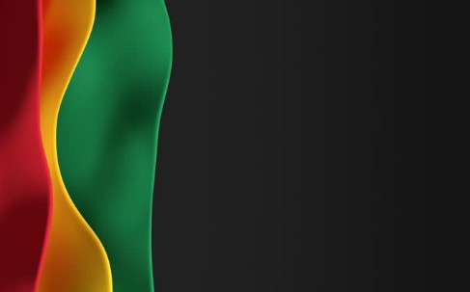

Sunday, March 29,
2026

Slide 2
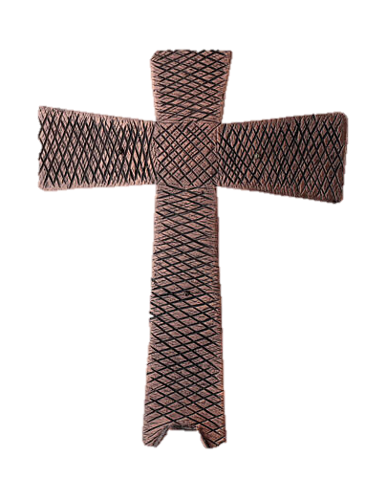
Processional

Slide 3

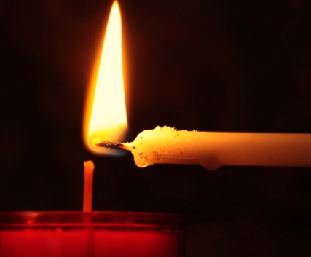
Lighting of Candles

Slide 4


Greetings

Slide 5

Call to Worship…
LEADER: “Lenten travelers the journey to the cross begins with a procession into Jerusalem, a demonstration of Jesus’ saving power.
PEOPLE: We come to praise Jesus, the Messiah, the One who saves!

Slide 6
LEADER: The crowds line the path and shout “Hosanna! Save us!” as Jesus rides in, not on a mighty war horse, but on the backs of a donkey and a colt.
PEOPLE: We come to call on Jesus, the Messiah, the One who saves!

Slide 7
LEADER: The city murmurs, wondering who this person is who demonstrates power through humility, strength without tyranny.
PEOPLE: We come to witness Jesus, the Messiah, the One who saves!

Slide 8
LEADER: Lenten travelers, will you come on the journey to Jerusalem, following a Messiah who saves us to live after the pattern of the kin-dom of God, not the kingdoms of this world?

Slide 9
PEOPLE: We come to follow Jesus, the Messiah, the One who saves!

Slide 10
Opening Hymn
“Blessed Be the Name”
#63

Slide 11
Blessed be the name!
Blessed be the name!
Blessed be the name of the Lord!
Blessed be the name!
Blessed be the name!
Blessed be the name of the Lord!

Slide 12


Morning Prayer
⧫
Sis. Thelma Cohen

Slide 13

Response
⧫
Wesley’s Ensemble

Slide 14

Affirmation of
#881
The Apostles’ Creed

Slide 15
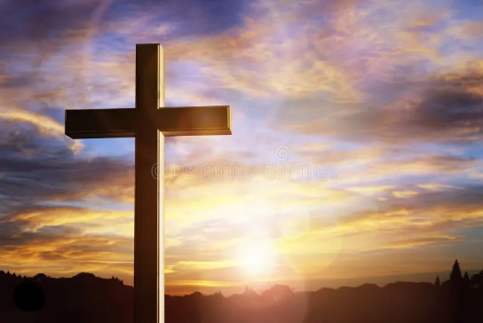
I believe in God the Father Almighty. The maker of heaven and earth;

Slide 16
and in Jesus Christ his only Son our Lord: who was conceived by the Holy Spirit, born of the Virgin Mary,

Slide 17
suffered under Pontius Pilate, was crucified, dead, and buried;

Slide 18
the third day he rose from the dead; he ascended into heaven,

Slide 19
and sitteth at the right hand of God the Father Almighty; from thence he shall come to judge the quick and the dead.

Slide 20
I believe in the Holy Spirit, the Holy catholic** church, the communion of saints, the forgiveness of sins,
**Church Universal

Slide 21
the resurrection of the body, and the life everlasting. Amen.

Slide 22
Gloria Patri, #71
Glory be to the Father, and to the Son and to the Holy Ghost,

Slide 23
as it was in the beginning, is now, and ever shall be, world with-out end.
A-men. A-men

Slide 24

Parish Notices/Recognition of Visitors

Slide 25
The Offering
(It’s Giving Time)
“Praise God, from whom all blessings flow; praise him, all creatures here below; praise him above, ye heavenly host; praise Father Son, and Holy Ghost, Amen”

Slide 26
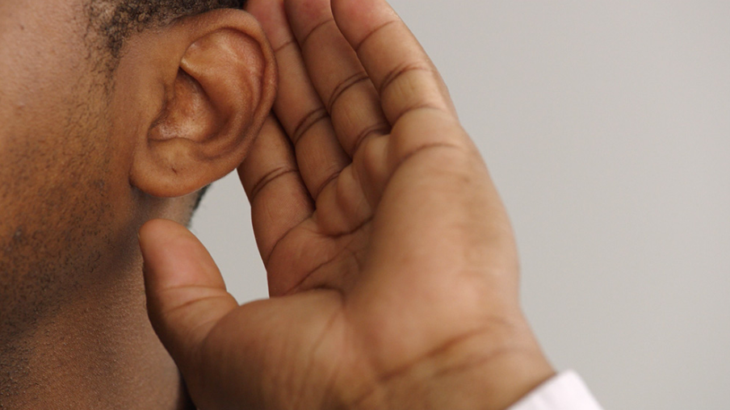
WE Listen for God’s Word

Slide 27
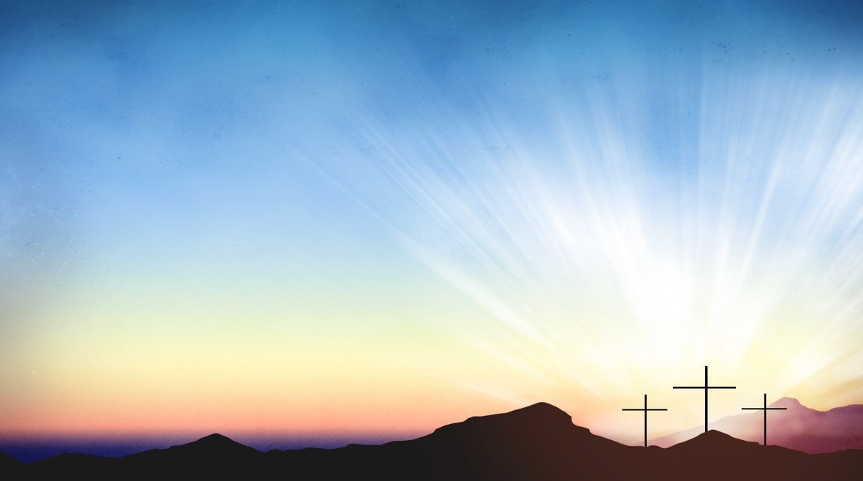
Proclamation and Response/We Listen for God’s Word
Old Testament: Psalm 118: 1-2, 19-29(ESV)
New Testament: Matthew 21: 1-11(ESV)

Slide 28
Psalm 118: 1-2
118:1 - O give thanks to the LORD, for he is good; his steadfast love endures forever!
118:2 - Let Israel say, “His steadfast love endures forever.”

Slide 29
118:19 - Open to me the gates of
righteousness, that I may enter
through them and give thanks to the
LORD.
118:20 - This is the gate of the LORD; the righteous shall enter through it.

Slide 30
118:21 - I thank you that you have
answered me and have become my
salvation.
118:22 - The stone that the builders
rejected has become the chief
cornerstone.

Slide 31
118:23 - This is the Lord’s doing; it is marvelous in our eyes.
118:24 - This is the day that the LORD has made; let us rejoice and be glad in it.

Slide 32
118:25 - Save us, we beseech you, O
LORD! O LORD, we beseech you, give
us success!
118:26 - Blessed is the one who comes in
the name of the LORD. We bless you
from the house of the LORD.

Slide 33
118:27 - The LORD is God, and he has given us light. Bind the festal
procession with branches, up to the
horns of the altar.
118:28 - You are my God, and I will give thanks to you; you are my God; I will extol you.

Slide 34
118:29 - O give thanks to the LORD, for he is good, for his steadfast love endures forever.

Slide 35
SELECTION
Wesley’s Ensemble

Slide 36
THE MESSAGE
Rev. Doris R. Bright, Pastor

Slide 37
Invitational / Altar Call
Wesley’s Ensemble

Slide 38

Extinguishing of the Candles

Slide 39

Reverend Doris Bright

