Slide 1


Slide 2
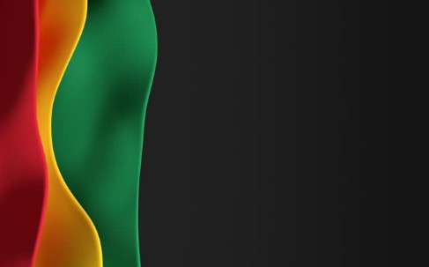
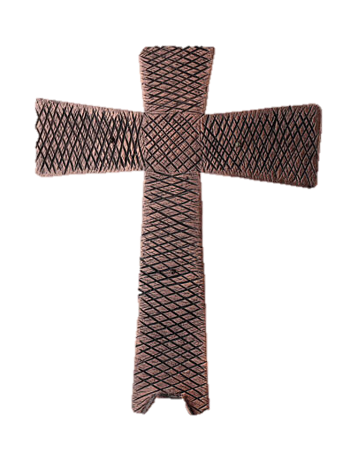
Processional

Slide 3
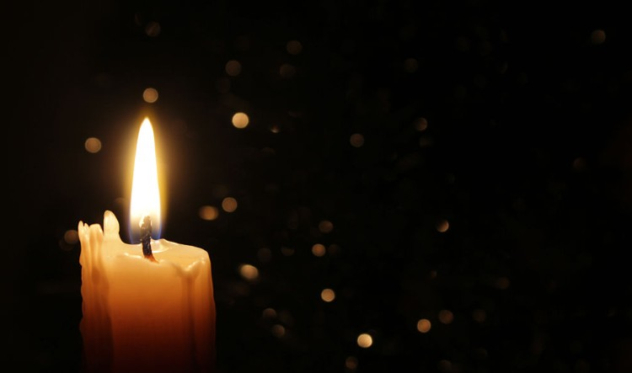
Lighting of Candles

Slide 4


Greetings

Slide 5
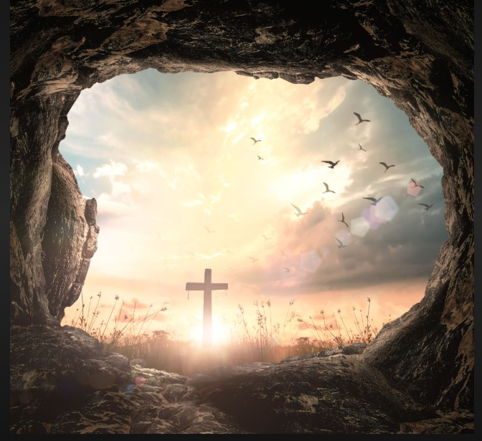
Call to Worship…
LEADER: “Easter people, Christ Is Risen! God is doing a new thing!
PEOPLE: Hallelujah! Christ is risen!

Slide 6
LEADER: Life has conquered death! Love has overcome fear!
PEOPLE: Hallelujah! Christ is risen!

Slide 7
LEADER: God has transformed a dead end into a new start!
PEOPLE: Hallelujah! Christ is risen!

Slide 8
LEADER: Easter people, raise your voices! Christ is risen!

Slide 9
PEOPLE: Christ is risen indeed! Hallelujah!

Slide 10
Opening Hymn
“Because He Lives”
#364

Slide 11
God sent His son,
they called Him Jesus
He came to love, heal, and forgive.
He lived and died to buy my pardon,
An empty grave is there to prove my Savior lives.

Slide 12
Because He lives,
I can face tomorrow.
Because He lives, All fear is gone.
Because I know He holds the future,
And life is worth the living just because He lives.

Slide 13
2. How sweet to hold a newborn baby,
And feel the pride and joy he gives.
But greater still the calm assurance,
This child can face uncertain days because He lives.

Slide 14
Because He lives,
I can face tomorrow.
Because He lives, All fear is gone.
Because I know He holds the future,
And life is worth the living just because He lives.

Slide 15
3. And then one day
I'll cross the river,
I'll fight life's final war with pain.
And then as death gives way to victory,
I'll see the lights of glory and I'll know He lives.

Slide 16
Because He lives,
I can face tomorrow.
Because He lives, All fear is gone!
Because I know He holds the future
And life is worth the living just because He lives!

Slide 17


Morning Prayer
⧫
Sis. Evelyn Brown

Slide 18

Response
⧫
Wesley’s Ensemble

Slide 19

Affirmation of
#881
The Apostles’ Creed

Slide 20
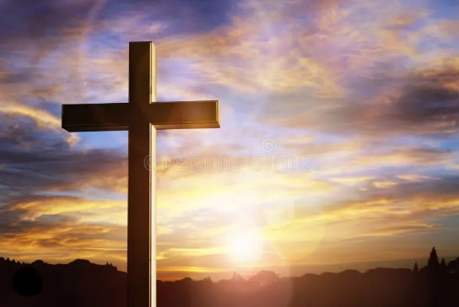
I believe in God the Father Almighty. The maker of heaven and earth;

Slide 21
and in Jesus Christ his only Son our Lord: who was conceived by the Holy Spirit, born of the Virgin Mary,

Slide 22
suffered under Pontius Pilate, was crucified, dead, and buried;

Slide 23
the third day he rose from the dead; he ascended into heaven,

Slide 24
and sitteth at the right hand of God the Father Almighty; from thence he shall come to judge the quick and the dead.

Slide 25
I believe in the Holy Spirit, the Holy catholic** church, the communion of saints, the forgiveness of sins,
**Church Universal

Slide 26
the resurrection of the body, and the life everlasting. Amen.

Slide 27
Gloria Patri, #71
Glory be to the Father, and to the Son and to the Holy Ghost,

Slide 28
as it was in the beginning, is now, and ever shall be, world with-out end.
A-men. A-men

Slide 29

Sis. Donnise Hammond

Slide 30
The Offering
(It’s Giving Time)
“Praise God, from whom all blessings flow; praise him, all creatures here below; praise him above, ye heavenly host; praise Father Son, and Holy Ghost, Amen”

Slide 31
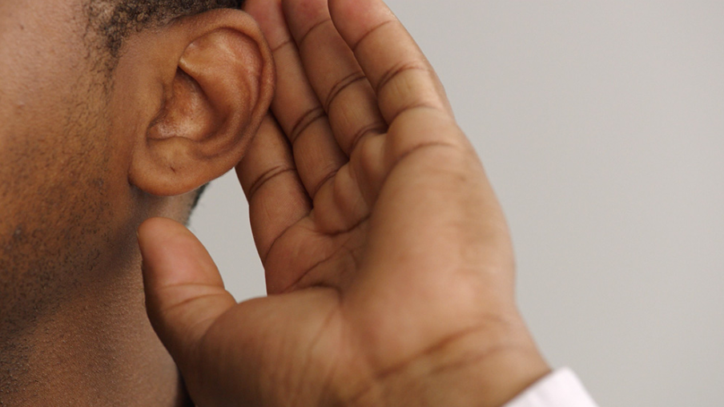
WE Listen for God’s Word

Slide 32
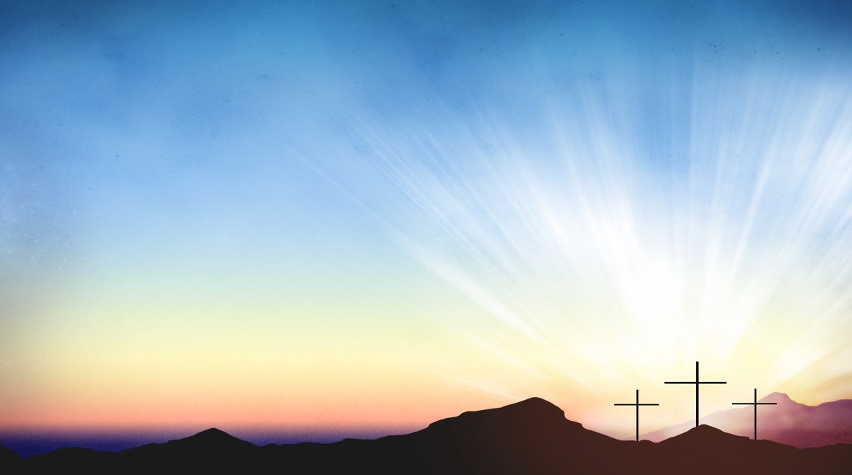
Proclamation and Response/We Listen for God’s Word
Sis. Joell Wigfall
Old Testament: Jeremiah 31:1-6(ESV)
New Testament: Matthew 28: 1-10(ESV)

Slide 33
Old Testament: Jeremiah 31:1-6
31:1 At that time, says the LORD, I will be the God of all the families of Israel, and
they shall be my people.
31:2 Thus says the LORD: The people who survived the sword found grace in the
wilderness; when Israel sought for rest,

Slide 34
31:3 the LORD appeared to him from far away. I have loved you with an everlasting
love; therefore, I have continued my faithfulness to you.
31:4 Again I will build you, and you shall be built, O virgin Israel! Again you shall
adorn yourself with your tambourines and go forth in the dance of the
merrymakers.

Slide 35
31:5 Again you shall plant vineyards on the mountains of Samaria; the planters shall
plant and shall enjoy the fruit.
31:6 For there shall be a day when sentinels will call in the hill country of Ephraim:
“Come, let us go up to Zion, to the LORD our God.”

Slide 36
New Testament: Matthew 28:1-10
28:1 After the Sabbath, as the first day of the week was dawning, Mary Magdalene
and the other Mary went to see the tomb.
28:2 And suddenly there was a great earthquake, for an angel of the Lord,
descending from heaven, came and rolled back the stone and sat on it.

Slide 37
28:3 His appearance was like lightning and his clothing white as snow.
28:4 For fear of him the guards shook and became like dead men.
28:5 But the angel said to the women, “Do not be afraid, for I know that you are looking for Jesus who was crucified.

Slide 38
28:6 He is not here, for he has been raised, as he said. Come, see the place where
he lay.
28:7 Then go quickly and tell his disciples,
‘He has been raised from the dead, and
indeed he is going ahead of you to Galilee; there you will see him.’ This is my
message for you.”

Slide 39
28:8 So they left the tomb quickly with fear and great joy and ran to tell his
disciples.
28:9 Suddenly Jesus met them and said, “Greetings!” And they came to him, took hold of his feet, and worshiped him.

Slide 40
28:10 Then Jesus said to them, “Do not be afraid; go and tell my brothers and sisters to go to Galilee; there they will see me.”

Slide 41
SELECTION
Wesley’s Ensemble

Slide 42


Rev. Doris R. Bright, Pastor

Slide 43
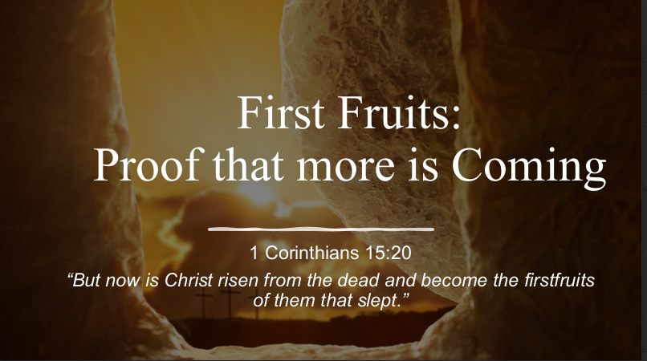
1 Corinthians 15:20
“But now is Christ risen from the dead and become the firstfruits of them that slept.”

Slide 44
Invitational / Altar Call
Wesley’s Ensemble

Slide 45
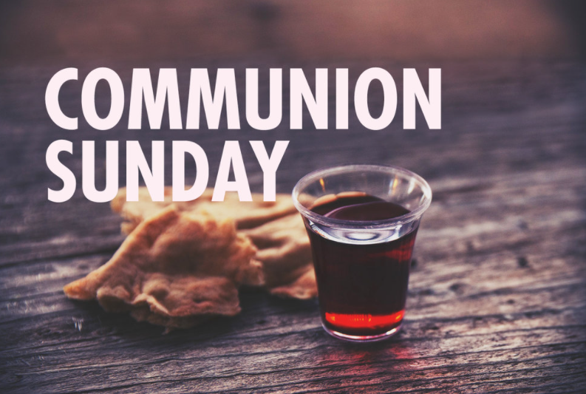

Slide 46
INVITATION
Christ our Lord invites to his table all who love him, who earnestly repent of their sin
and seek to live in peace with one another.

Slide 47
Therefore, let us confess our sin before God and one another.

Slide 48
CONFESSION AND PARDON
Merciful God,
We confess that we have not loved you with our whole heart.
We have failed to be an obedient church.

Slide 49
We have not done your will,
We have broken your law,
We have rebelled against your love,
we have not loved our neighbors,
and we have not heard the cry of the needy.

Slide 50
Forgive us, we pray.
Free us for joyful obedience,
through Jesus Christ our Lord. Amen.

Slide 51
Leader to people:
Here the good news:
Christ died for us while we were yet sinners; that proves God’s love toward us.
In the name of Jesus Christ, you are forgiven!

Slide 52
People to leader:
In the name of Jesus Christ, you are forgiven!

Slide 53
Leader to people:
Glory to God. Amen

Slide 54
TAKING THE BREAD AND CUP
THE GREAT THANKSGIVING
The Lord be with you.
And also with you.
Lift up your hearts.
We lift them up to the Lord.

Slide 55
Let us give thanks to the Lord our God.
It is right to give our thanks and praise.

Slide 56
It is right, and a good and joyful thing, always and everywhere to give thanks to you, Father Almighty, creator of heaven and earth.*

Slide 57
And so,
with your people on earth and all the company of heaven we praise your name and join their unending hymn:

Slide 58
Holy, holy, holy Lord, God of power and might, heaven and earth are full of your glory. Hosanna in the highest. Blessed is he who comes in the name of the Lord. Hosanna in the highest.

Slide 59
Holy are you, and blessed is your Son Jesus Christ.* By the baptism of his suffering, death, and resurrection you give birth to your church,

Slide 60
delivered us from slavery to sin and death, and made with us a new covenant by water and the Spirit.*

Slide 61
On the night in which he gave himself up for us he took bread, gave thanks to you, broke the bread, gave it to his disciples, and said:

Slide 62
“Take, eat; this is my body which is given for you.
Do this in remembrance of me.”

Slide 63
When the supper was over, he took the cup, gave thanks to you, gave it to his disciples, and said:

Slide 64
“Drink from this, all of you;
this is my blood of the new covenant, poured out for you and for many for the forgiveness of sins.

Slide 65
Do this, as often as your drink it, in remembrance of me.”

Slide 66
And so,
In remembrance of these your mighty acts in Jesus Christ, we offer ourselves in praise and thanksgiving as a holy and living sacrifice,

Slide 67
in union with Christ’s offering for us, as we proclaim the mystery of faith.

Slide 68
Christ has died; Christ is risen; Christ will come again.

Slide 69
Pour out your Holy Spirit on us gathered here, and on these gifts of bread and wine.

Slide 70
Make them be for us the body and blood of Christ, that we may be for the world the body of Christ, redeemed by his blood.”*

Slide 71
By your Spirit make us one with Christ, one with each other, and one in ministry to all the world, until Christ comes in final victory, and we feast at his heavenly banquet.

Slide 72
Through your Son Jesus Christ, with the Holy Spirit in your holy church, all honor and glory is yours, almighty Father, now and for ever. AMEN

Slide 73
And now, with the confidence of children of God, let us pray:
THE LORD’S PRAYER

Slide 74
BREAKING THE BREAD
GIVING THE BREAD AND CUP
The body of Christ, given for you. Amen
The blood of Christ, given for you. Amen

Slide 75
HYMN OR SONG
DISMISSAL WITH BLESSING
Go forth in peace.
The grace of the Lord Jesus Christ,
And the love of God, and the communion of the Holy Spirit be with you all. Amen

Slide 76
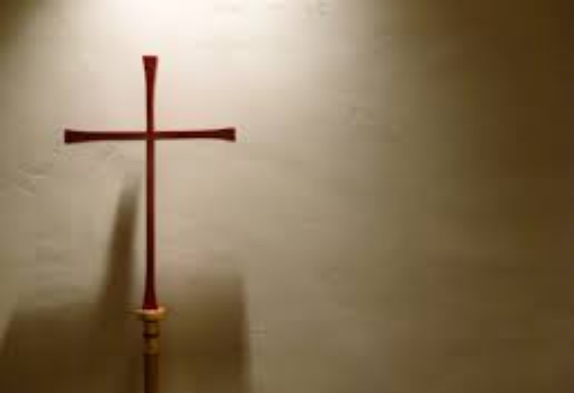
Song of Sending Forth

Slide 77

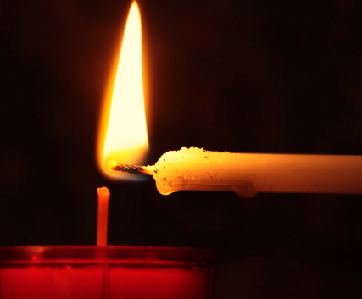
Extinguishing of the Candles

Slide 78

Reverend Doris Bright

