Slide 1

Sunday, December 7, 2025

Slide 2

Processional

Slide 3

Lighting of Candles
Greetings

Slide 4
Call to Worship…
Leader: Beloved, we gather to remember who we are, not who the world tells us to be.

Slide 5
People: We tell the story together of the day that all the earth awaits.

Slide 6
Leader: We recall the story of God’s people, how God has called us to live in peace and righteousness in a world full of conflict and twisted morality.

Slide 7
People: We tell the story together o the day that all the earth awaits.

Slide 8
Leader: We recount the story of our journey with God, the moments of God’s provision, God’s prodding, and God’s prophetic guidance.

Slide 9
People: We tell the story together of the day that all the earth awaits.

Slide 10
Leader: We gather to repent and return anew to God’s story that guides our lives to work for peace and flourishing for all God’s creation.

Slide 11
All: We gather to tell the story of the day that all the earth awaits. Thanks be to God! Amen.

Slide 12

Opening Hymn
”Jesus the Light of the World”

Slide 13

1. Hark! the herald angels sing,
Jesus, the Light of the world;
glory to the newborn King, Jesus, the Light of the world.

Slide 14
Refrain:
We’ll walk in the light, beautiful light; come where the dewdrops of mercy are bright, shine all around us by day and by night,
Jesus, the Light of the world.

Slide 15
2. Joyful, all ye nations, rise, Jesus, the Light of the world; join the triumph of the skies,
Jesus, the Light of the world. (Refrain)

Slide 16
Refrain:
We’ll walk in the light, beautiful light; come where the dewdrops of mercy are bright, shine all around us by day and by night,
Jesus, the Light of the world.

Slide 17
3. Christ, by highest heav’n adored, Jesus, the Light of the world; Christ, the everlasting Lord, Jesus, the Light of the world. (Refrain)

Slide 18
Refrain:
We’ll walk in the light, beautiful light; come where the dewdrops of mercy are bright, shine all around us by day and by night,
Jesus, the Light of the world.

Slide 19
4. Hail the heav’n-born Prince of peace! Jesus, the Light of the world. Hail the Sun of Righteousness! Jesus, the Light of the world. (Refrain)

Slide 20
Refrain:
We’ll walk in the light, beautiful light; come where the dewdrops of mercy are bright, shine all around us by day and by night,
Jesus, the Light of the world.

Slide 21
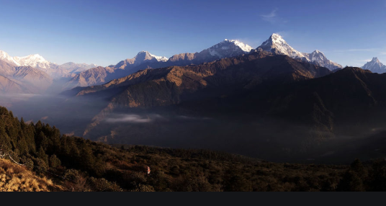
Morning Prayer

Slide 22

Response

Slide 23
Affirmation of
Faith
“The Apostles’ Creed”

Slide 24

I believe in God the Father Almighty. The maker of heaven and earth;

Slide 25
and in Jesus Christ his only Son our Lord: who was conceived by the Holy Spirit, born of the Virgin Mary,

Slide 26
suffered under Pontius Pilate, was crucified, dead, and buried;

Slide 27
the third day he rose from the dead; he ascended into heaven,

Slide 28
and sitteth at the right hand of God the Father Almighty; from thence he shall come to judge the quick and the dead.

Slide 29
I believe in the Holy Spirit, the Holy catholic** church, the communion of saints, the forgiveness of sins,
**Church Universal

Slide 30
the resurrection of the body, and the life everlasting. Amen.

Slide 31

Gloria Patri
Glory be to the Father, and to the Son and to the Holy Ghost,

Slide 32
as it was in the beginning, is now, and ever shall be, world with-out end.
A-men. A-men

Slide 33

The Offering
(It’s Giving Time)
“Praise God, from whom all blessings flow; praise him, all creatures here below; praise him above, ye heavenly host; praise Father Son, and Holy Ghost, Amen”

Slide 34
*The Dedication of Tithes and Offering
UMH #588
“All things come of thee, O Lord, and of thine own have we given thee.” AMEN!

Slide 35

Parish Notices/Recognition of Visitors

Slide 36
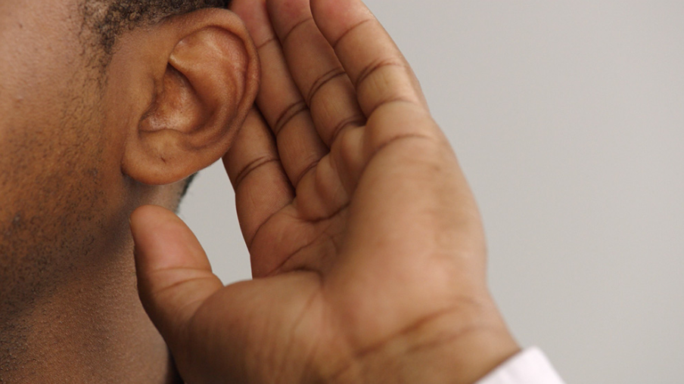
WE Listen for God’s Word

Slide 37
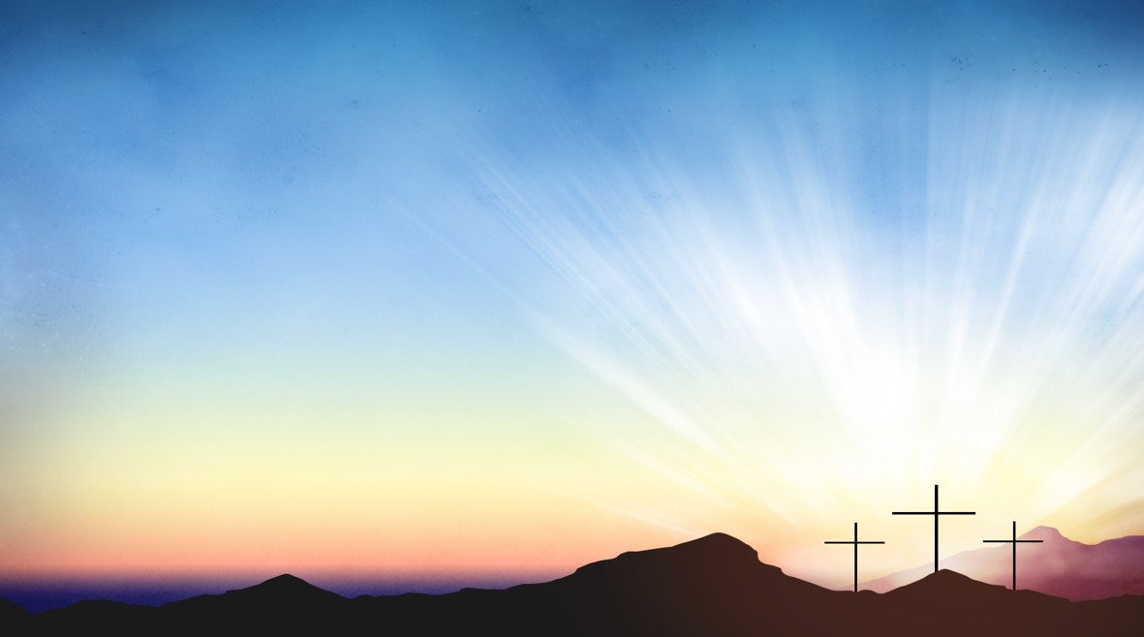
Proclamation and Response/We Listen for God’s Word
Old Testament: Isaiah 11:1-10 (ESV)
New Testament: Matthew 3:1-12 (ESV)
Leader: The Word of God for the people of God.
People: Thanks be to God.

Slide 38
Old Testament: Isaiah 11:1-10 ESV
There shall come forth a shoot from the stump of Jesse, and a branch from his roots shall bear fruit.

Slide 39
² And the Spirit of the Lord shall rest upon him, the Spirit of wisdom and understanding, the Spirit of counsel and might, the Spirit of knowledge and the fear of the Lord.

Slide 40
³ And his delight shall be in the fear of the Lord. He shall not judge by what his eyes see, or decide disputes by what his ears hear,

Slide 41
⁴ but with righteousness he shall judge the poor, and decide with equity for the meek of the earth; and he shall strike the earth with the rod of his mouth, and with the breath of his lips he shall kill the wicked.

Slide 42
⁵ Righteousness shall be the belt of his waist, and faithfulness the belt of his loins.

Slide 43
⁶ The wolf shall dwell with the lamb, and the leopard shall lie down with the young goat, and the calf and the lion and the fattened calf together; and a little child shall lead them.

Slide 44
⁷ The cow and the bear shall graze; their young shall lie down together; and the lion shall eat straw like the ox.

Slide 45
⁸ The nursing child shall play over the hole of the cobra, and the weaned child shall put his hand on the adder's den.

Slide 46
⁹ They shall not hurt or destroy in all my holy mountain; for the earth shall be full of the knowledge of the Lord as the waters cover the sea.

Slide 47
¹⁰ In that day the root of Jesse, who shall stand as a signal for the peoples—of him shall the nations inquire, and his resting place shall be glorious.

Slide 48
8:26 Then they arrived at the region
of the Gerasenes, which is opposite
Galilee.
8:27 As he stepped out on shore, a
man from the city who had demons
met him. For a long time he had not
worn any clothes, and he did not live
in a house but in the tombs.
New Testament: Matthew 3: 1-12(ESV)
John the Baptist Prepares the Way
3:1 In those days John the Baptist came preaching in the wilderness of Judea,

Slide 49
² “Repent, for the kingdom of heaven is at hand.”^{[a]}

Slide 50
³ For this is he who was spoken of by the prophet Isaiah when he said, “The voice of one crying in the wilderness:
‘Prepare^{[b]} the way of the Lord; make his paths straight.’”

Slide 51
⁴ Now John wore a garment of camel's hair and a leather belt around his waist, and his food was locusts and wild honey.

Slide 52
⁵ Then Jerusalem and all Judea and all the region about the Jordan were going out to him,

Slide 53
⁶ and they were baptized by him in the river Jordan, confessing their sins.

Slide 54
⁷ But when he saw many of the Pharisees and Sadducees coming to his baptism, he said to them, “You brood of vipers! Who warned you to flee from the wrath to come?

Slide 55
⁸ Bear fruit in keeping with repentance.
⁹ And do not presume to say to yourselves, ‘We have Abraham as our father,’ for I tell you, God is able from these stones to raise up children for Abraham.

Slide 56
¹⁰ Even now the axe is laid to the root of the trees. Every tree therefore that does not bear good fruit is cut down and thrown into the fire.

Slide 57
¹¹ “I baptize you with water for repentance, but he who is coming after me is mightier than I, whose sandals I am not worthy to carry. He will baptize you with the Holy Spirit and fire.

Slide 58
¹² His winnowing fork is in his hand, and he will clear his threshing floor and gather his wheat into the barn, but the chaff he will burn with unquenchable fire.”

Slide 59

Selection
Wesley’s Ensemble

Slide 60
-The Message by-
Rev. Doris Bright,
Pastor

Slide 61
Invitational /
Altar Call

Slide 62
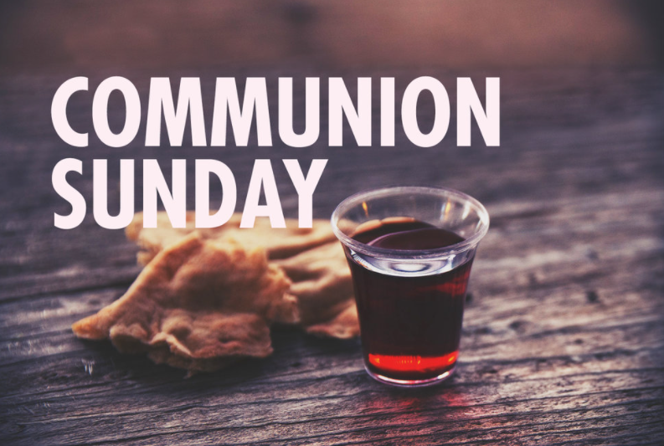

Slide 63

INVITATION
Christ our Lord invites to his table all who love him, who earnestly repent of their sin
and seek to live in peace with one another.

Slide 64
Therefore, let us confess our sin before God and one another.

Slide 65
CONFESSION AND PARDON
Merciful God,
We confess that we have not loved you with our whole heart.
We have failed to be an obedient church.

Slide 66
We have not done your will,
We have broken your law,
We have rebelled against your love,
we have not loved our neighbors,
and we have not heard the cry of the needy.

Slide 67
Forgive us, we pray.
Free us for joyful obedience,
through Jesus Christ our Lord. Amen.

Slide 68
Leader to people:
Here the good news:
Christ died for us while we were yet sinners; that proves God’s love toward us.
In the name of Jesus Christ, you are forgiven!

Slide 69
People to leader:
In the name of Jesus Christ, you are forgiven!

Slide 70
Leader to people:
Glory to God. Amen

Slide 71
TAKING THE BREAD AND CUP
THE GREAT THANKSGIVING
The Lord be with you.
And also with you.
Lift up your hearts.
We lift them up to the Lord.

Slide 72
Let us give thanks to the Lord our God.
It is right to give our thanks and praise.

Slide 73
It is right, and a good and joyful thing, always and everywhere to give thanks to you, Father Almighty, creator of heaven and earth.*

Slide 74
And so,
with your people on earth and all the company of heaven we praise your name and join their unending hymn:

Slide 75
Holy, holy, holy Lord, God of power and might, heaven and earth are full of your glory. Hosanna in the highest. Blessed is he who comes in the name of the Lord. Hosanna in the highest.

Slide 76
Holy are you, and blessed is your Son Jesus Christ.* By the baptism of his suffering, death, and resurrection you give birth to your church,

Slide 77
delivered us from slavery to sin and death, and made with us a new covenant by water and the Spirit.*

Slide 78
On the night in which he gave himself up for us he took bread, gave thanks to you, broke the bread, gave it to his disciples, and said:

Slide 79
“Take, eat; this is my body which is given for you.
Do this in remembrance of me.”

Slide 80
When the supper was over, he took the cup, gave thanks to you, gave it to his disciples, and said:

Slide 81
“Drink from this, all of you;
this is my blood of the new covenant, poured out for you and for many for the forgiveness of sins.

Slide 82
Do this, as often as your drink it, in remembrance of me.”

Slide 83
And so,
In remembrance of these your mighty acts in Jesus Christ, we offer ourselves in praise and thanksgiving as a holy and living sacrifice,

Slide 84
in union with Christ’s offering for us, as we proclaim the mystery of faith.

Slide 85
Christ has died; Christ is risen; Christ will come again.

Slide 86
Pour out your Holy Spirit on us gathered here, and on these gifts of bread and wine.

Slide 87
Make them be for us the body and blood of Christ, that we may be for the world the body of Christ, redeemed by his blood.”*

Slide 88
By your Spirit make us one with Christ, one with each other, and one in ministry to all the world, until Christ comes in final victory, and we feast at his heavenly banquet.

Slide 89
Through your Son Jesus Christ, with the Holy Spirit in your holy church, all honor and glory is yours, almighty Father, now and for ever. AMEN

Slide 90
And now, with the confidence of children of God, let us pray:
THE LORD’S PRAYER

Slide 91
BREAKING THE BREAD
GIVING THE BREAD AND CUP
The body of Christ, given for you. Amen
The blood of Christ, given for you. Amen

Slide 92
HYMN OR SONG
DISMISSAL WITH BLESSING
Go forth in peace.
The grace of the Lord Jesus Christ,
And the love of God, and the communion of the Holy Spirit be with you all. Amen

Slide 93
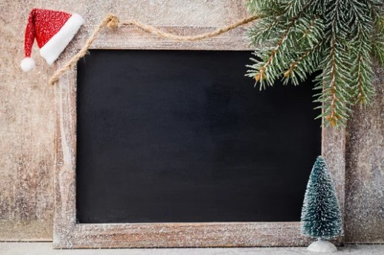
Song of Sending Forth

Slide 94
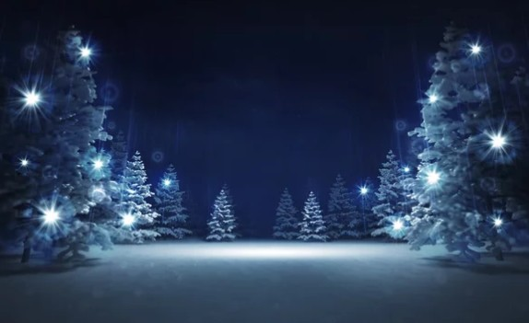
Extinguishing of the Candles

Slide 95

Benediction

