Slide 1

May 3, 2026

Slide 2
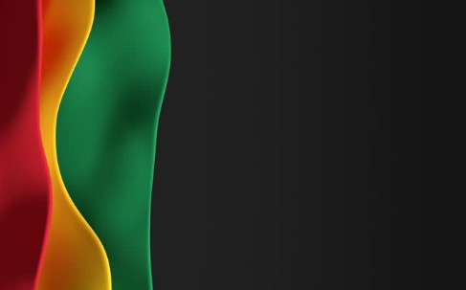
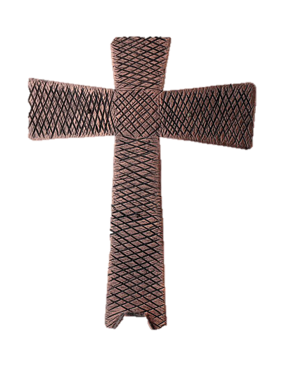
Processional

Slide 3
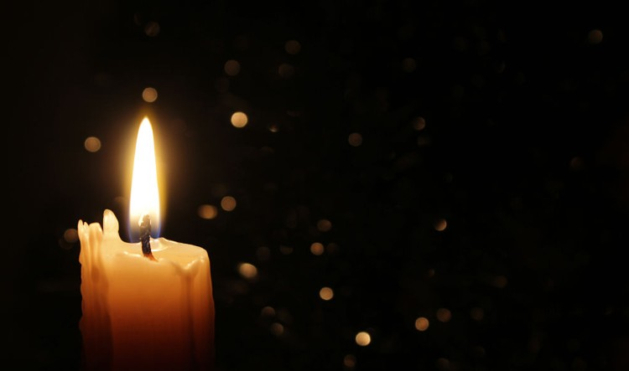
Lighting of Candles

Slide 4


Greetings

Slide 5

Call to Worship…
Leader: Easter people, in the midst of our questions and doubts, Jesus answers:
People: I am the way, the truth, and the life.

Slide 6
Leader: In the midst of our worry and distress, Jesus assures us:
People: I am the way, the truth, and the life.

Slide 7
Leader people In the midst of misinformation, confusion, and distrust, Jesus reminds us:
People: I am the way, the truth, and the life.

Slide 8
Leader: In the midst of dead ends and impossible challenges, Jesus shows us:
People: I am the way, the truth, and the life.

Slide 9
Leader: Come, let us worship as we learn to follow Christ, our way, our truth, and our life.
ALL: Come, let us worship! Thanks be to God! Amen.

Slide 10
Opening Hymn
“Nothing But The Blood”
#362 (Verses 1, 2 & 4)

Slide 11
1) What can wash away my sin?
Nothing but the blood of Jesus.
What can make me whole again?
Nothing but the blood of Jesus.

Slide 12
Refrain:
O precious is the flow
that makes me bright as snow;
no other fount I know;
nothing but the blood of Jesus.

Slide 13
2) For my pardon this I see:
nothing but the blood of Jesus.
For my cleansing this my plea:
nothing but the blood of Jesus. [Refrain]

Slide 14
Refrain:
O precious is the flow
that makes me bright as snow;
no other fount I know;
nothing but the blood of Jesus.

Slide 15
4) This is all my hope and peace:
nothing but the blood of Jesus.
This is all my righteousness:
nothing but the blood of Jesus. [Refrain]

Slide 16
Refrain:
O precious is the flow
that makes me bright as snow;
no other fount I know;
nothing but the blood of Jesus.

Slide 17


Morning Prayer
⧫
Sis. Easter LaRoche

Slide 18

Response
⧫
Wesley’s Ensemble

Slide 19

Affirmation of
#881
The Apostles’ Creed

Slide 20
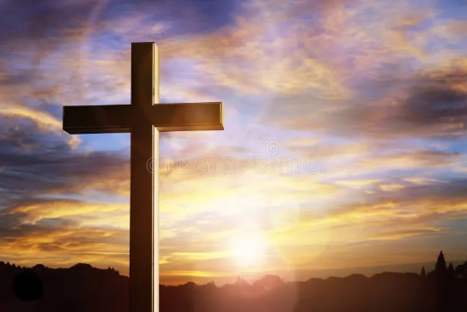
I believe in God the Father Almighty. The maker of heaven and earth;

Slide 21
and in Jesus Christ his only Son our Lord: who was conceived by the Holy Spirit, born of the Virgin Mary,

Slide 22
suffered under Pontius Pilate, was crucified, dead, and buried;

Slide 23
the third day he rose from the dead; he ascended into heaven,

Slide 24
and sitteth at the right hand of God the Father Almighty; from thence he shall come to judge the quick and the dead.

Slide 25
I believe in the Holy Spirit, the Holy catholic** church, the communion of saints, the forgiveness of sins,
**Church Universal

Slide 26
the resurrection of the body, and the life everlasting. Amen.

Slide 27
Gloria Patri, #71
Glory be to the Father, and to the Son and to the Holy Ghost,

Slide 28
as it was in the beginning, is now, and ever shall be, world with-out end.
A-men. A-men

Slide 29

Sis. Donnise Hammond

Slide 30
The Offering
(It’s Giving Time)
“Praise God, from whom all blessings flow; praise him, all creatures here below; praise him above, ye heavenly host; praise Father Son, and Holy Ghost, Amen”

Slide 31
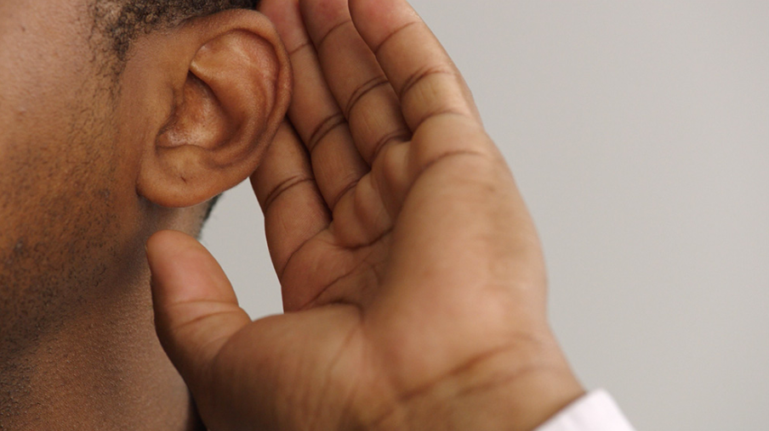
WE Listen for God’s Word

Slide 32
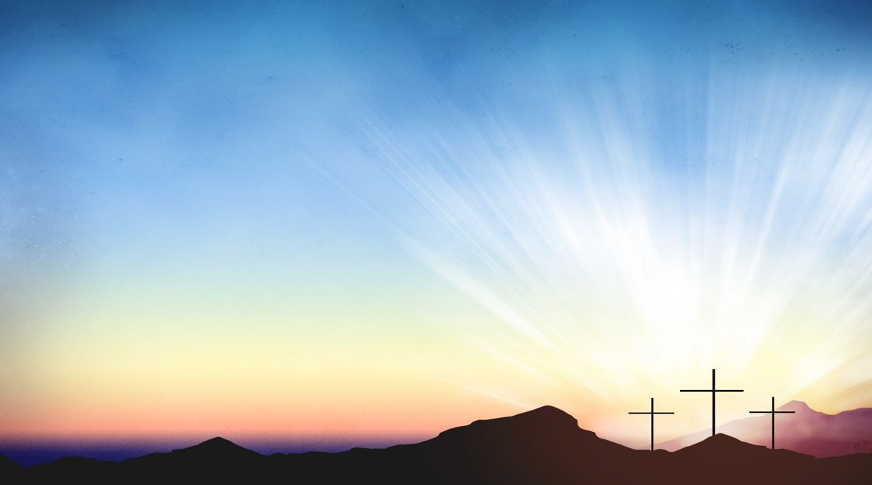
Proclamation and Response/We Listen for God’s Word
Sis. Joell Wigfall
Old Testament: Acts 7:55-60(ESV)
New Testament: John 14:1-14(ESV)

Slide 33
Old Testament: Acts 7:55-60 (ESV)
⁵⁵ But he, full of the Holy Spirit, gazed into heaven and saw the glory of God, and Jesus standing at the right hand of God.

Slide 34
⁵⁶ And he said, “Behold, I see the heavens opened, and the Son of Man standing at the right hand of God.”

Slide 35
⁵⁷ But they cried out with a loud voice and stopped their ears and rushed together at him.

Slide 36
⁵⁸ Then they cast him out of the city and stoned him. And the witnesses laid down their garments at the feet of a young man named Saul.

Slide 37
⁵⁹ And as they were stoning Stephen, he called out, “Lord Jesus, receive my spirit.”

Slide 38
⁶⁰ And falling to his knees he cried out with a loud voice, “Lord, do not hold this sin against them.” And when he had said this, he fell asleep.

Slide 39
NewTestament: John 14: 1-14 (ESV)
¹ “Let not your hearts be troubled. Believe in God; believe also in me. ² In my Father's house are many rooms. If it were not so, would I have told you that I go to prepare a place for you?

Slide 40
³ And if I go and prepare a place for you, I will come again and will take you to myself, that where I am you may be also. ⁴ And you know the way to where I am going.”

Slide 41
⁵ Thomas said to him, “Lord, we do not know where you are going. How can we know the way?”

Slide 42
⁶ Jesus said to him, “I am the way, and the truth, and the life. No one comes to the Father except through me.

Slide 43
⁷ If you had known me, you would have known my Father also. From now on you do know him and have seen him.”

Slide 44
⁸ Philip said to him, “Lord, show us the Father, and it is enough for us.”

Slide 45
⁹ Jesus said to him, “Have I been with you so long, and you still do not know me, Philip? Whoever has seen me has seen the Father. How can you say, ‘Show us the Father’?

Slide 46
¹⁰ Do you not believe that I am in the Father and the Father is in me? The words that I say to you I do not speak on my own authority, but the Father who dwells in me does his works.

Slide 47
¹¹ Believe me that I am in the Father and the Father is in me, or else believe on account of the works themselves.

Slide 48
¹² “Truly, truly, I say to you, whoever believes in me will also do the works that I do; and greater works than these will he do, because I am going to the Father.

Slide 49
¹³ Whatever you ask in my name, this I will do, that the Father may be glorified in the Son. ¹⁴ If you ask me anything in my name, I will do it.

Slide 50
SELECTION
Wesley’s Ensemble

Slide 51
The Message
Rev. Doris R. Bright, Pastor

Slide 52
Invitational / Altar Call
Wesley’s Ensemble

Slide 53
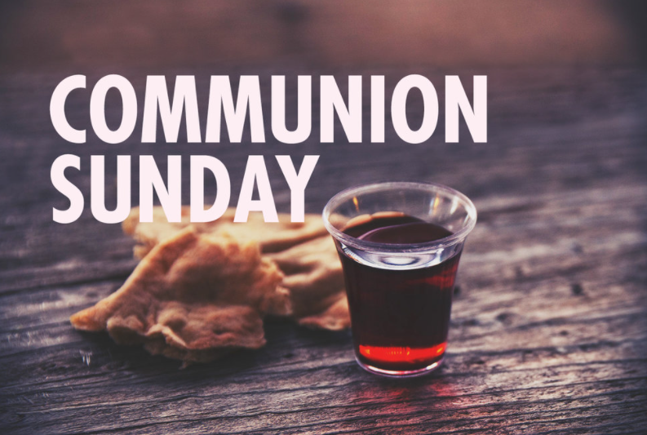

Slide 54
INVITATION
Christ our Lord invites to his table all who love him, who earnestly repent of their sin
and seek to live in peace with one another.

Slide 55
Therefore, let us confess our sin before God and one another.

Slide 56
CONFESSION AND PARDON
Merciful God,
We confess that we have not loved you with our whole heart.
We have failed to be an obedient church.

Slide 57
We have not done your will,
We have broken your law,
We have rebelled against your love,
we have not loved our neighbors,
and we have not heard the cry of the needy.

Slide 58
Forgive us, we pray.
Free us for joyful obedience,
through Jesus Christ our Lord. Amen.

Slide 59
Leader to people:
Here the good news:
Christ died for us while we were yet sinners; that proves God’s love toward us.
In the name of Jesus Christ, you are forgiven!

Slide 60
People to leader:
In the name of Jesus Christ, you are forgiven!

Slide 61
Leader to people:
Glory to God. Amen

Slide 62
TAKING THE BREAD AND CUP
THE GREAT THANKSGIVING
The Lord be with you.
And also with you.
Lift up your hearts.
We lift them up to the Lord.

Slide 63
Let us give thanks to the Lord our God.
It is right to give our thanks and praise.

Slide 64
It is right, and a good and joyful thing, always and everywhere to give thanks to you, Father Almighty, creator of heaven and earth.*

Slide 65
And so,
with your people on earth and all the company of heaven we praise your name and join their unending hymn:

Slide 66
Holy, holy, holy Lord, God of power and might, heaven and earth are full of your glory. Hosanna in the highest. Blessed is he who comes in the name of the Lord. Hosanna in the highest.

Slide 67
Holy are you, and blessed is your Son Jesus Christ.* By the baptism of his suffering, death, and resurrection you give birth to your church,

Slide 68
delivered us from slavery to sin and death, and made with us a new covenant by water and the Spirit.*

Slide 69
On the night in which he gave himself up for us he took bread, gave thanks to you, broke the bread, gave it to his disciples, and said:

Slide 70
“Take, eat; this is my body which is given for you.
Do this in remembrance of me.”

Slide 71
When the supper was over, he took the cup, gave thanks to you, gave it to his disciples, and said:

Slide 72
“Drink from this, all of you;
this is my blood of the new covenant, poured out for you and for many for the forgiveness of sins.

Slide 73
Do this, as often as your drink it, in remembrance of me.”

Slide 74
And so,
In remembrance of these your mighty acts in Jesus Christ, we offer ourselves in praise and thanksgiving as a holy and living sacrifice,

Slide 75
in union with Christ’s offering for us, as we proclaim the mystery of faith.

Slide 76
Christ has died; Christ is risen; Christ will come again.

Slide 77
Pour out your Holy Spirit on us gathered here, and on these gifts of bread and wine.

Slide 78
Make them be for us the body and blood of Christ, that we may be for the world the body of Christ, redeemed by his blood.”*

Slide 79
By your Spirit make us one with Christ, one with each other, and one in ministry to all the world, until Christ comes in final victory, and we feast at his heavenly banquet.

Slide 80
Through your Son Jesus Christ, with the Holy Spirit in your holy church, all honor and glory is yours, almighty Father, now and for ever. AMEN

Slide 81
And now, with the confidence of children of God, let us pray:
THE LORD’S PRAYER

Slide 82
BREAKING THE BREAD
GIVING THE BREAD AND CUP
The body of Christ, given for you. Amen
The blood of Christ, given for you. Amen

Slide 83
HYMN OR SONG
DISMISSAL WITH BLESSING
Go forth in peace.
The grace of the Lord Jesus Christ,
And the love of God, and the communion of the Holy Spirit be with you all. Amen

Slide 84
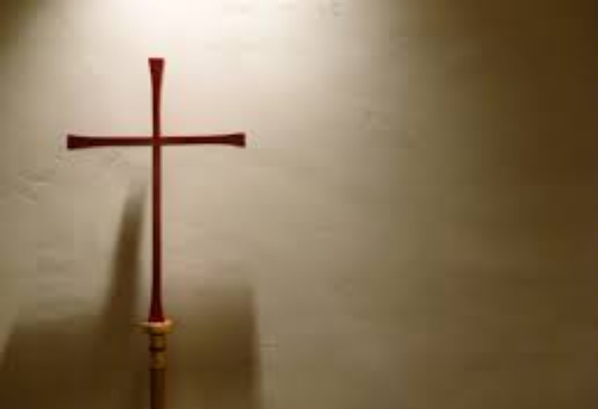
Song of Sending Forth

Slide 85

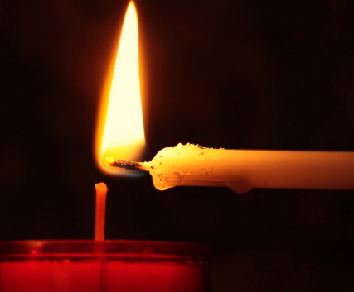
Extinguishing of the Candles

Slide 86

Reverend Doris Bright

