Slide 1


Sunday, August 10th

Slide 2
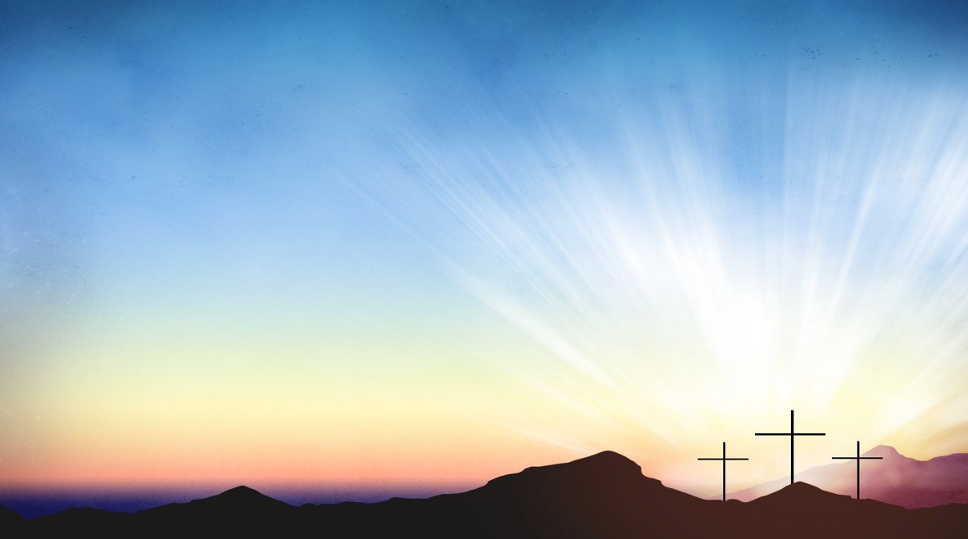
Processional

Slide 3

Lighting of Candles
Greetings

Slide 4
Call to Worship…
Leader: Beloved, we gather today as inheritors of faith in God’s salvific work, a faith handed down to us over generations that we claim and proclaim today in this community.

Slide 5
People: By faith, we follow God’s call as we journey toward a better country.

Slide 6
Leader: By faith, our grandparents, parents, aunts, uncles, neighbors, and friends shared God’s love with us, a love that longs to draw us all as members of the Body of Christ.

Slide 7
People: By faith, we follow God’s call as we journey toward a better country.

Slide 8
Leader: By faith, we remember the story today, the story of God’s desire for all creation to be reconciled to God and one another.

Slide 9
People: By faith, we follow God’s call as we journey toward a better country.

Slide 10
Leader: By faith, we carry the faith forward, building a Community of belonging, provision, and care as we journey with God toward a better country.

Slide 11
ALL: By faith, we gather to nourish and encourage one another on the journey toward a better country as we build God’s already- but-not-yet kingdom here and now. Amen

Slide 12

Opening Selection
“Come Out The Wilderness”

Slide 13
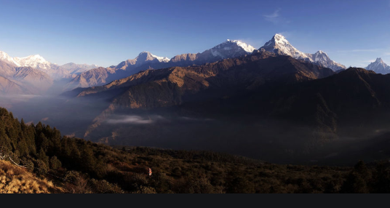
Morning Prayer

Slide 14
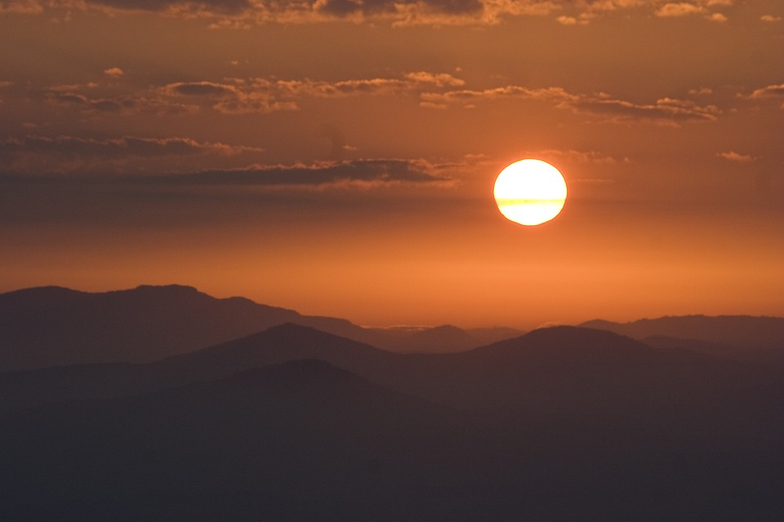
Response

Slide 15
Affirmation of
Faith
“The Apostles’ Creed”

Slide 16

I believe in God the Father Almighty. The maker of heaven and earth;

Slide 17
and in Jesus Christ his only Son our Lord: who was conceived by the Holy Spirit, born of the Virgin Mary,

Slide 18
suffered under Pontius Pilate, was crucified, dead, and buried;

Slide 19
the third day he rose from the dead; he ascended into heaven,

Slide 20
and sitteth at the right hand of God the Father Almighty; from thence he shall come to judge the quick and the dead.

Slide 21
I believe in the Holy Spirit, the Holy catholic** church, the communion of saints, the forgiveness of sins,
**Church Universal

Slide 22
the resurrection of the body, and the life everlasting. Amen.

Slide 23

Gloria Patri
Glory be to the Father, and to the Son and to the Holy Ghost,

Slide 24
as it was in the beginning, is now, and ever shall be, world with-out end.
A-men. A-men

Slide 25

The Offering
(It’s Giving Time)
“Praise God, from whom all blessings flow; praise him, all creatures here below; praise him above, ye heavenly host; praise Father Son, and Holy Ghost, Amen”

Slide 26
*The Dedication of Tithes and Offering
UMH #588
“All things come of thee, O Lord, and of thine own have we given thee.” AMEN!

Slide 27

Parish Notices/Recognition of Visitors

Slide 28
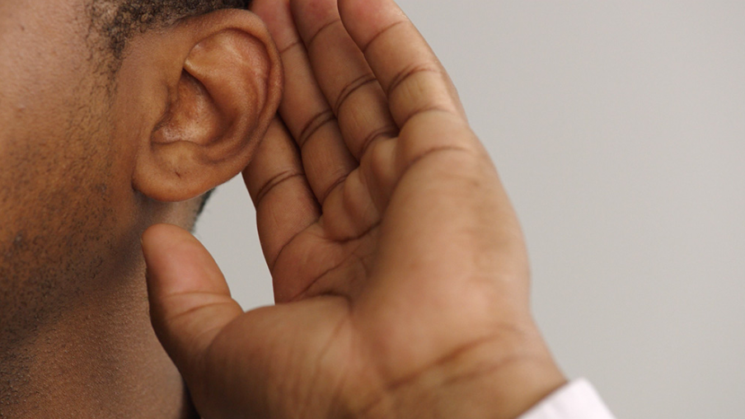
WE Listen for God’s Word

Slide 29
Proclamation and Response/We Listen for God’s Word
Old Testament: Psalm 50: 1-8, 43 (ESV)
New Testament: Luke 12: 32-40 (ESV)
Leader: The Word of God for the people of God.
People: Thanks be to God.

Slide 30
Old Testament: Psalm 50: 1-8, 22-23, ESV
50:1The mighty one, God the LORD, speaks and summons the earth from the rising of the sun to its setting.
50:2 Out of Zion, the perfection of
^{beauty, God shines forth.}

Slide 31
50:3 Our God comes and does not keep
silent; before him is a devouring fire and
a mighty tempest all around him.
50:4 He calls to the heavens above and
to the earth, that he may judge his

Slide 32
50:5 “Gather to me my faithful ones, who
made a covenant with me by sacrifice!”;
^{50:6 The heavens declare his}
righteousness, for God himself is judge. Selah

Slide 33
50:7 “Hear, O my people, and I will speak,
O Israel, I will testify against you. I am
^{God, your God.}
50:8 Not for your sacrifices do I rebuke
you; your burnt offerings are continually
^{before me.}

Slide 34
50:22Mark this, then, you who forget God, or I will tear you apart, and there will be no one to deliver.
50:23Those who bring thanksgiving as
their sacrifice honor me; to those who
go the right way, I will show the
^{salvation of God.”}

Slide 35
8:28 When he saw Jesus, he cried
out and fell down before him,
shouting, at the top of his voice,
&quot;What have you to do with me,
Jesus, Son of the Most High God? I
beg you, do not torment me,&quot;
New Testament: Luke 12: 32-40, (ESV)
12:32 “Do not be afraid, little flock, for it is
your Father’s good pleasure to give you
^{the kingdom.}
12:33 Sell your possessions and give alms.
Make purses for yourselves that do not
wear out, an unfailing treasure in
heaven, where no thief comes near and no moth destroys.

Slide 36
8:28 When he saw Jesus, he cried
out and fell down before him,
shouting, at the top of his voice,
&quot;What have you to do with me,
Jesus, Son of the Most High God? I
beg you, do not torment me,&quot;
12:34 For where your treasure is, there
^{your heart will be also.}
12:35 “Be dressed for action and have
^{your lamps lit;}

Slide 37
8:28 When he saw Jesus, he cried
out and fell down before him,
shouting, at the top of his voice,
&quot;What have you to do with me,
Jesus, Son of the Most High God? I
beg you, do not torment me,&quot;
12:36 be like those who are waiting for
their master to return from the wedding banquet, so that they may open the door for him as soon as he comes and knocks.

Slide 38
12:37 Blessed are those slaves whom the
master finds alert when he comes; truly
I tell you, he will fasten his belt and have
them sit down to eat, and he will come and serve them.

Slide 39
12:38 If he comes during the middle of the night or near dawn and finds them so, blessed are those slaves.

Slide 40
12:39 “But know this: if the owner of the
house had known at what hour the thief
was coming, he would not have let his
house be broken into.

Slide 41
12:40 You also must be ready, for the Son of Man is coming at an hour you do not expect.”

Slide 42

Selection
Wesley’s Ensemble

Slide 43
The Message by
Rev. Doris R. Bright
Pastor
“Let You Light Speak: A picture is Worth a Thousand Words – Matthew 5:16

Slide 44
Invitational /
Altar Call
Wesley’s Ensemble

Slide 45
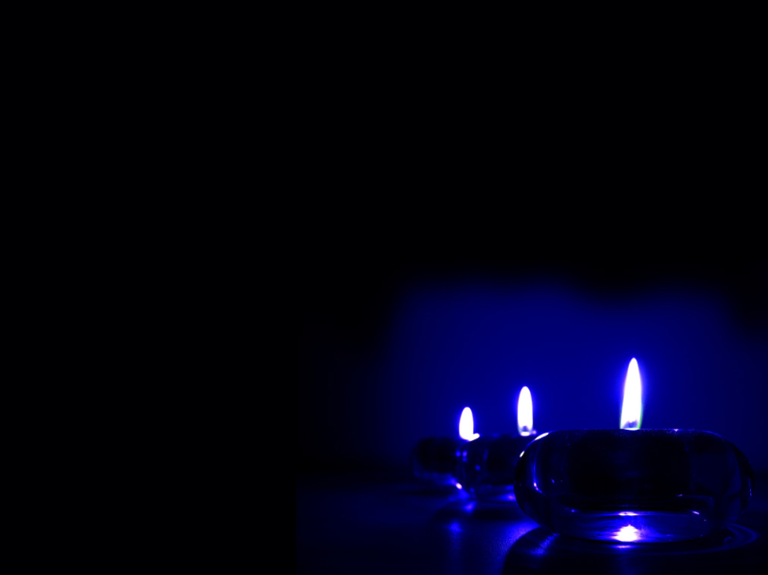
Extinguishing of the Candles

Slide 46


Song of Sending Forth

Slide 47


