Slide 1
September 24, 2023
Welcome
Family and Friends

Slide 2
Church News & Announcements

Slide 3
Processional…

Slide 4
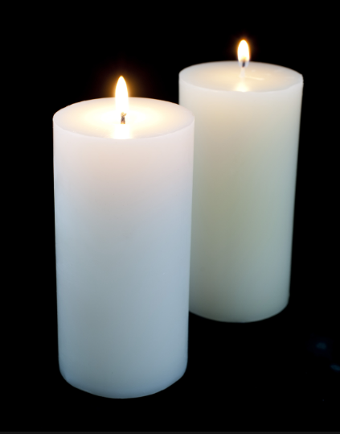
Lighting of Candles
Greetings

Slide 5
Call to Worship

Slide 6
Opening Selection

Slide 7
Morning Prayer

Slide 8
Response

Slide 9
Affirmation of Faith

Slide 10
I believe in God the Father Almighty. The maker of heaven and earth;

Slide 11
and in Jesus Christ his only Son our Lord: who was conceived by the Holy Spirit, born of the Virgin Mary,

Slide 12
suffered under Pontius Pilate, was crucified, dead, and buried;

Slide 13
the third day he rose from the dead; he ascended into heaven,

Slide 14
and sitteth at the right hand of God the Father Almighty; from thence he shall come to judge the quick and the dead.

Slide 15
I believe in the Holy Spirit, the Holy catholic** church, the communion of saints, the forgiveness of sins,
**Church Universal

Slide 16
the resurrection of the body, and the life everlasting. Amen.

Slide 17
Glory be to the Father, and to the Son and to the Holy Ghost,

Slide 18
as it was in the beginning, is now, and ever shall be, world with-out end.
A-men. A-men

Slide 19
The Offering (It’s Giving Time) (Offering Baskets will not be passed. Please leave your tithes and offerings in the back of the Sanctuary when entering or leaving.)

Slide 20
*The Dedication of Tithes and Offering UMH # 588 “All things come of thee, O Lord, and of thine own have we given thee.” AMEN!

Slide 21
WE Listen for God’s Word

Slide 22
Proclamation and Response/We Listen for God’s Word
Old Testament
New Testament
Leader: The Word of God for the people of God.
People: Thanks be to God

Slide 23
Selection

Slide 24
The Message by
Reverend Doris Bright

Slide 25
Invitational /
Altar Call

Slide 26
Extinguishing of the Candles

Slide 27
Song of
Sending Forth

Slide 28
Benediction

