Slide 1

JUNE 15, 2025

Slide 2
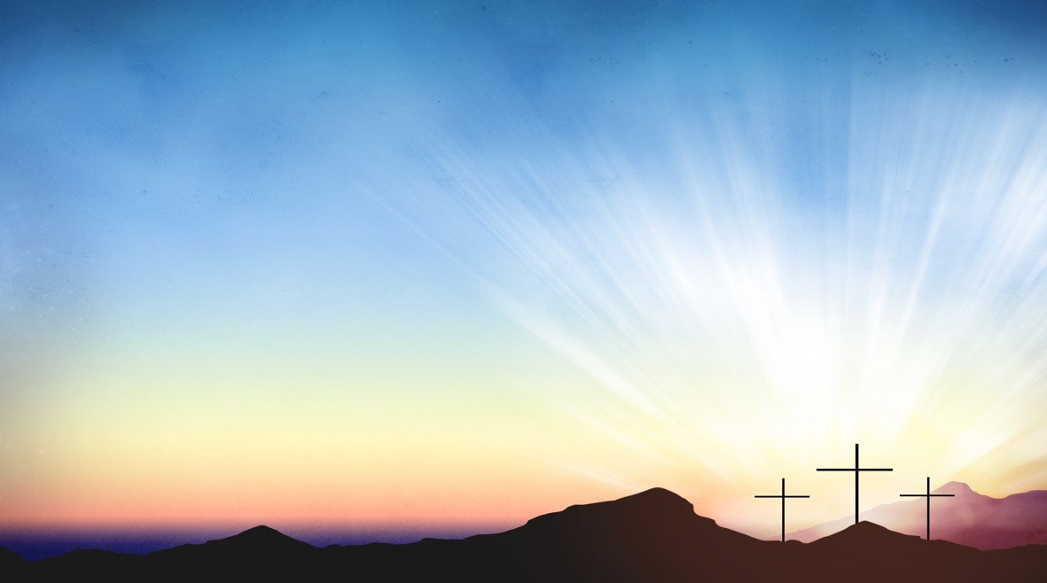
Processional

Slide 3
Lighting of Candles
Greetings

Slide 4
Call to Worship…
Leader: God, how majestic is your name! You create, and through creation, we encounter your wisdom and power.

Slide 5
People: How majestic is the name of God, our Creator!

Slide 6
Leader: You redeem, and through Jesus Christ, we encounter your saving love and grace.

Slide 7
People: How majestic is the name of God, our redeemer!

Slide 8
Leader: You sustains us, and through your Spirit, we
encounter your renewing presence.

Slide 9
People: How majestic is the name of God, our Sustainer!

Slide 10
Leader: Come, let us worship the Triune God!

Slide 11
People: We gather to worship God, Three-in-One and
One-in-Three!

Slide 12

Opening Hymn
”Victory In Jesus”
#370

Slide 13
I heard an old, old story,
How a Savior came from glory,
How He gave His life on Calvary
To save a wretch like me;
I heard about His groaning,
Of His precious blood's atoning,
Then I repented of my sins
And won the victory.

Slide 14
O victory in Jesus,
My Savior, forever.
He sought me and bought me
With His redeeming blood;
He loved me ere I knew Him
And all my love is due Him,
He plunged me to victory,
Beneath the cleansing flood.

Slide 15
I heard about His healing,
Of His cleansing pow'r revealing.
How He made the lame to walk again
And caused the blind to see;
And then I cried, "Dear Jesus,
Come and heal my broken spirit,"
And somehow Jesus came and bro't
To me the victory.

Slide 16
O victory in Jesus,
My Savior, forever.
He sought me and bought me
With His redeeming blood;
He loved me ere I knew Him
And all my love is due Him,
He plunged me to victory,
Beneath the cleansing flood.

Slide 17
I heard about a mansion
He has built for me in glory.
And I heard about the streets of gold
Beyond the crystal sea;
About the angels singing,
And the old redemption story,
And some sweet day I'll sing up there
The song of victory.

Slide 18
O victory in Jesus,
My Savior, forever.
He sought me and bought me
With His redeeming blood;
He loved me ere I knew Him
And all my love is due Him,
He plunged me to victory,
Beneath the cleansing flood.

Slide 19
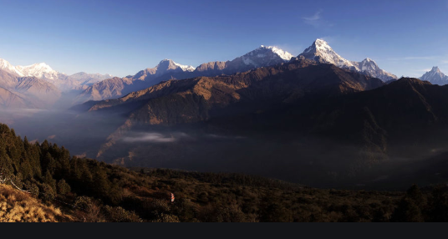
Morning Prayer

Slide 20
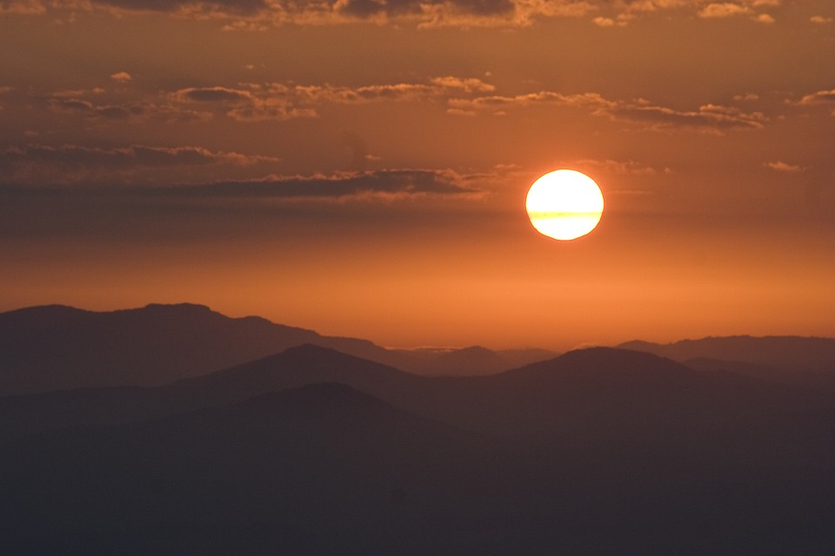
Response

Slide 21
Affirmation of
Faith
“The Apostles’ Creed”

Slide 22

I believe in God the Father Almighty. The maker of heaven and earth;

Slide 23
and in Jesus Christ his only Son our Lord: who was conceived by the Holy Spirit, born of the Virgin Mary,

Slide 24
suffered under Pontius Pilate, was crucified, dead, and buried;

Slide 25
the third day he rose from the dead; he ascended into heaven,

Slide 26
and sitteth at the right hand of God the Father Almighty; from thence he shall come to judge the quick and the dead.

Slide 27
I believe in the Holy Spirit, the Holy catholic** church, the communion of saints, the forgiveness of sins,
**Church Universal

Slide 28
the resurrection of the body, and the life everlasting. Amen.

Slide 29

Gloria Patri
Glory be to the Father, and to the Son and to the Holy Ghost,

Slide 30
as it was in the beginning, is now, and ever shall be, world with-out end.
A-men. A-men

Slide 31

The Offering
(It’s Giving Time)
“Praise God, from whom all blessings flow; praise him, all creatures here below; praise him above, ye heavenly host; praise Father Son, and Holy Ghost, Amen”

Slide 32
*The Dedication of Tithes and Offering
UMH #588
“All things come of thee, O Lord, and of thine own have we given thee.” AMEN!

Slide 33

Parish Notices/Recognition of Visitors

Slide 34
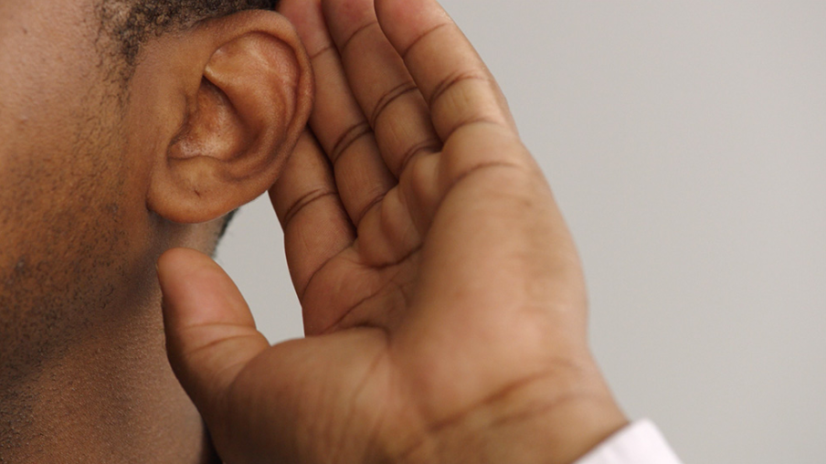
WE Listen for God’s Word

Slide 35
Proclamation and Response/We Listen for God’s Word
Old Testament: Psalm 8(ESV)
New Testament: John 16:12-15 (ESV)
Leader: The Word of God for the people of God.
People: Thanks be to God.

Slide 36
Old Testament: Psalm 8 ESV
8:1 O Lord, our Lord, how majestic is your name in all the earth! You have set your glory above the heavens.
8:2 Out of the mouth of babies and infants, you have established strength because of your foes, to still the enemy and the avenger.
8:3 When I look at your heavens, the work of your fingers, the moon and the stars, which you have set in place,

Slide 37
8:4 what is man that you are mindful of him, and the son of man that you care for him?
8:5 Yet you have made him a little lower than the heavenly beings and crowned him with glory and honor.
8:6 You have given him dominion over the works of your hands; you have put all things under his feet,

Slide 38
8:7 all sheep and oxen, and also the beasts of the field,
8:8 the birds of the heavens, and the fish of the sea, whatever passes along the paths of the seas.
8:9 O Lord, our Lord, how majestic is your name in all the earth!

Slide 39
New Testament: John 16:12-15 (ESV)
16:12 “I still have many things to say to you, but you cannot bear them now.
16:13 When the Spirit of truth comes, he will guide you into all the truth, for he will not speak on his own authority, but whatever he hears he will speak, and he will declare to you the things that are to come.

Slide 40
16:14 He will glorify me, for he will take what is mine and declare it to you.
16:15 All that the Father has is mine; therefore I said that he will take what is mine and declare it to you.

Slide 41

Selection
Wesley’s Women Choir

Slide 42
The Message by
Rev. Doris Bright, Pastor

Slide 43
Invitational /
Altar Call

Slide 44


Slide 45
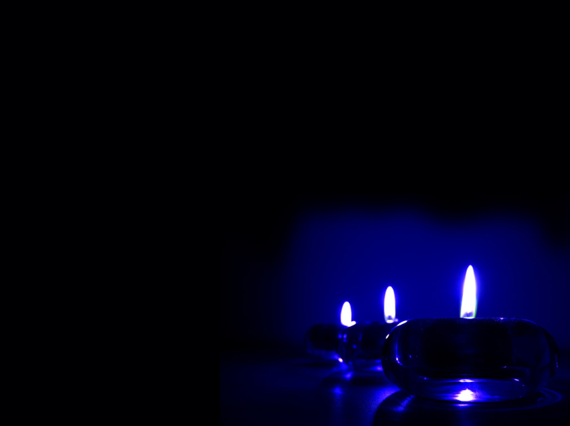
Extinguishing of the Candles

Slide 46


Song of Sending Forth

Slide 47


