Slide 1

Sunday, January 11,

Slide 2
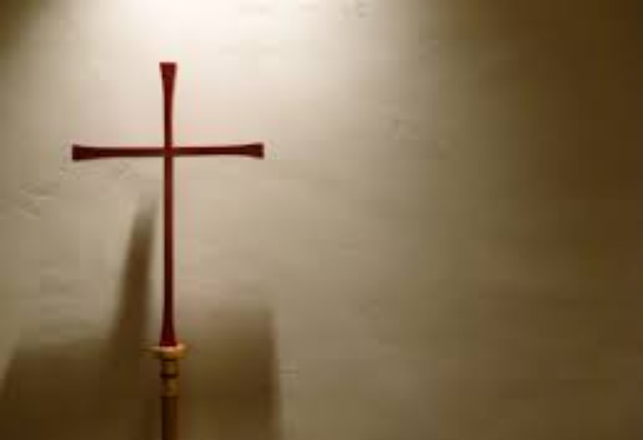
Processional

Slide 3
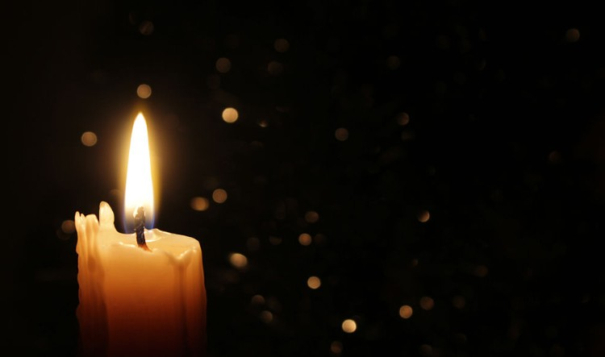
Lighting of Candles

Slide 4
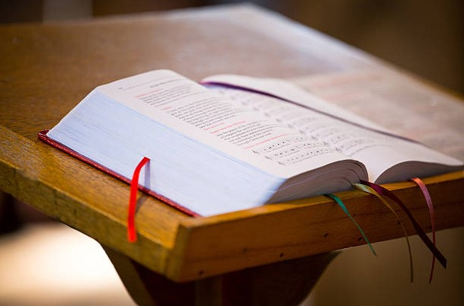
Greetings

Slide 5

Call to Worship…
Leader: Come! Let us follow Jesus to the edge of the Jordan River to be baptized.
People: We come to be cleansed and made whole.

Slide 6
Leader: Come! Let us witness John’s confusion and Jesus’ insistence that John baptize God Incarnate.
People: We come to join Jesus in choosing life in the kingdom of God.

Slide 7
Leader: Come! Let us hear God declare the truth of Jesus’ identity and the truth of our identity as baptized people.
People: We come to remember and embody who we are as beloved children of God.

Slide 8
Leader: Come! Let us worship God who leads us into the baptismal waters and salvation life.
All: We come to worship God who
empowers us through divine presence
to live together as the family of God.

Slide 9

Opening Hymn
“Leave It There”
#522 (versus 1,2,&4)

Slide 10
1. If the world from you withholds
of its silver and its gold,
And you have to get along with meagre fare,
Just remember, in his Word,
how he feeds the little bird;
Take your burden to the Lord
and leave it there.

Slide 11
Refrain:
Leave it there, leave it there.
Take your burden to the Lord and leave it there.
If you trust and never doubt,
he will surely bring you out;
Take your burden to the Lord
and leave it there.

Slide 12
2. If your body suffers pain
and your health you can't regain,
And your soul is almost sinking in despair,
Jesus knows the pain you feel;
he can save and he can heal;
Take your burden to the Lord
and leave it there.

Slide 13
Refrain:
Leave it there, leave it there.
Take your burden to the Lord and leave it there.
If you trust and never doubt,
he will surely bring you out;
Take your burden to the Lord
and leave it there.

Slide 14
4. When your youthful days are gone,
and old age is stealing on,
And your body bends beneath the weight of care,
He will never leave you then;
He'll go with you to the end;
Take your burden to the Lord
and leave it there.

Slide 15
Refrain:
Leave it there, leave it there.
Take your burden to the Lord and leave it there.
If you trust and never doubt,
he will surely bring you out;
Take your burden to the Lord
and leave it there.

Slide 16
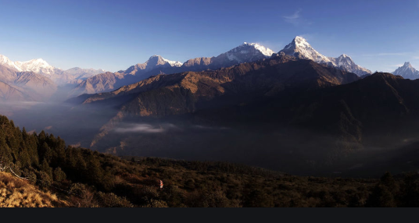
Morning Prayer

Slide 17
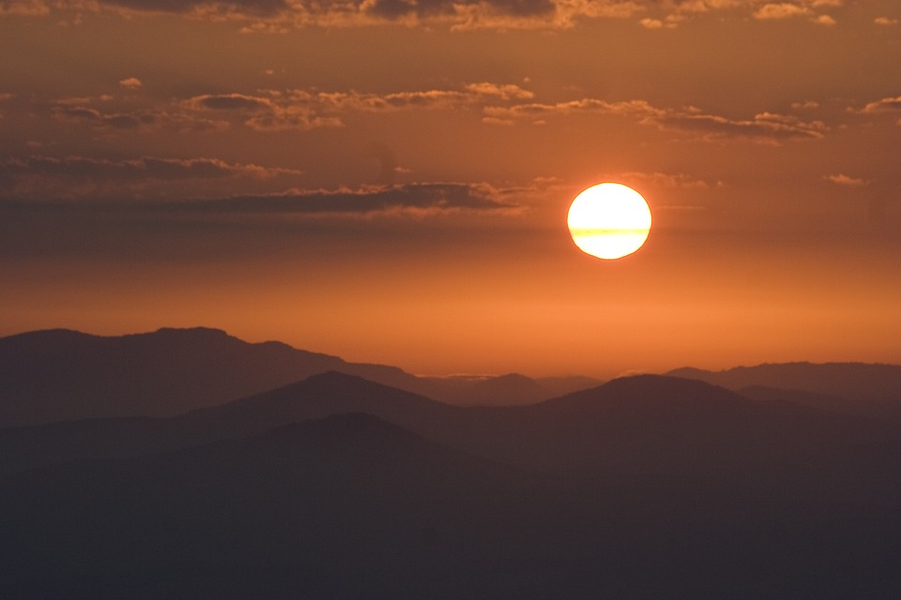
Response

Slide 18

Affirmation of
The Apostles’ Creed

Slide 19

I believe in God the Father Almighty. The maker of heaven and earth;

Slide 20
and in Jesus Christ his only Son our Lord: who was conceived by the Holy Spirit, born of the Virgin Mary,

Slide 21
suffered under Pontius Pilate, was crucified, dead, and buried;

Slide 22
the third day he rose from the dead; he ascended into heaven,

Slide 23
and sitteth at the right hand of God the Father Almighty; from thence he shall come to judge the quick and the dead.

Slide 24
I believe in the Holy Spirit, the Holy catholic** church, the communion of saints, the forgiveness of sins,
**Church Universal

Slide 25
the resurrection of the body, and the life everlasting. Amen.

Slide 26

Gloria Patri
Glory be to the Father, and to the Son and to the Holy Ghost,

Slide 27
as it was in the beginning, is now, and ever shall be, world with-out end.
A-men. A-men

Slide 28

Dismissal of Youth/Children

Slide 29

The Offering
(It’s Giving Time)
“Praise God, from whom all blessings flow; praise him, all creatures here below; praise him above, ye heavenly host; praise Father Son, and Holy Ghost, Amen”

Slide 30
*The Dedication of Tithes and Offering
UMH #588
“All things come of thee, O Lord, and of thine own have we given thee.” AMEN!

Slide 31

Parish Notices/Recognition of Visitors

Slide 32
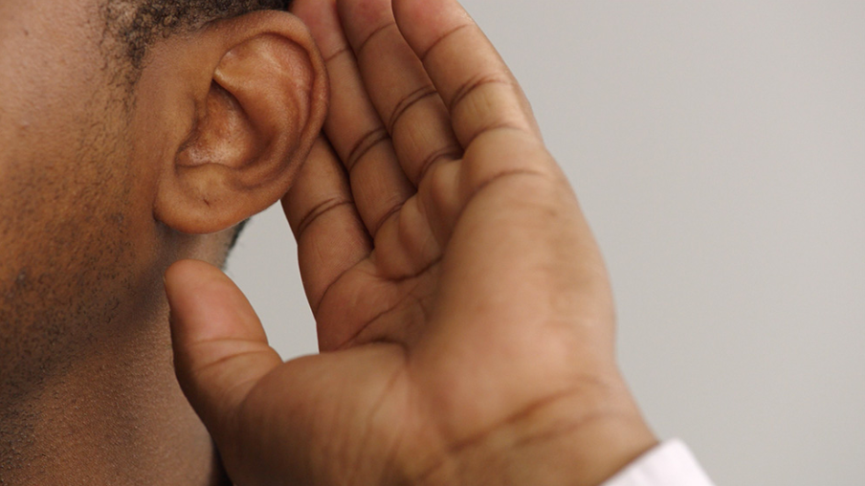
WE Listen for God’s Word

Slide 33
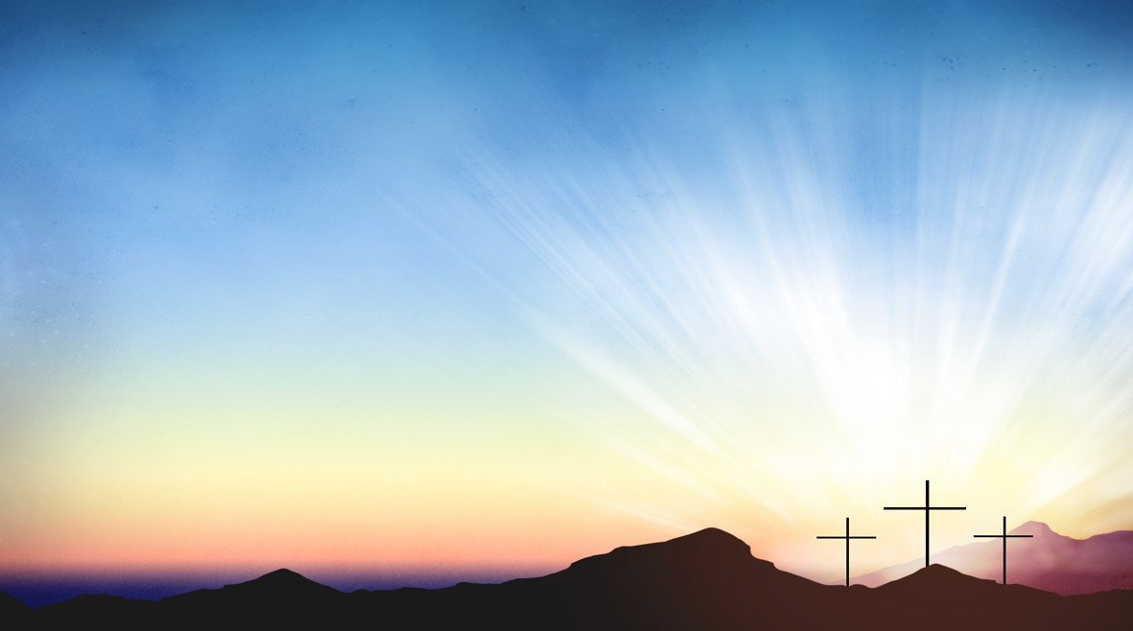
Proclamation and Response/We Listen for God’s Word
Old Testament: Psalm 29 (ESV)
New Testament: Matthew 3:13-17 (ESV)

Slide 34
Old Testament: Psalm 29 (ESV)
29:1 Ascribe to the LORD, O heavenly
beings, ascribe to the LORD glory and
strength.
29:2 Ascribe to the LORD the glory of his
name; worship the LORD in holy splendor.

Slide 35
29:3 The voice of the LORD is over the waters; the God of glory thunders, the LORD, over mighty waters.
29:4 The voice of the LORD is powerful; the
voice of the LORD is full of majesty.

Slide 36
29:5 The voice of the LORD breaks the cedars; the LORD breaks the cedars of Lebanon.
29:6 He makes Lebanon skip like a calf and Sirion like a young wild ox.

Slide 37
29:7 The voice of the LORD flashes forth flames of fire.
29:8 The voice of the LORD shakes the wilderness; the LORD shakes the wilderness of Kadesh.

Slide 38
29:9 The voice of the LORD causes the oaks to whirl and strips the forest bare, and in his temple all say, “Glory!”

Slide 39
29:10 The LORD sits enthroned over the flood; the LORD sits enthroned as king forever.
29:11 May the LORD give strength to his people! May the LORD bless his people with peace!

Slide 40
New Testament: Matthew 3:13-17
3:13 Then Jesus came from Galilee to John at the Jordan, to be baptized by him.
3:14 John would have prevented him, saying, “I need to be baptized by you, and do you come to me?”

Slide 41
3:15 But Jesus answered him, “Let it be so now, for it is proper for us in this way to fulfil all righteousness.” Then he consented.

Slide 42
3:16 And when Jesus had been baptized, just as he came up from the water, suddenly the heavens were opened to him and he saw God’s Spirit descending like a dove and alighting on him.

Slide 43
3:17 And a voice from the heavens said, “This is my Son, the Beloved, with whom I
am well pleased.”
Leader: The Word of God for the people of God.
People: Thanks be to God.

Slide 44

Selection
Wesley’s Ensemble

Slide 45

The Message
by
Rev. Doris Bright,
Pastor

Slide 46
Invitational /
Altar Call

Slide 47
Song of Sending Forth

Slide 48
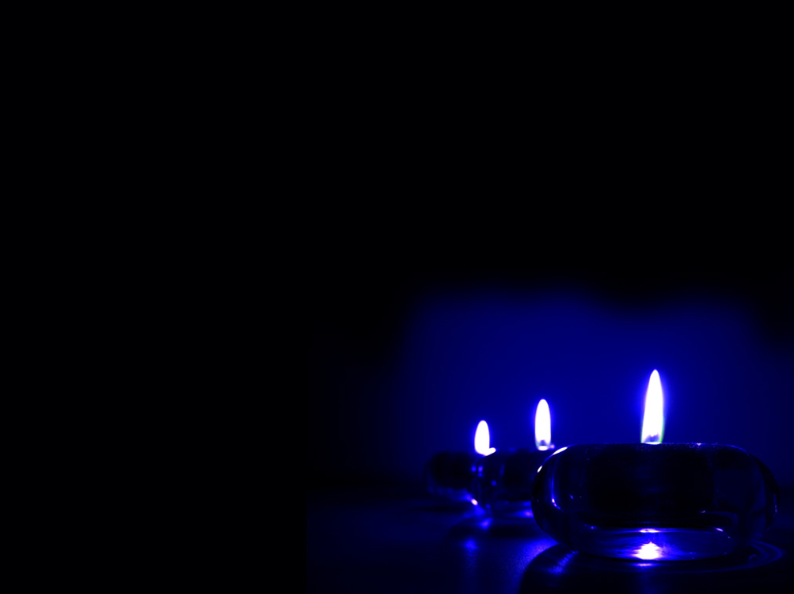
Extinguishing of the Candles

Slide 49


