Slide 1


Slide 2
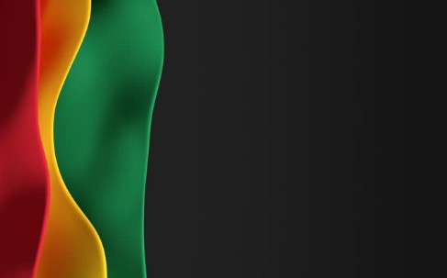
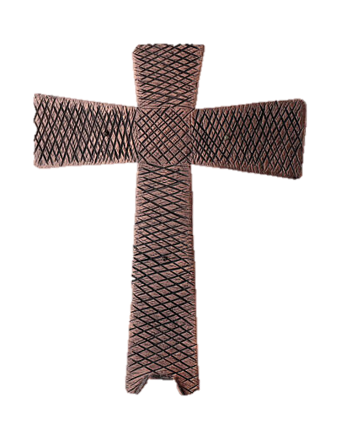
Processional

Slide 3
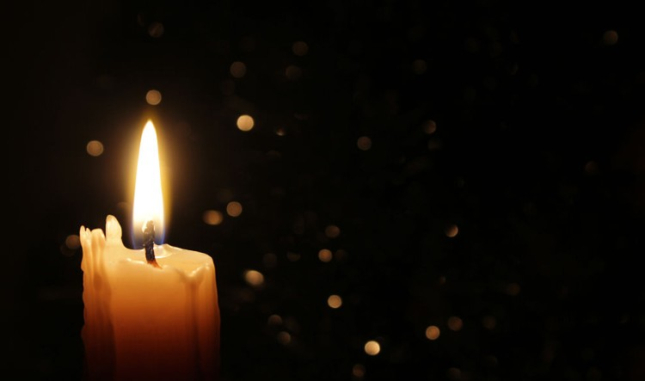
Lighting of Candles

Slide 4


Greetings

Slide 5
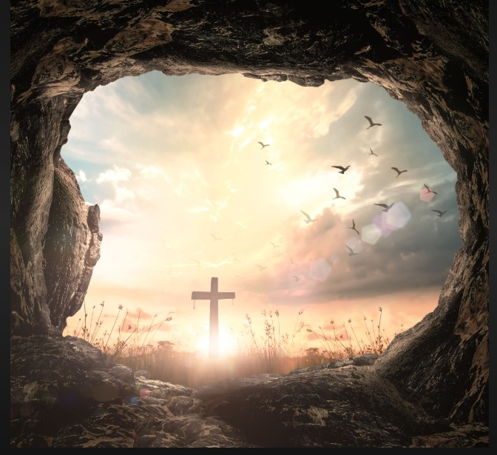
Call to Worship…
Leader: Some of us come to worship today, weary and worn, heavy with all the circumstances that are too much to bear alone.

Slide 6
People: We gather to travel God’s redemption road together.

Slide 7
Leader: Some of us come to worship today, dry and thirsty,
longing for relief and peace from the troubles that surround us.

Slide 8
People: We gather to travel God’s redemption road together.

Slide 9
Leader: Some of us come to worship today with stories to tell of little resurrections, moments of new life that sprang up when we least expected them.

Slide 10
People: We gather to travel God’s redemption road together.

Slide 11
Leader: Beloved, whatever we bring with us to worship
today, God welcomes us and calls us to work together as we travel God’s redemption road together.

Slide 12
ALL: We gather to be truth-tellers and life-bringers as we travel God’s redemption road together. Amen.

Slide 13
Opening Hymn
“O How I Love Jesus”
#170

Slide 14
1. There is a name I love to hear,
I love to sing its worth;
it sounds like music in my ear,
the sweetest name on earth.

Slide 15
Refrain:
O how I love Jesus,
O how I love Jesus,
O how I love Jesus,
because he first loved me!

Slide 16
2. It tells me of a Savior's love,
who died to set me free;
it tells me of his precious blood,
the sinner's perfect plea. [Refrain]

Slide 17
Refrain:
O how I love Jesus,
O how I love Jesus,
O how I love Jesus,
because he first loved me!

Slide 18
3. It tells of one whose loving heart
can feel my deepest woe;
who in each sorrow bears a part
that none can bear below. [Refrain]

Slide 19
Refrain:
O how I love Jesus,
O how I love Jesus,
O how I love Jesus,
because he first loved me!

Slide 20


Morning Prayer
⧫
Bro. Jason Legare, Sr.

Slide 21

Response
⧫
Wesley’s
Male Ensemble

Slide 22

Affirmation of
#881
The Apostles’ Creed

Slide 23
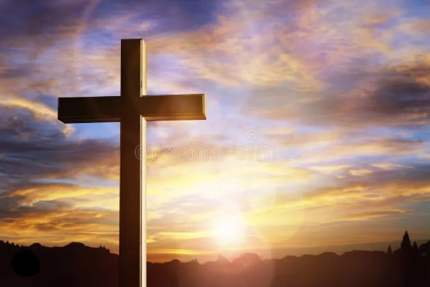
I believe in God the Father Almighty. The maker of heaven and earth;

Slide 24
and in Jesus Christ his only Son our Lord: who was conceived by the Holy Spirit, born of the Virgin Mary,

Slide 25
suffered under Pontius Pilate, was crucified, dead, and buried;

Slide 26
the third day he rose from the dead; he ascended into heaven,

Slide 27
and sitteth at the right hand of God the Father Almighty; from thence he shall come to judge the quick and the dead.

Slide 28
I believe in the Holy Spirit, the Holy catholic** church, the communion of saints, the forgiveness of sins,
**Church Universal

Slide 29
the resurrection of the body, and the life everlasting. Amen.

Slide 30
Gloria Patri, #71
Glory be to the Father, and to the Son and to the Holy Ghost,

Slide 31
as it was in the beginning, is now, and ever shall be, world with-out end.
A-men. A-men

Slide 32

NOTICES

Slide 33

Welcome Visitors

Slide 34
The Offering
(It’s Giving Time)
“Praise God, from whom all blessings flow; praise him, all creatures here below; praise him above, ye heavenly host; praise Father Son, and Holy Ghost, Amen”

Slide 35
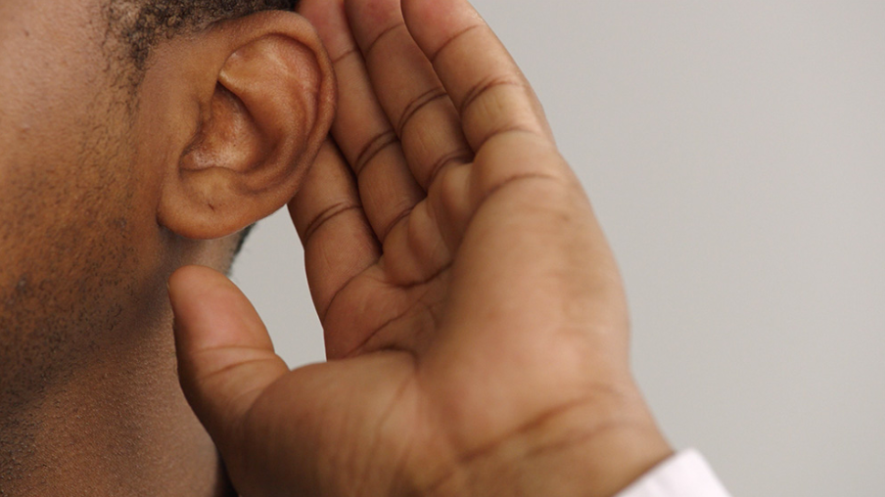
WE Listen for God’s Word

Slide 36
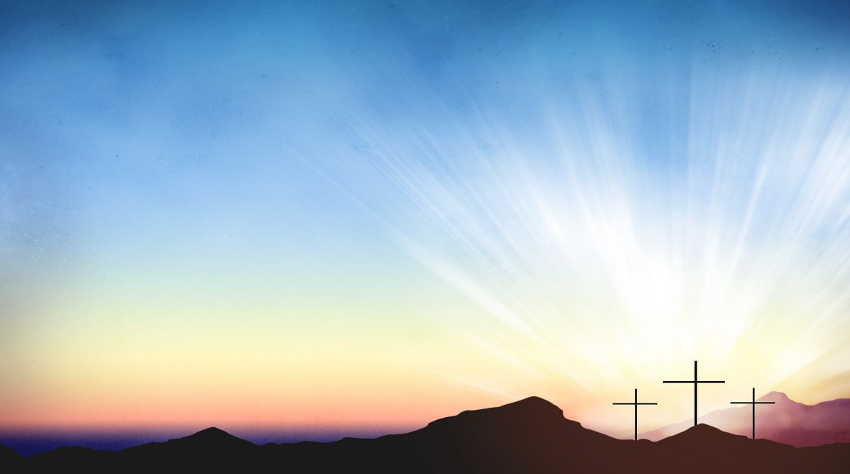
Proclamation and Response/We Listen for God’s Word
Bro. Xavion Legare
Old Testament: Psalm 130 (ESV)
New Testament: Roman 8:6-11(ESV)

Slide 37
Old Testament: Psalm 130 (ESV)
¹ Out of the depths I cry to you, O Lord!
² O Lord, hear my voice!
Let your ears be attentive
to the voice of my pleas for mercy!

Slide 38
³ If you, O Lord, should mark iniquities, O Lord, who could stand?
⁴ But with you there is forgiveness, that you may be feared.

Slide 39
⁵ I wait for the Lord, my soul waits, and in his word I hope;
⁶ my soul waits for the Lord more than watchmen for the morning, more than watchmen for the morning.

Slide 40
⁷ O Israel, hope in the Lord! For with the Lord there is steadfast love, and with him is plentiful redemption.
⁸ And he will redeem Israel from all his iniquities.

Slide 41
New Testament: Romans 8: 6-11(ESV)
⁶ For to set the mind on the flesh is death, but to set the mind on the Spirit is life and peace. ⁷ For the mind that is set on the flesh is hostile to God, for it does not submit to God's law; indeed, it cannot.

Slide 42
⁸ Those who are in the flesh cannot please God.
⁹ You, however, are not in the flesh but in the Spirit, if in fact the Spirit of God dwells in you. Anyone who does not have the Spirit of Christ does not belong to him.

Slide 43
¹⁰ But if Christ is in you, although the body is dead because of sin, the Spirit is life because of righteousness. ¹¹ If the Spirit of him who raised Jesus from the dead dwells in you, he who raised Christ Jesus from the dead will also give life to your mortal bodies through his Spirit who dwells in you.

Slide 44
SELECTION
Wesley’s
Male Ensemble

Slide 45
The Message
Rev. Doris R. Bright, Pastor

Slide 46
Invitational / Altar Call
Wesley’s Male Ensemble

Slide 47
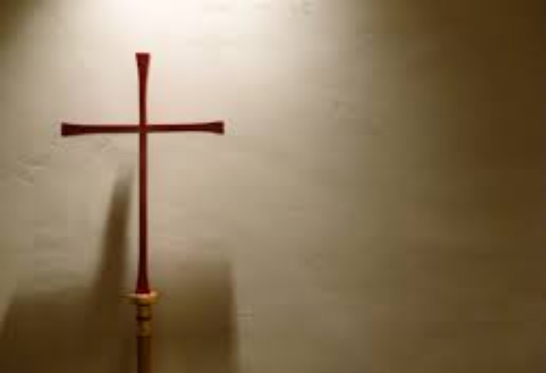
Song of Sending Forth

Slide 48

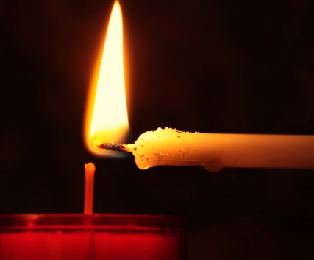
Extinguishing of the Candles

Slide 49

Reverend Doris Bright

