Slide 1

Sunday, February 8,

Slide 2
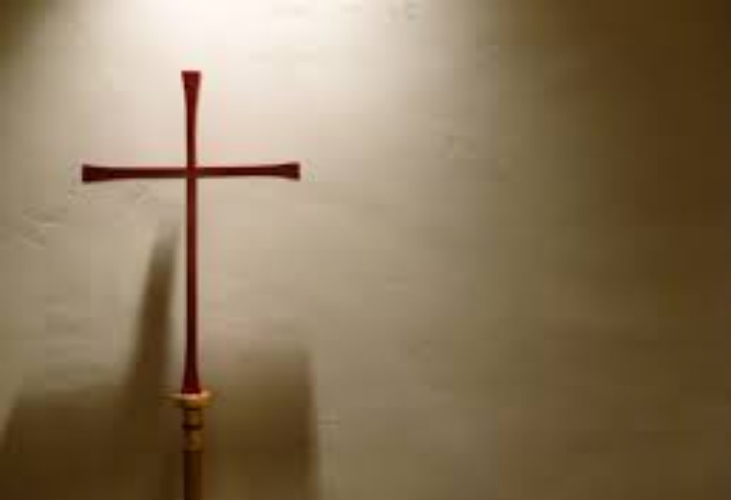
Processional

Slide 3
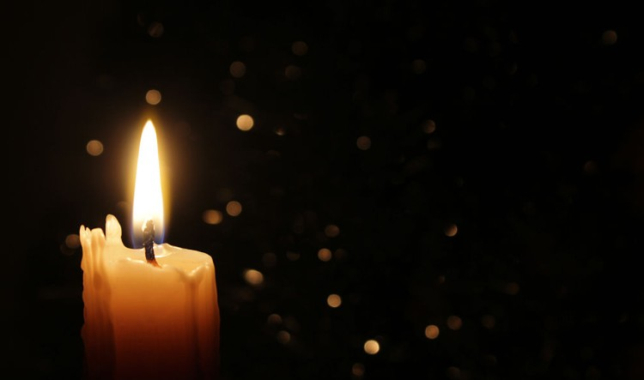
Lighting of Candles
Greetings

Slide 4
Call to Worship…
Leader: People of God, why are you here?

Slide 5
People: We gather to worship with our hearts and our lives.

Slide 6
Leader: People of God, who do you worship?

Slide 7
People: We worship God, who loves us and teaches us to love.

Slide 8
Leader: People of God, how do you worship?

Slide 9
People: We worship God by breaking the bods of injustice and freeing the oppressed.

Slide 10
Leader: People of God, come, let us worship God, whose glory surrounds us!

Slide 11
ALL: May our worship demonstrate God’s glory in our neighborhood, community, and the whole earth.

Slide 12

Opening Hymn
“We Are Climbing Jacob’s Ladder” #418
(Vs, 1, 2, & 5)

Slide 13
1 We are climbing Jacob’s ladder; we are climbing Jacob’s ladder, we are climbing Jacob’s ladder; soldiers of the cross.

Slide 14
2 Every round goes higher, higher; every round goes higher, higher, every round goes higher, higher; soldiers of the cross.

Slide 15
5 We are climbing higher, higher;
we are climbing higher, higher,
we are climbing higher, higher;
soldiers of the cross.

Slide 16
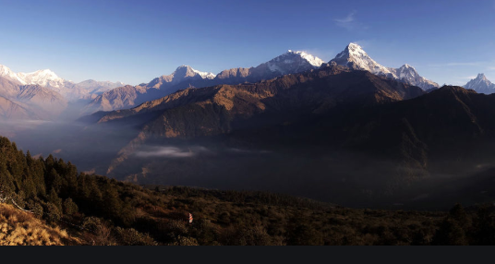
Morning Prayer

Slide 17
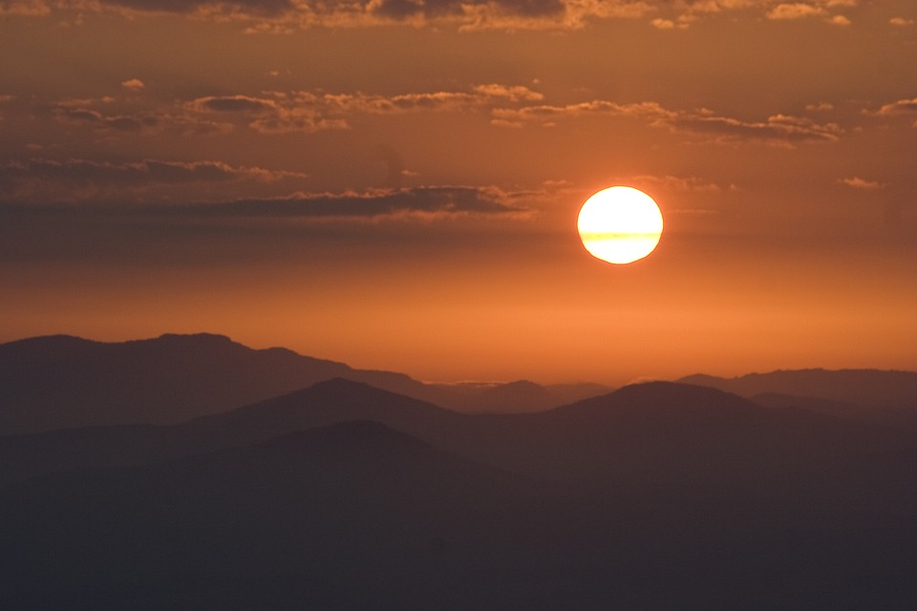
Response

Slide 18
Affirmation of
Faith
“The Apostles’ Creed”

Slide 19

I believe in God the Father Almighty. The maker of heaven and earth;

Slide 20
and in Jesus Christ his only Son our Lord: who was conceived by the Holy Spirit, born of the Virgin Mary,

Slide 21
suffered under Pontius Pilate, was crucified, dead, and buried;

Slide 22
the third day he rose from the dead; he ascended into heaven,

Slide 23
and sitteth at the right hand of God the Father Almighty; from thence he shall come to judge the quick and the dead.

Slide 24
I believe in the Holy Spirit, the Holy catholic** church, the communion of saints, the forgiveness of sins,
**Church Universal

Slide 25
the resurrection of the body, and the life everlasting. Amen.

Slide 26

Gloria Patri
Glory be to the Father, and to the Son and to the Holy Ghost,

Slide 27
as it was in the beginning, is now, and ever shall be, world with-out end.
A-men. A-men

Slide 28

The Offering
(It’s Giving Time)
“Praise God, from whom all blessings flow; praise him, all creatures here below; praise him above, ye heavenly host; praise Father Son, and Holy Ghost, Amen”

Slide 29
*The Dedication of Tithes and Offering
UMH #588
“All things come of thee, O Lord, and of thine own have we given thee.” AMEN!

Slide 30

Parish Notices/Recognition of Visitors

Slide 31
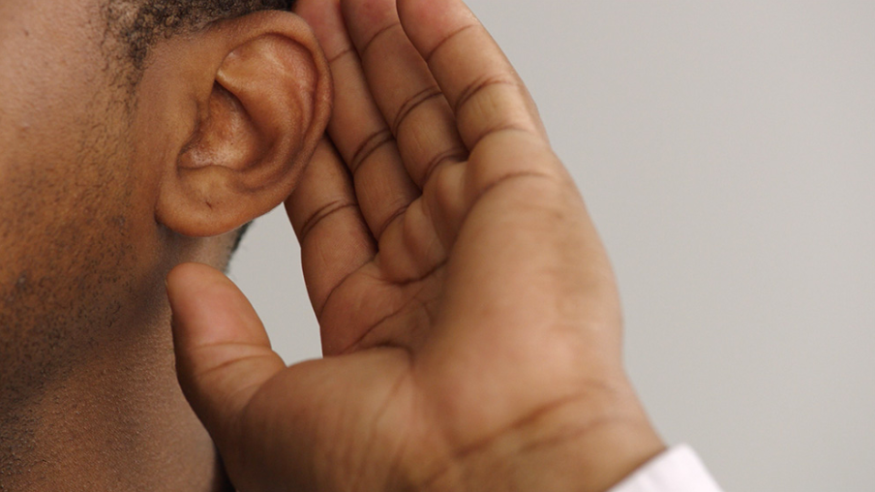
WE Listen for God’s Word

Slide 32
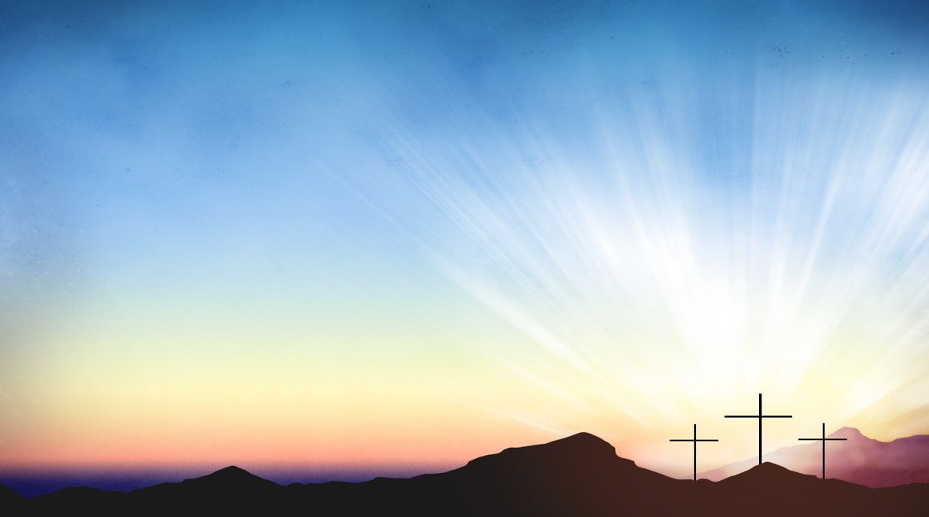
Proclamation and Response/We Listen for God’s Word
Old Testament: Psalm 112:1-10 (ESV)
New Testament: Matthew 5:13-20 (ESV)
Leader: The Word of God for the people of God.
People: Thanks be to God.

Slide 33
Old Testament: Psalm 112:1-10 (ESV)
¹ Praise the Lord!
Blessed is the man who fears the Lord,
who greatly delights in his commandments!
² His offspring will be mighty in the land; the generation of the upright will be blessed.

Slide 34
³ Wealth and riches are in his house, and his righteousness endures forever.
⁴ Light dawns in the darkness for the upright; he is gracious, merciful, and righteous.

Slide 35
⁵ It is well with the man who deals generously and lends; who conducts his affairs with justice.

Slide 36
⁶ For the righteous will never be moved; he will be remembered forever.
⁷ He is not afraid of bad news; his heart is firm, trusting in the Lord.

Slide 37
⁸ His heart is steady; he will not be afraid, until he looks in triumph on his adversaries.
⁹ He has distributed freely; he has given to the poor; his righteousness endures forever; his horn is exalted in honor.

Slide 38
¹⁰ The wicked man sees it and is angry; he gnashes his teeth and melts away; the desire of the wicked will perish!

Slide 39
New Testament: Matthew 5:13-20 (ESV)
¹³ “You are the salt of the earth, but if salt has lost its taste, how shall its saltiness be restored? It is no longer good for anything except to be thrown out and trampled under people's feet.

Slide 40
¹⁴ “You are the light of the world. A city set on a hill cannot be hidden.
¹⁵ Nor do people light a lamp and put it under a basket, but on a stand, and it gives light to all in the house.

Slide 41
¹⁶ In the same way, let your light shine before others, so that they may see your good works and give glory to your Father who is in heaven.

Slide 42
¹⁷ “Do not think that I have come to abolish the Law or the Prophets; I have not come to abolish them but to fulfill them.

Slide 43
¹⁸ For truly, I say to you, until heaven and earth pass away, not an iota, not a dot, will pass from the Law until all is accomplished.

Slide 44
¹⁹ Therefore whoever relaxes one of the least of these commandments and teaches others to do the same will be called least in the kingdom of heaven, but whoever does them and teaches them will be called great in the kingdom of heaven.

Slide 45
²⁰ For I tell you, unless your righteousness exceeds that of the scribes and Pharisees, you will never enter the kingdom of heaven.

Slide 46

Selection
Wesley’s Ensemble

Slide 47

The Message by
Rev. Doris Bright, Pastor

Slide 48
Invitational /
Altar Call

Slide 49
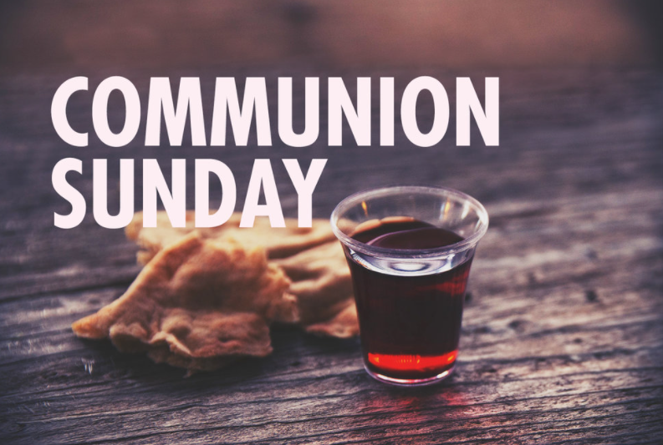

Slide 50
INVITATION
Christ our Lord invites to his table all who love him, who earnestly repent of their sin
and seek to live in peace with one another.

Slide 51
Therefore, let us confess our sin before God and one another.

Slide 52
CONFESSION AND PARDON
Merciful God,
We confess that we have not loved you with our whole heart.
We have failed to be an obedient church.

Slide 53
We have not done your will,
We have broken your law,
We have rebelled against your love,
we have not loved our neighbors,
and we have not heard the cry of the needy.

Slide 54
Forgive us, we pray.
Free us for joyful obedience,
through Jesus Christ our Lord. Amen.

Slide 55
Leader to people:
Here the good news:
Christ died for us while we were yet sinners; that proves God’s love toward us.
In the name of Jesus Christ, you are forgiven!

Slide 56
People to leader:
In the name of Jesus Christ, you are forgiven!

Slide 57
Leader to people:
Glory to God. Amen

Slide 58
TAKING THE BREAD AND CUP
THE GREAT THANKSGIVING
The Lord be with you.
And also with you.
Lift up your hearts.
We lift them up to the Lord.

Slide 59
Let us give thanks to the Lord our God.
It is right to give our thanks and praise.

Slide 60
It is right, and a good and joyful thing, always and everywhere to give thanks to you, Father Almighty, creator of heaven and earth.*

Slide 61
And so,
with your people on earth and all the company of heaven we praise your name and join their unending hymn:

Slide 62
Holy, holy, holy Lord, God of power and might, heaven and earth are full of your glory. Hosanna in the highest. Blessed is he who comes in the name of the Lord. Hosanna in the highest.

Slide 63
Holy are you, and blessed is your Son Jesus Christ.* By the baptism of his suffering, death, and resurrection you give birth to your church,

Slide 64
delivered us from slavery to sin and death, and made with us a new covenant by water and the Spirit.*

Slide 65
On the night in which he gave himself up for us he took bread, gave thanks to you, broke the bread, gave it to his disciples, and said:

Slide 66
“Take, eat; this is my body which is given for you.
Do this in remembrance of me.”

Slide 67
When the supper was over, he took the cup, gave thanks to you, gave it to his disciples, and said:

Slide 68
“Drink from this, all of you;
this is my blood of the new covenant, poured out for you and for many for the forgiveness of sins.

Slide 69
Do this, as often as your drink it, in remembrance of me.”

Slide 70
And so,
In remembrance of these your mighty acts in Jesus Christ, we offer ourselves in praise and thanksgiving as a holy and living sacrifice,

Slide 71
in union with Christ’s offering for us, as we proclaim the mystery of faith.

Slide 72
Christ has died; Christ is risen; Christ will come again.

Slide 73
Pour out your Holy Spirit on us gathered here, and on these gifts of bread and wine.

Slide 74
Make them be for us the body and blood of Christ, that we may be for the world the body of Christ, redeemed by his blood.”*

Slide 75
By your Spirit make us one with Christ, one with each other, and one in ministry to all the world, until Christ comes in final victory, and we feast at his heavenly banquet.

Slide 76
Through your Son Jesus Christ, with the Holy Spirit in your holy church, all honor and glory is yours, almighty Father, now and for ever. AMEN

Slide 77
And now, with the confidence of children of God, let us pray:
THE LORD’S PRAYER

Slide 78
BREAKING THE BREAD
GIVING THE BREAD AND CUP
The body of Christ, given for you. Amen
The blood of Christ, given for you. Amen

Slide 79
HYMN OR SONG
DISMISSAL WITH BLESSING
Go forth in peace.
The grace of the Lord Jesus Christ,
And the love of God, and the communion of the Holy Spirit be with you all. Amen

Slide 80
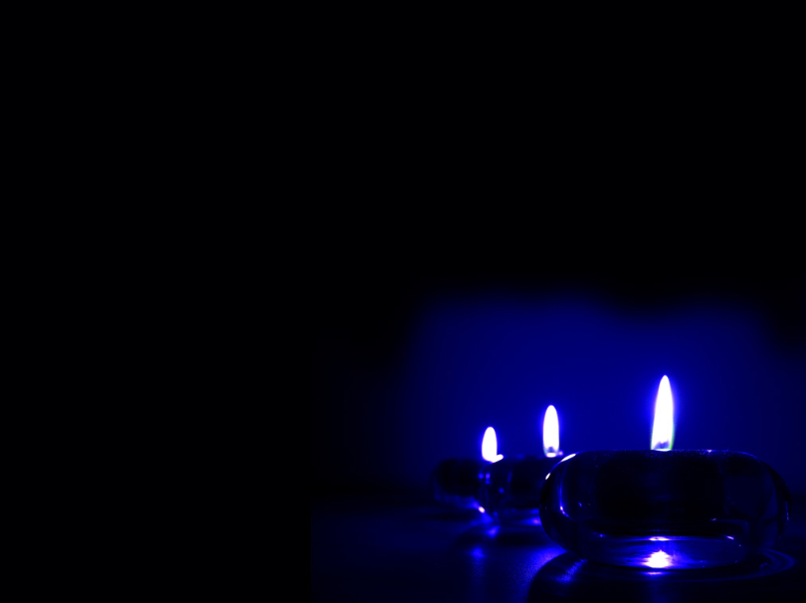
Extinguishing of the Candles

Slide 81


