Slide 1

Sunday, April 21, 2024

Slide 2
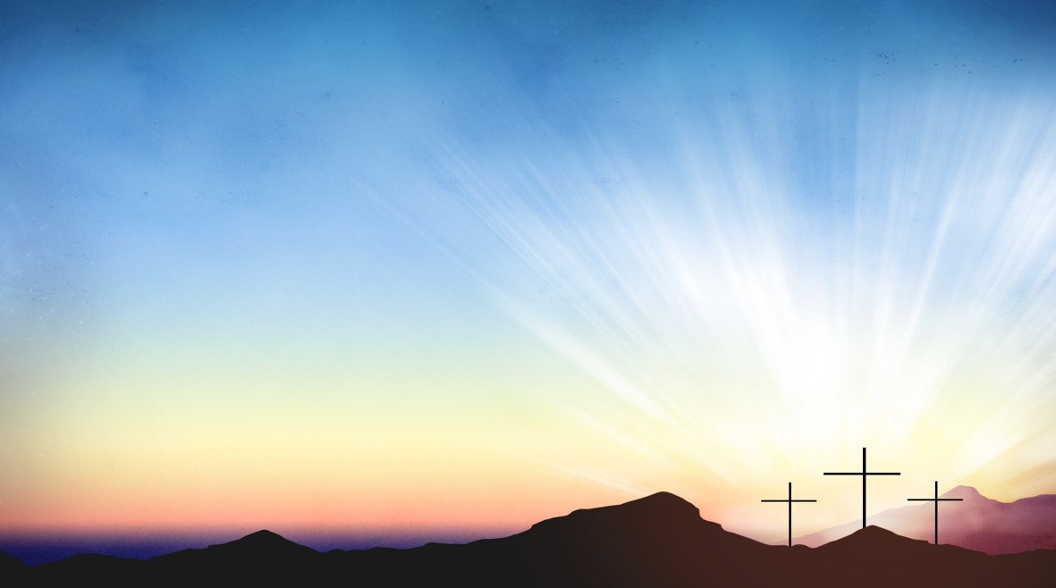
Processional

Slide 3
Lighting of Candles
Greetings

Slide 4
Call to Worship…
LEADER: The God of all shepherds has called us here.
People: We come today, celebrating God’s love for us.

Slide 5
LEADER: The Good Shepherd has given his life for us.
People: We come today, thanking Jesus for his witness and his teaching.

Slide 6
LEADER: The Shepherding Spirit moves through us, bringing us new hope.
ALL: We come today ready to celebrate and to praise God. AMEN.

Slide 7
Opening
Hymn
(Wesley’s ensemble)

Slide 8
Every Time I Feel the Spirit
Hymn 404
Refrain:
Every time I feel the spirit
moving in my heart, I will pray.
Yes, every time I feel the spirit
moving in my heart, I will pray.

Slide 9
1 Upon the mountain, my Lord spoke,
out his mouth came fire and smoke.
All around me looks so shine,
ask my Lord if all was mine. (Refrain)

Slide 10
2 Jordan river runs right cold,
chills the body, not the soul.
Ain't but one train on this track,
runs to heaven and right back. (Refrain)

Slide 11
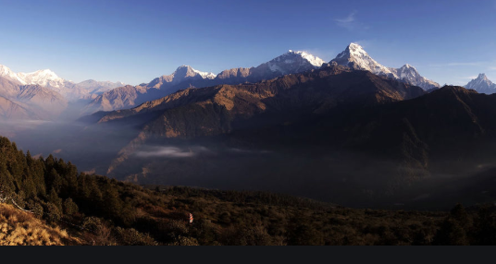
Morning Prayer

Slide 12

Response

Slide 13
Affirmation of
Faith

Slide 14

I believe in God the Father Almighty. The maker of heaven and earth;

Slide 15
and in Jesus Christ his only Son our Lord: who was conceived by the Holy Spirit, born of the Virgin Mary,

Slide 16
suffered under Pontius Pilate, was crucified, dead, and buried;

Slide 17
the third day he rose from the dead; he ascended into heaven,

Slide 18
and sitteth at the right hand of God the Father Almighty; from thence he shall come to judge the quick and the dead.

Slide 19
I believe in the Holy Spirit, the Holy catholic** church, the communion of saints, the forgiveness of sins,
**Church Universal

Slide 20
the resurrection of the body, and the life everlasting. Amen.

Slide 21

Glory be to the Father, and to the Son and to the Holy Ghost,

Slide 22
as it was in the beginning, is now, and ever shall be, world with-out end.
A-men. A-men

Slide 23

The Offering
(It’s Giving Time)
(Offering Baskets will not be passed. Please leave your tithes and offerings in the back of the Sanctuary when entering or leaving.)

Slide 24
*The Dedication
of
Tithes and Offering
UMH #588
“All things come of thee, O Lord, and of thine own have we given thee.” AMEN!

Slide 25

Church News & Announcements

Slide 26
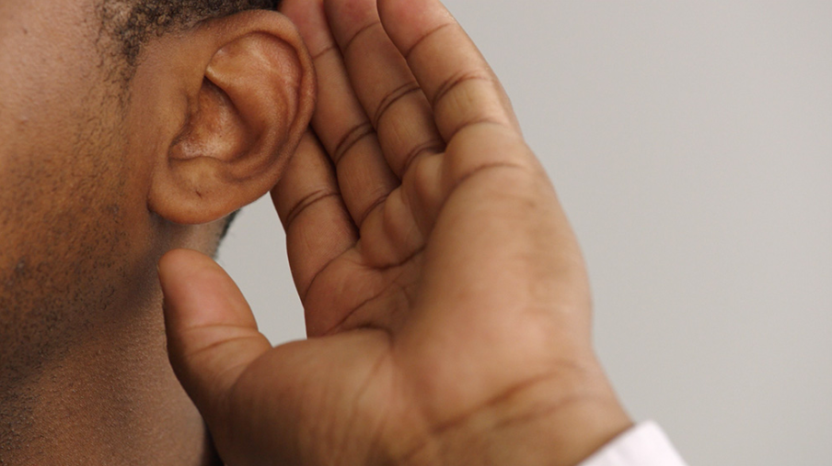
WE Listen for God’s Word

Slide 27
Proclamation and Response/We Listen for God’s Word
Old Testament: Psalm 23
New Testament: John 10: 11-18
Leader: The Word of God for the people of God.
People: Thanks be to God

Slide 28

Selection
(Wesley’s Ensemble)

Slide 29
The Message by
Reverend Doris R. Bright, Pastor

Slide 30
Invitational /
Altar Call

Slide 31
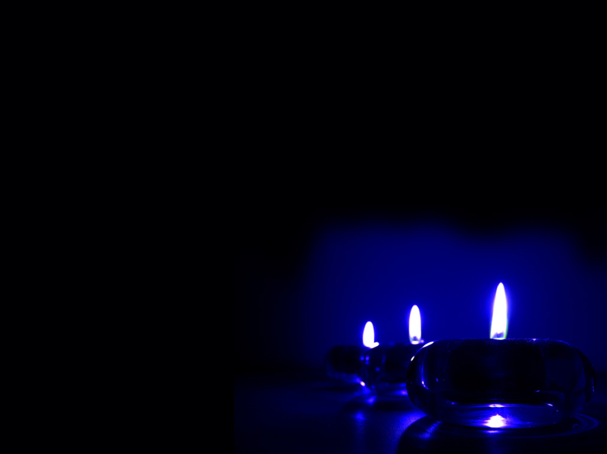
Extinguishing of the Candles

Slide 32

Song of
Sending Forth

Slide 33


