Slide 1
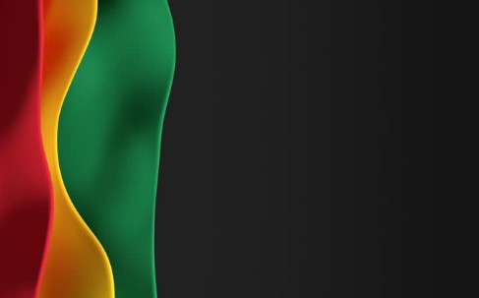

Sunday, March 8,
2026

Slide 2
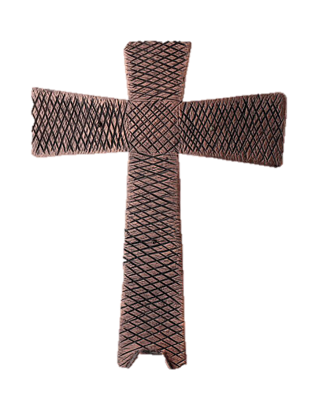
Processional

Slide 3

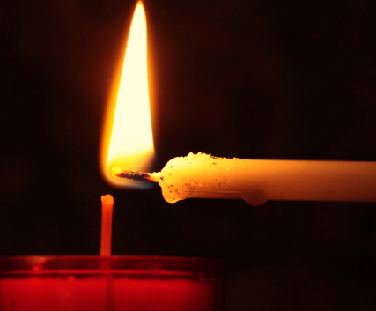
Lighting of Candles

Slide 4


Greetings

Slide 5

Call to Worship…
Leader: Come, let us worship God!
People: Let us make a joyful noise to the rock of our salvation!

Slide 6
Leader: Come, let us worship our Shepherd!
People: We are the sheep of God’s pasture, and we follow Where God leads us.

Slide 7
Leader: Come, let us open our hearts!
People: We receive God’s love poured into our hearts through the Spirit.

Slide 8
Leader: Come, let us worship God, the rock o our salvation!
All: Let us worship God, whose mercy guides and sustains us on the path of new life!

Slide 9
Opening Hymn
“Oh How I Love Jesus”

Slide 10
1 There is a name I love to hear,
I love to sing its worth;
it sounds like music in my ear,
the sweetest name on earth.

Slide 11
Refrain:
O how I love Jesus,
O how I love Jesus,
O how I love Jesus,
because he first loved me!

Slide 12
2 It tells me of a Savior's love,
who died to set me free;
it tells me of his precious blood,
the sinner's perfect plea. [Refrain]

Slide 13
Refrain:
O how I love Jesus,
O how I love Jesus,
O how I love Jesus,
because he first loved me!

Slide 14
3 It tells of one whose loving heart
can feel my deepest woe;
who in each sorrow bears a part
that none can bear below. [Refrain]

Slide 15
Refrain:
O how I love Jesus,
O how I love Jesus,
O how I love Jesus,
because he first loved me!

Slide 16


Morning Prayer

Slide 17

Response

Slide 18

Affirmation of
The Apostles’ Creed

Slide 19
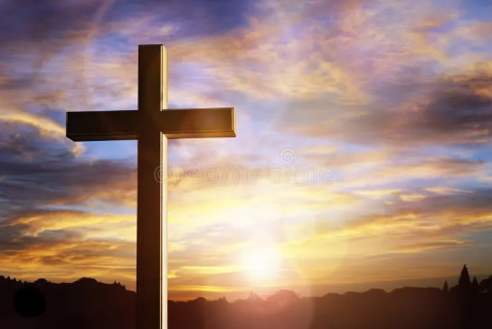
I believe in God the Father Almighty. The maker of heaven and earth;

Slide 20
and in Jesus Christ his only Son our Lord: who was conceived by the Holy Spirit, born of the Virgin Mary,

Slide 21
suffered under Pontius Pilate, was crucified, dead, and buried;

Slide 22
the third day he rose from the dead; he ascended into heaven,

Slide 23
and sitteth at the right hand of God the Father Almighty; from thence he shall come to judge the quick and the dead.

Slide 24
I believe in the Holy Spirit, the Holy catholic** church, the communion of saints, the forgiveness of sins,
**Church Universal

Slide 25
the resurrection of the body, and the life everlasting. Amen.

Slide 26
Gloria Patri
Glory be to the Father, and to the Son and to the Holy Ghost,

Slide 27
as it was in the beginning, is now, and ever shall be, world with-out end.
A-men. A-men

Slide 28

Parish Notices/Recognition of Visitors

Slide 29
The Offering
(It’s Giving Time)
“Praise God, from whom all blessings flow; praise him, all creatures here below; praise him above, ye heavenly host; praise Father Son, and Holy Ghost, Amen”

Slide 30
*The Dedication of Tithes and Offering
UMH #588
“All things come of thee, O Lord, and of thine own have we given thee.” AMEN!

Slide 31
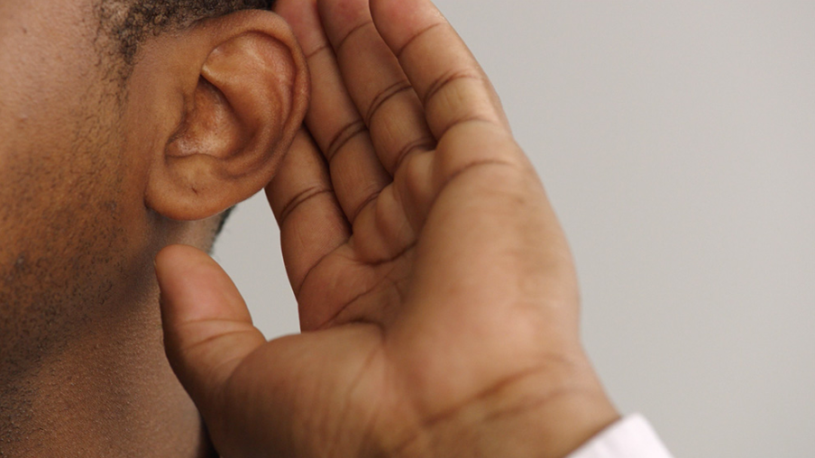
WE Listen for God’s Word

Slide 32
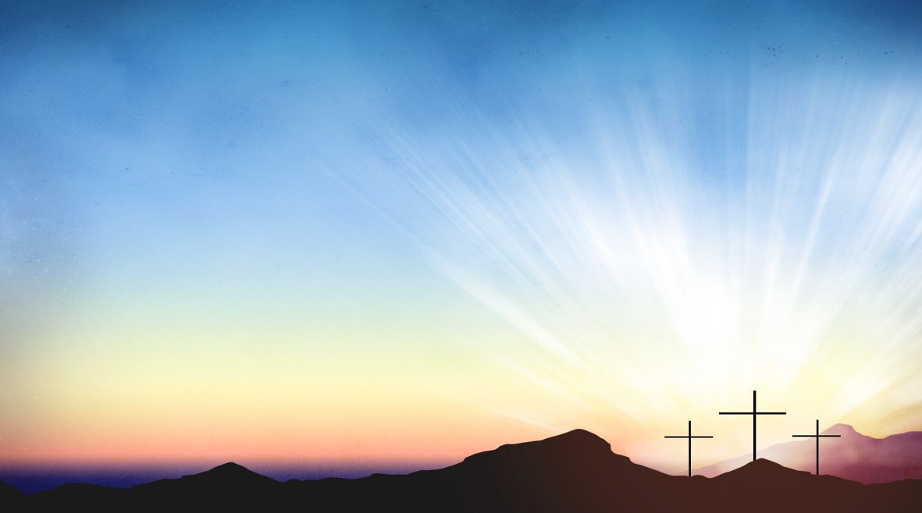
Proclamation and Response/We Listen for God’s Word
Old Testament: Psalm 95 (ESV)
New Testament: John 4:5-42(ESV)

Slide 33
Selection
Wesley’s Ensemble

Slide 34
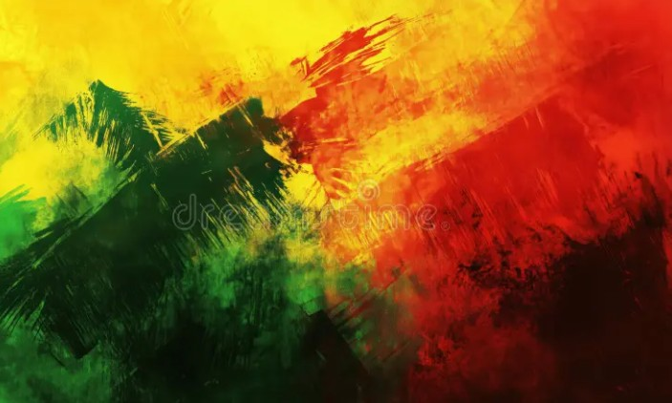
The Message
by
“Rev. Doris Bright”

Slide 35

Invitational

Altar Call

Slide 36
Town Hall Meeting

Slide 37
Song of Sending Forth

Slide 38

Extinguishing of the Candles

Slide 39


